Slide 1

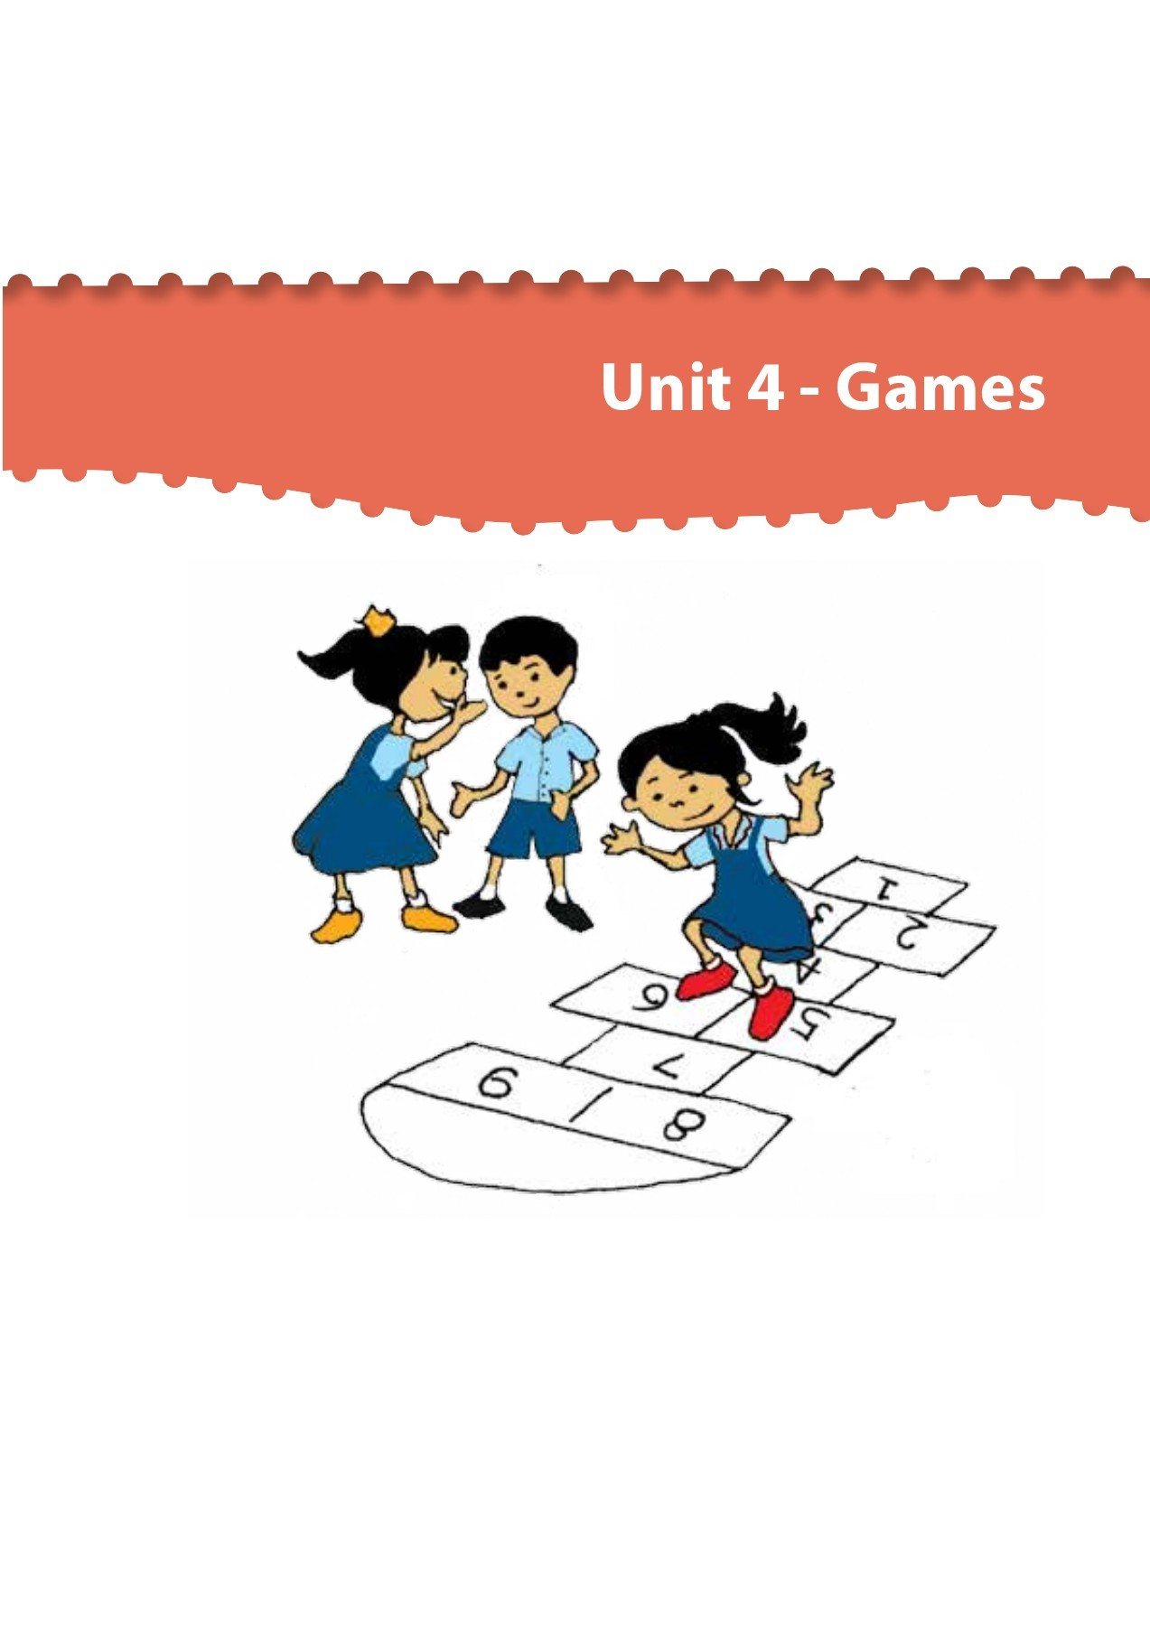

Northlands and Sunfield City School
Grade 1– Health Education
Unit 4 – Games
Being safe when playing outside
Week 14 prepared by Miss Nametah and Miss Amrine

Slide 2
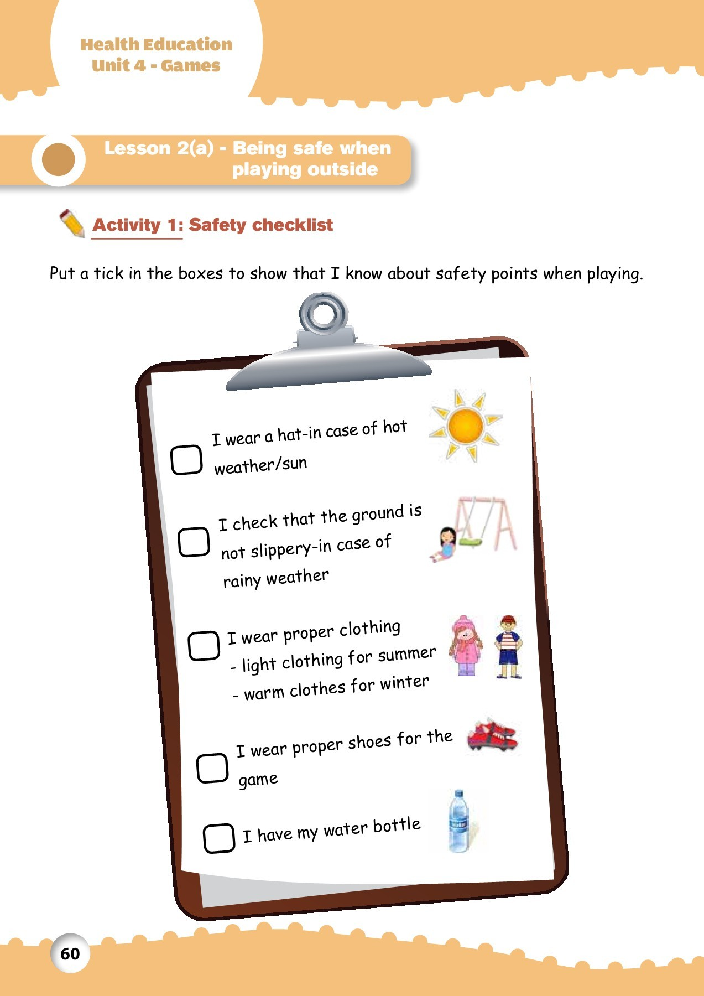
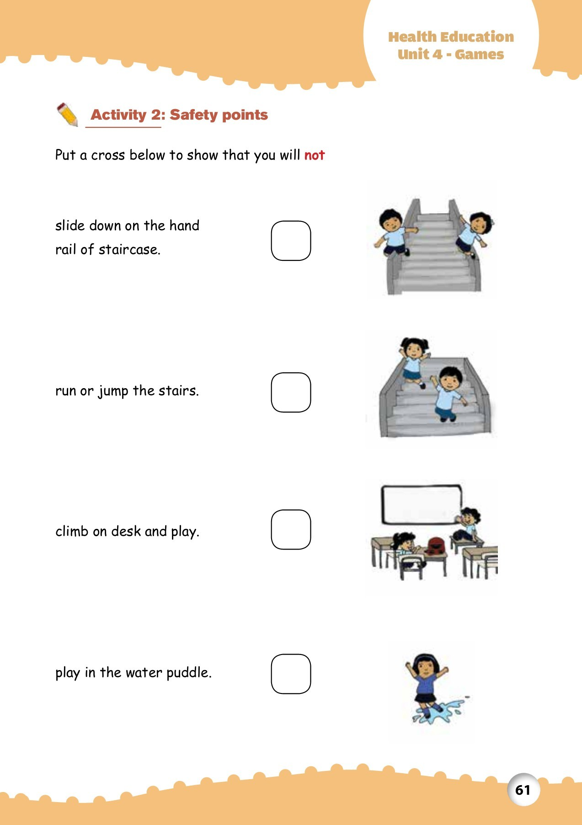
http://portal.mie.ac.mu/curriculum.html

Slide 3
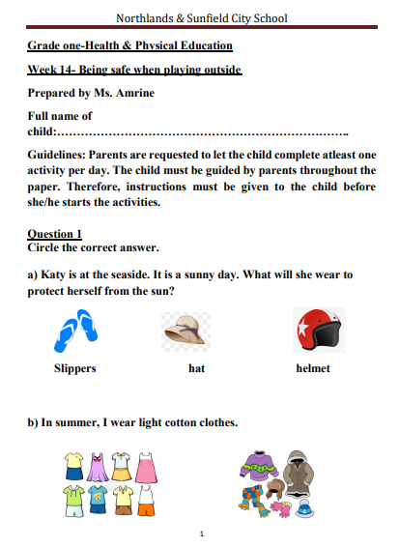
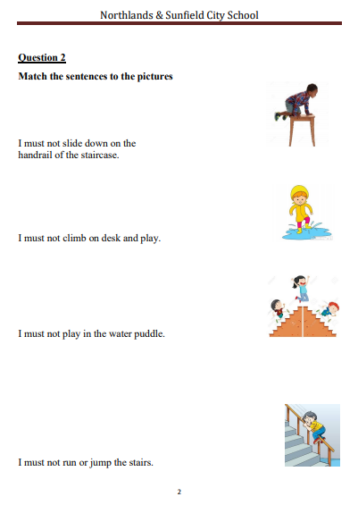

Slide 4
