Slide 1


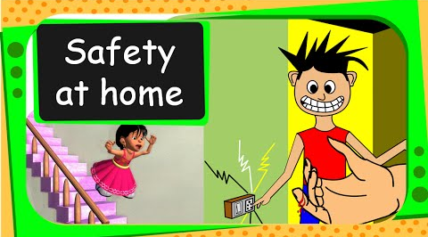
Northlands and Sunfield City School
Grade 2– Health Education
Unit 3 – Movement and safe practices
Safety at home
Week 13 prepared by Miss Amrine and Miss Krisma

Slide 2
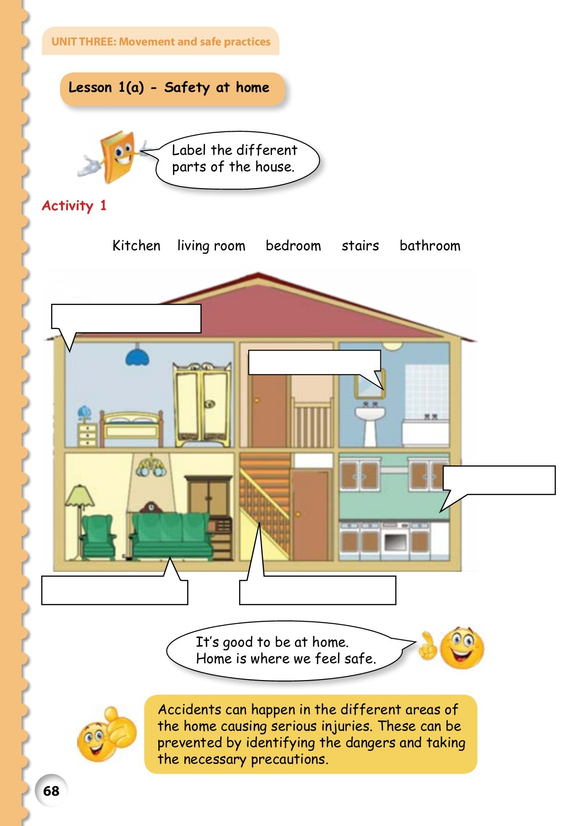
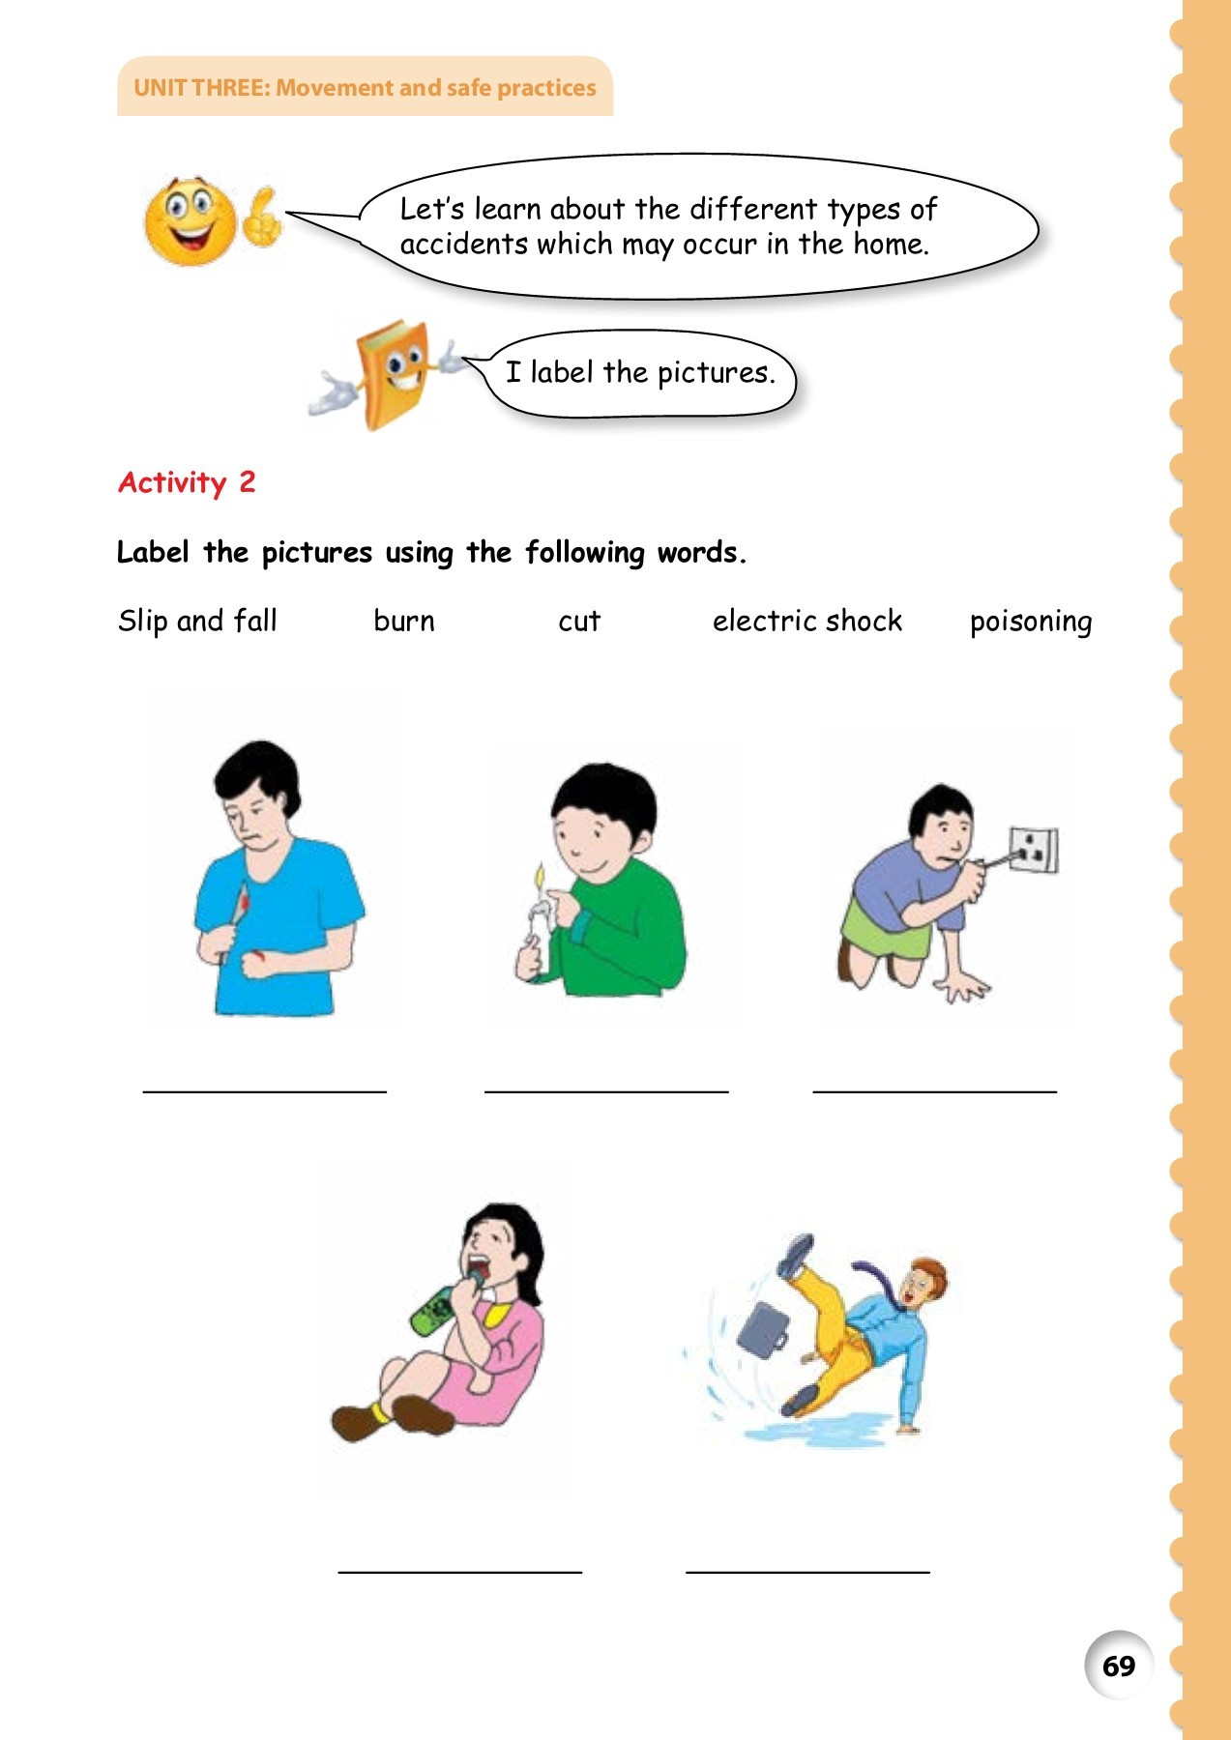
http://portal.mie.ac.mu/curriculum.html

Slide 3
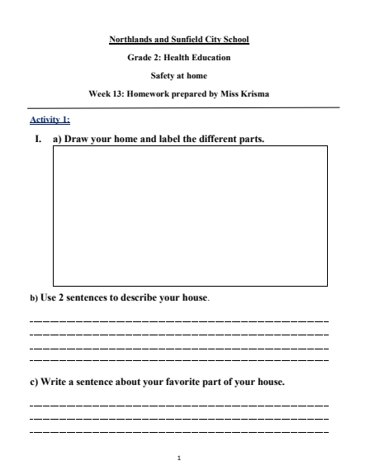
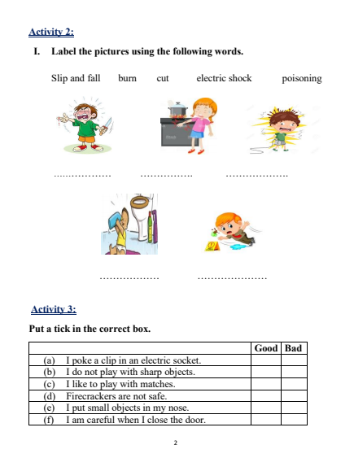

Slide 4
