Slide 1

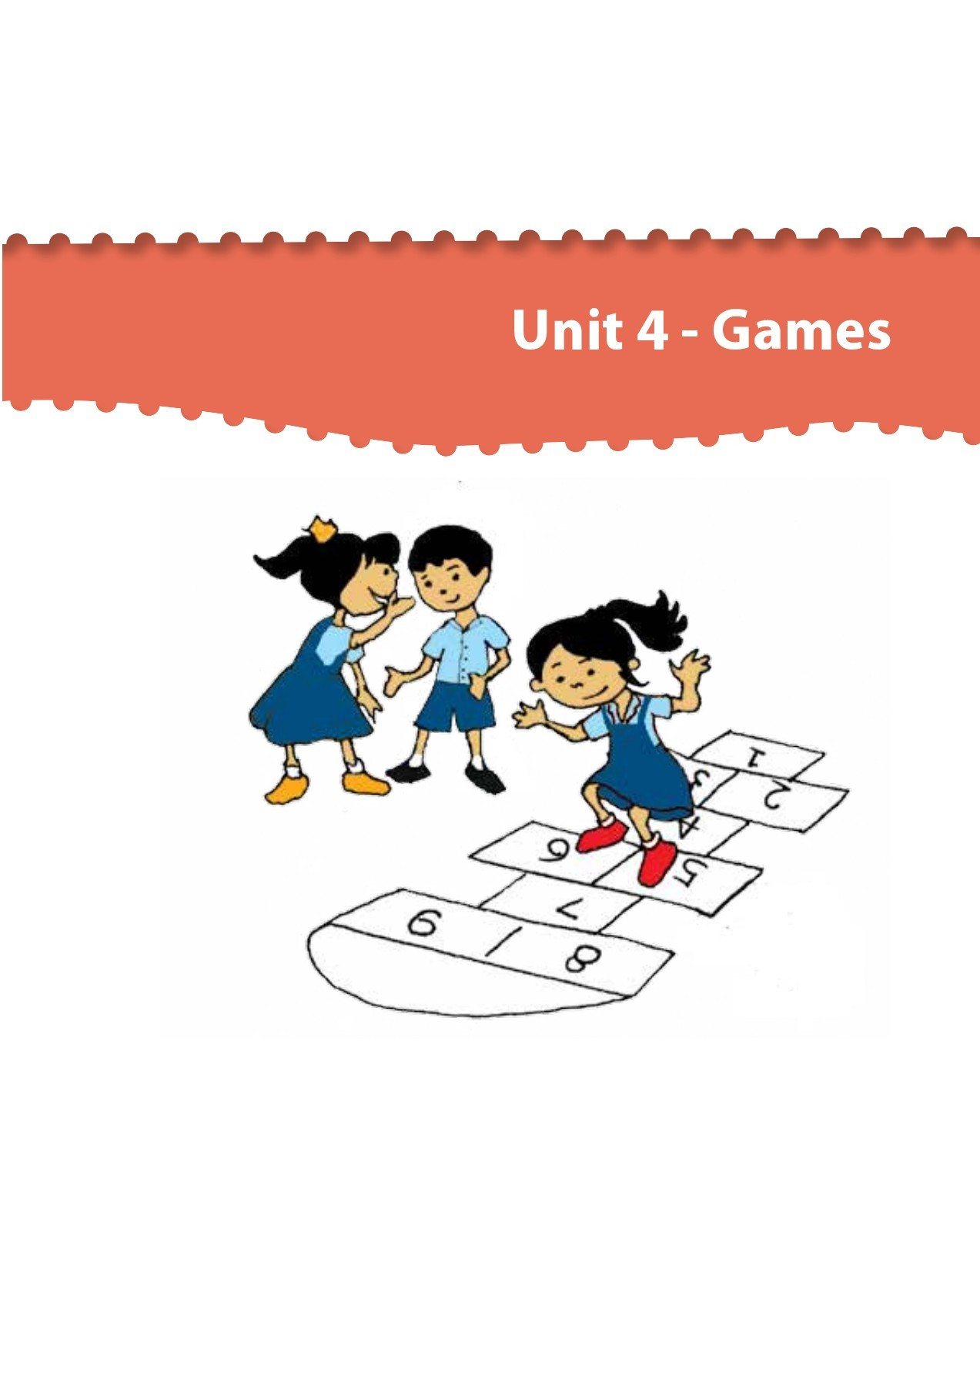

Northlands and Sunfield City School
Grade 1– Health Education
Unit 4 - Games
Week 13 prepared by Miss Amrine and Miss Nametah

Slide 2
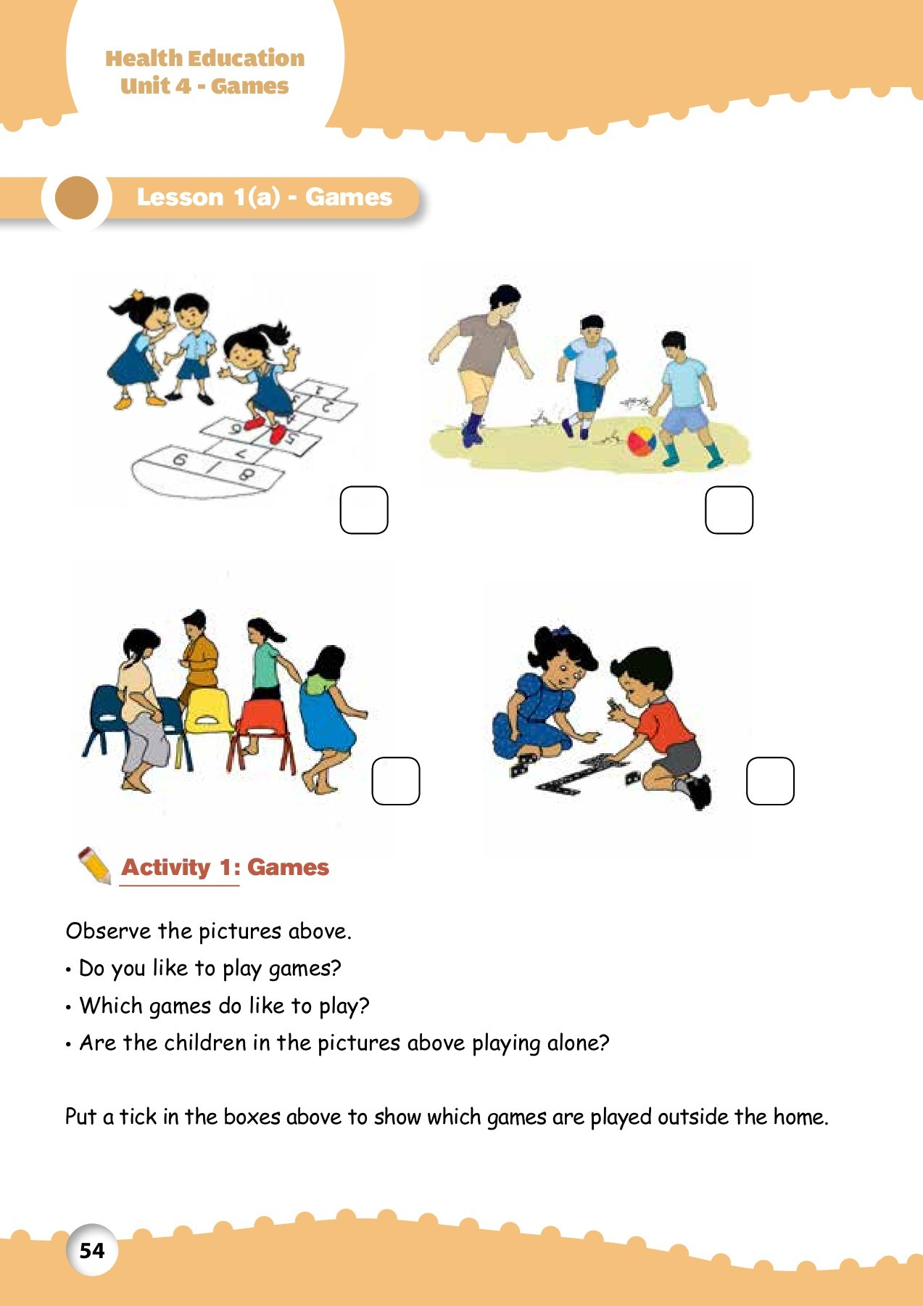
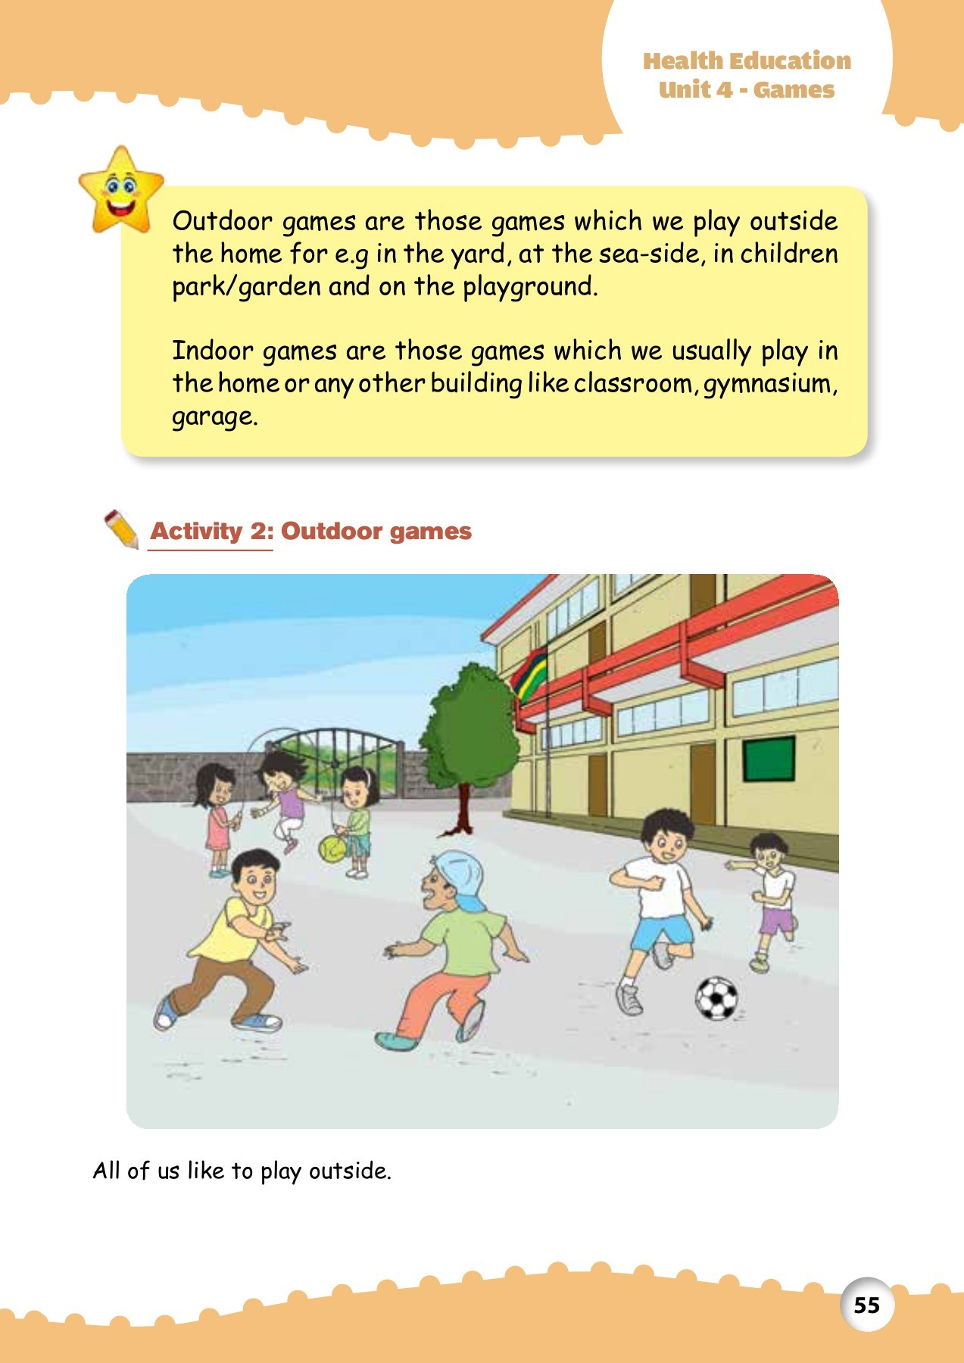

Slide 3
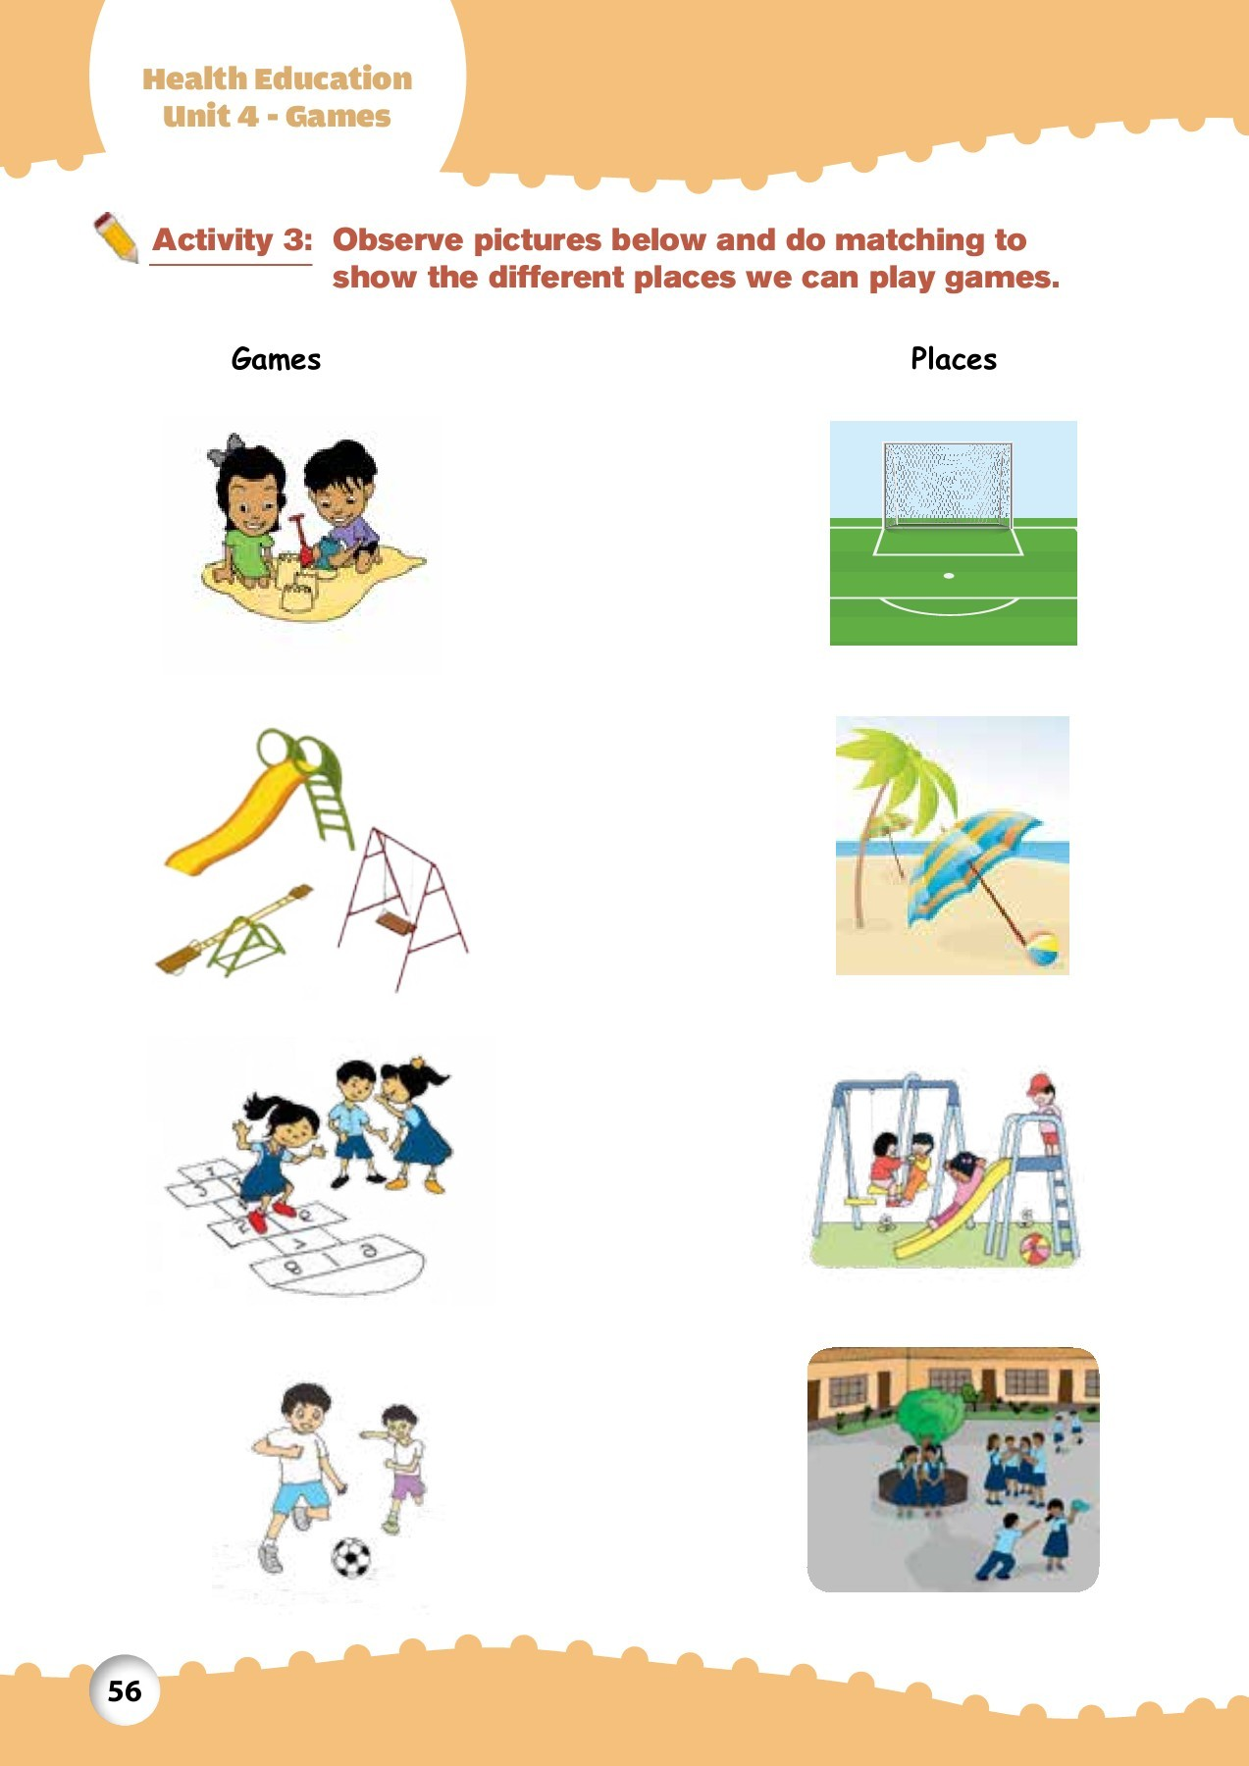
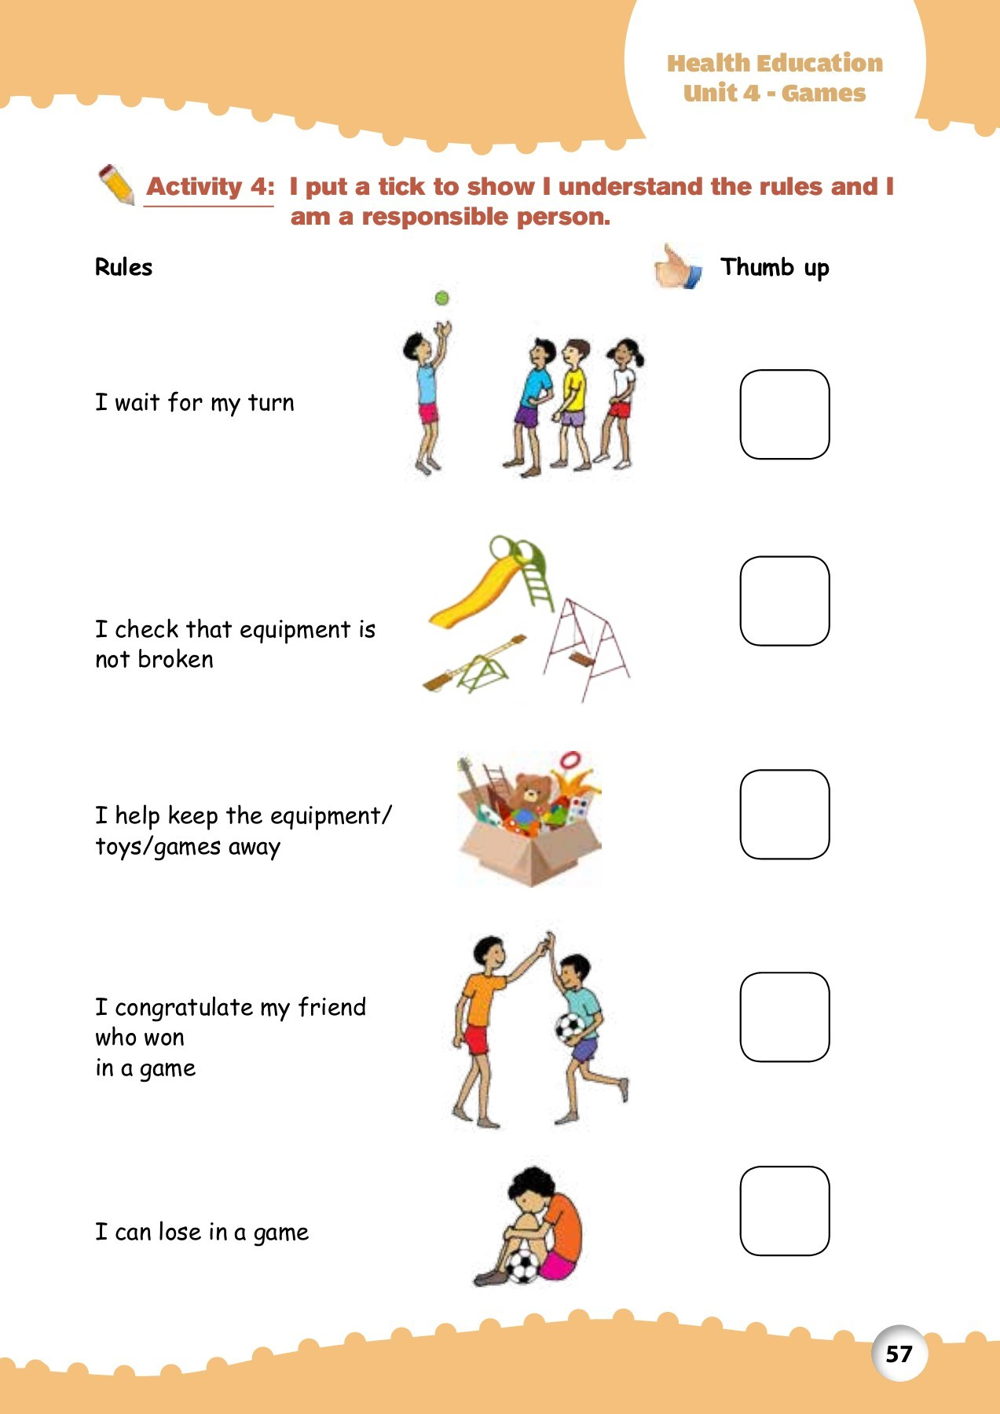
http://portal.mie.ac.mu/curriculum.html

Slide 4
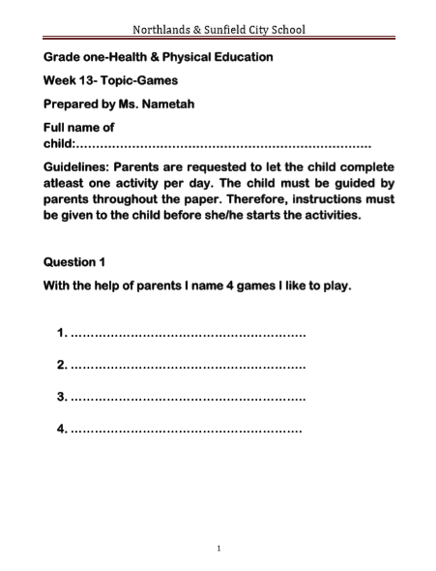
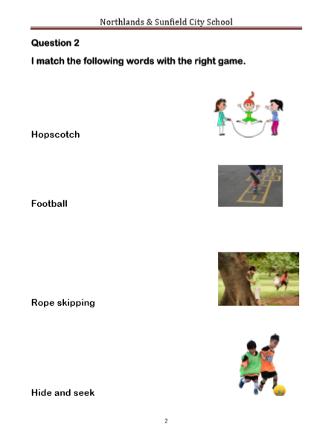

Slide 5
