Slide 1

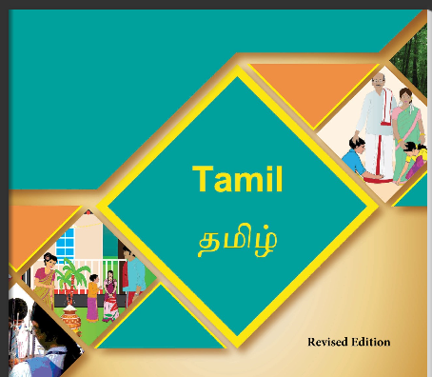

Northland and sunfiled city
Teacher name: kalaivanee Murugan
Subject: Tamil
Grade:3
Week: 14

Slide 2
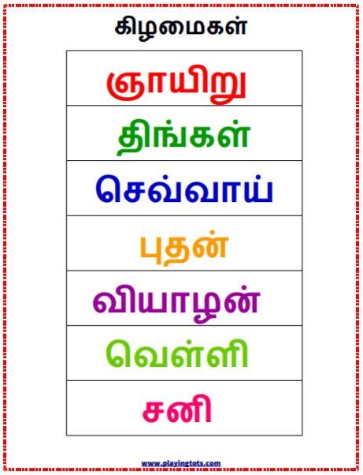

Slide 3
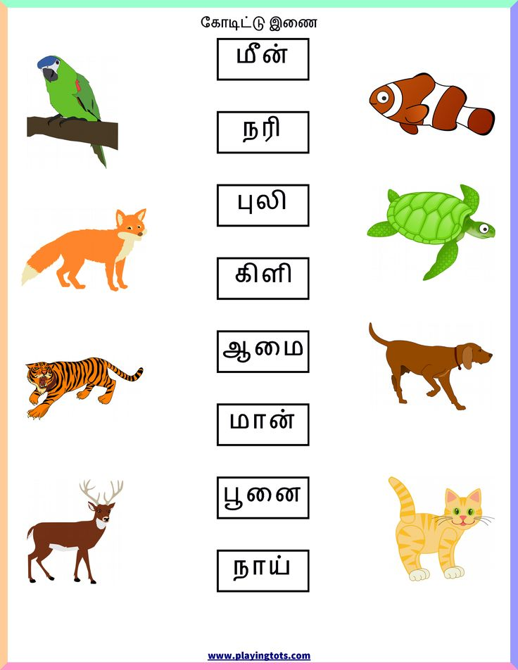

Slide 4
