Slide 1


NORTHLANDS SCHOOL AND SUNFIELD CITY SCHOOL
Topic : World Environment Day
Project - Rain Water Harvest
Grade 1 & 2
Presented by Miss Manju
What is the environment?
The environment is everything around us. All our surroundings including the air, soil, water, plants, and animals make up the environment.
https://youtu.be/ShsMiSOpoZc
Reference:

Slide 2
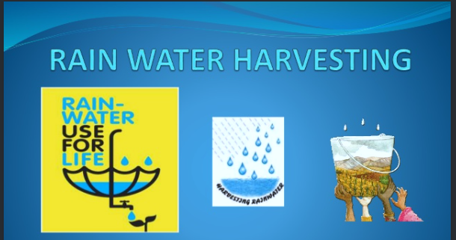
Rain Harvesting is a process of collecting and storing rain water. For example, when it is raining put a bucket outside and collect the rain water.
Benefits of Rain Harvesting
We can use the rainwater for several purposes such as :
To wash the car,
To water the plants,
For cleaning and mopping.
We can also store the rainwater in an underground tank.

Slide 3
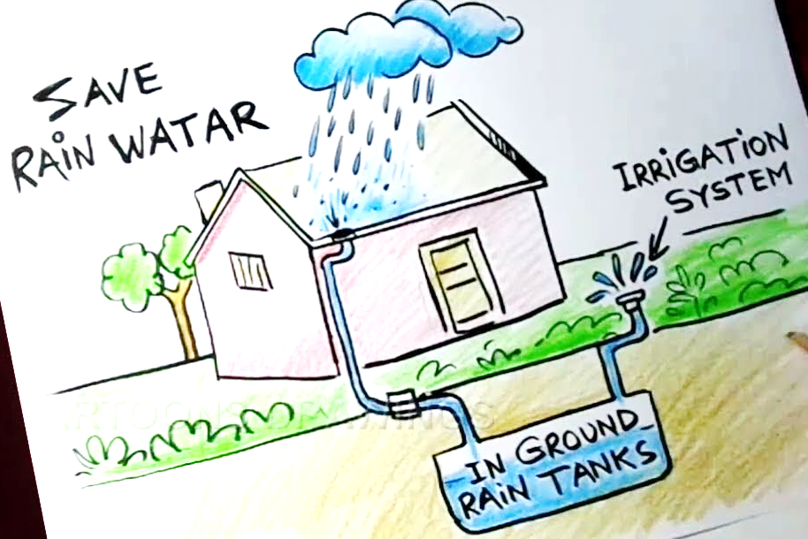

Let’s see the picture below, how we can use the rainwater.
Your Homework
Draw and colour the picture (LOOK AT THE PICTURE IN THE LEFT)
As experiment keep a bucket outside in your yard while it is raining. And later measure the quantity of water collected.
Can you imagine how much water you can save by collecting rainwater and use it for future use.
Look at the video
As it is raining , the rainwater goes through a pipe in an underground tank. Later the rainwater can be used for irrigation purpose.

