Slide 1
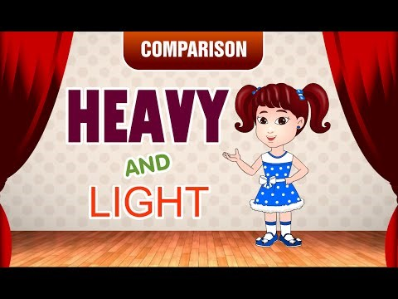
This video will help you understand the concept of heavy and light

