Slide 1


NORTHLANDS AND SUNFIELD CITY SCHOOL
Grade 1– Français
Topic: Le nombre
Week 13
Prepared by Miss Shrutee
French MIE text book part 1
Pg. 68-70
Source1:http://mie.ac.mu/curriculum.html#

Slide 2
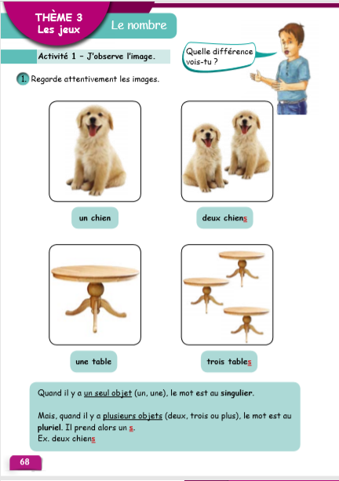
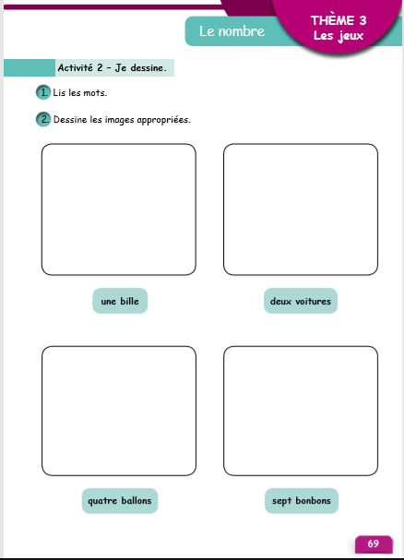

Slide 3
