Slide 1


Northlands and Sunfield City School
Grade 1– English Week 13
Unit 3 - Sound /l/ and Evaluation (feelings, games, actions, sound /h/, and pronouns)
Prepared by Miss Dikshita

Slide 2
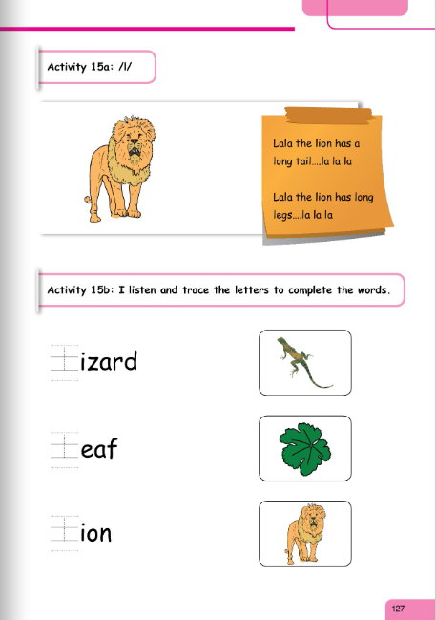
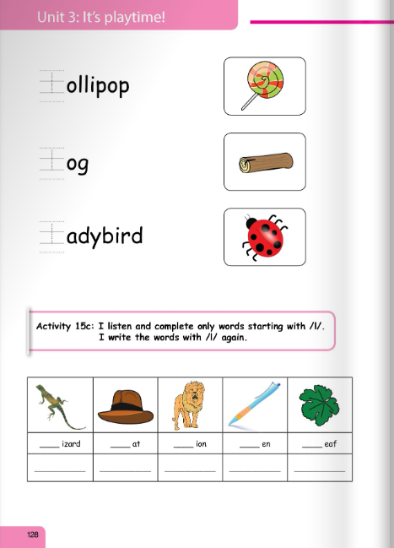

Slide 3
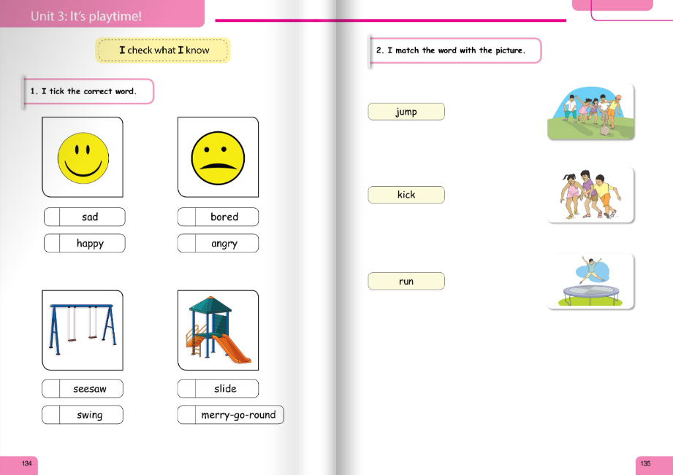

Slide 4
