Slide 1
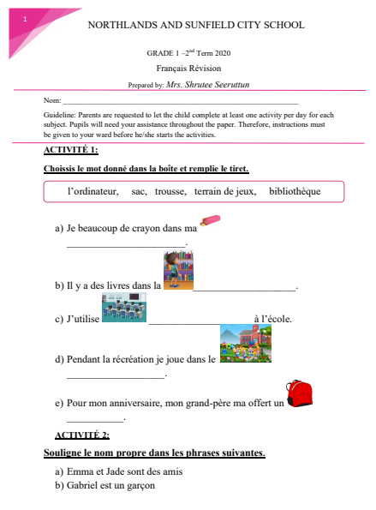
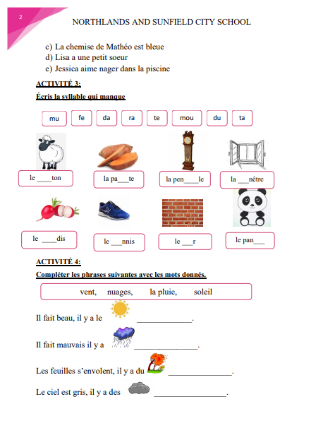


Slide 2

Source :https://www.youtube.com/watch?v=sqApl_iNd6s&t=4s

