Slide 1


NORTHLANDS AND SUNFIELD CITY PRIMARY SCHOOL
GRADE TWO
PART TWO
WEEK TEN
MISS NAZIMA

Slide 2
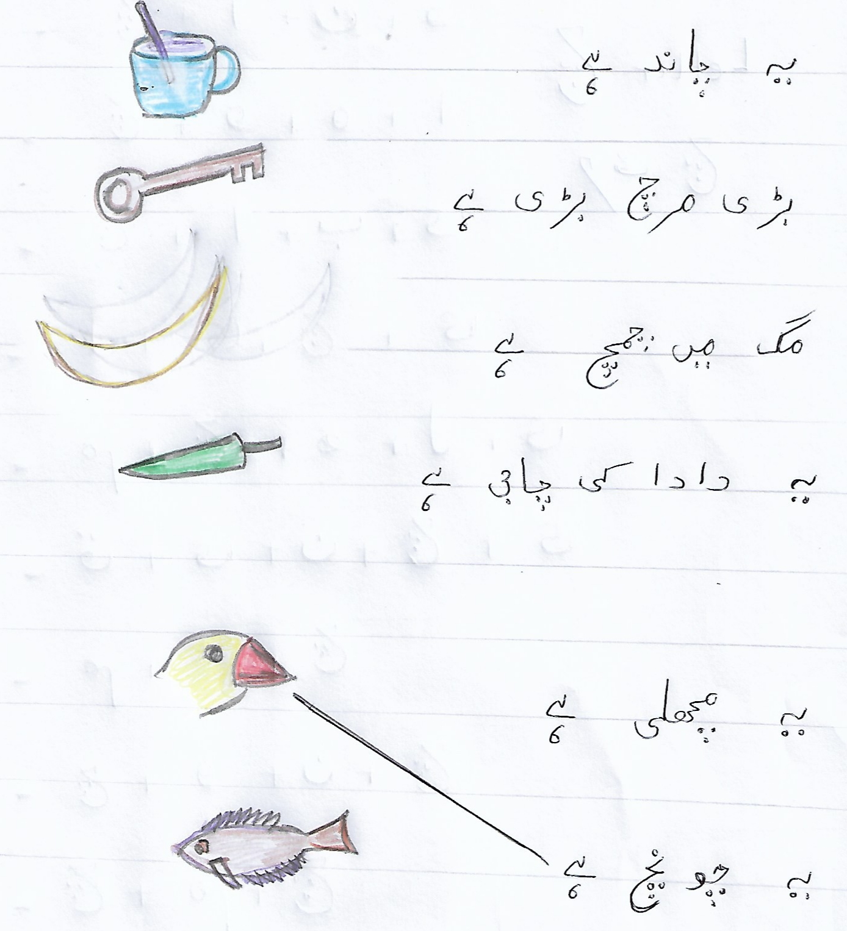

Slide 3
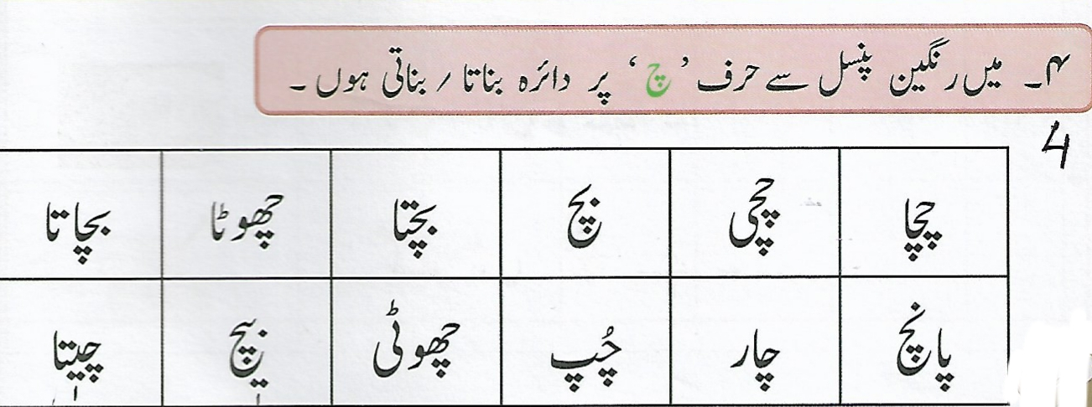
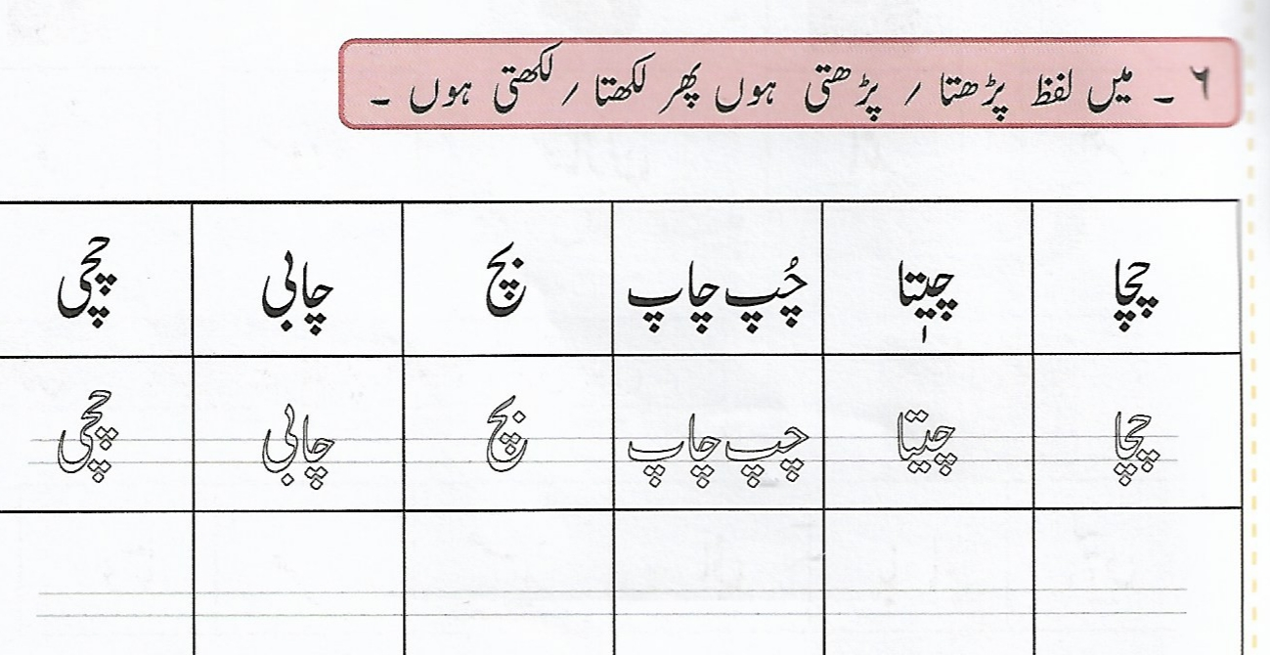
PAGE 39 EXERCISE 4 PAGE 40 EXERCISE 6

