Slide 1


Northlands and sunfield city primary school
GRADE 2
WEEK 13
LESSON 12: PAGE 45 EXERCISE 2, PAGE 46 EXERCISE 3 AND 4

Slide 2
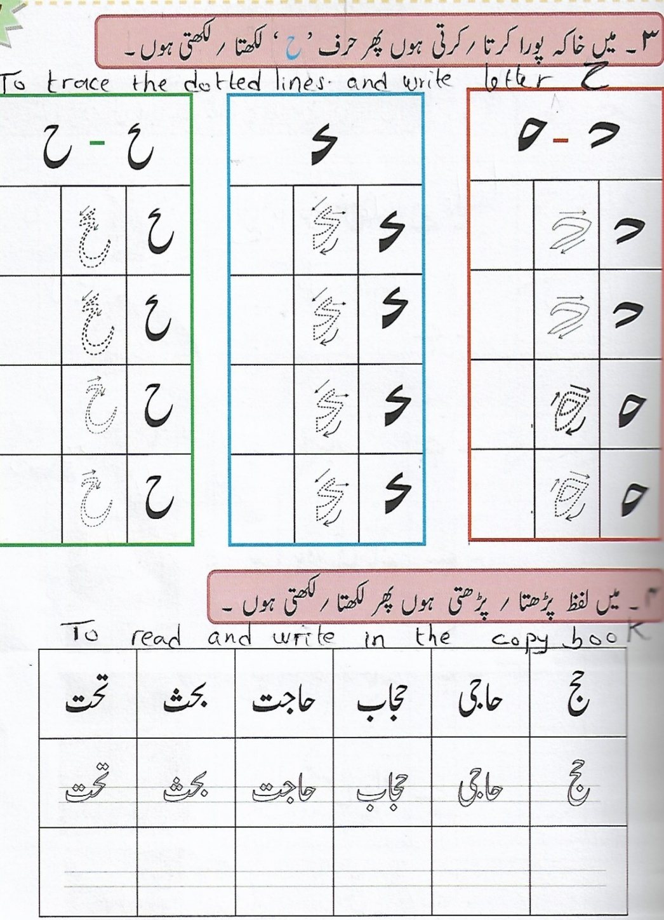
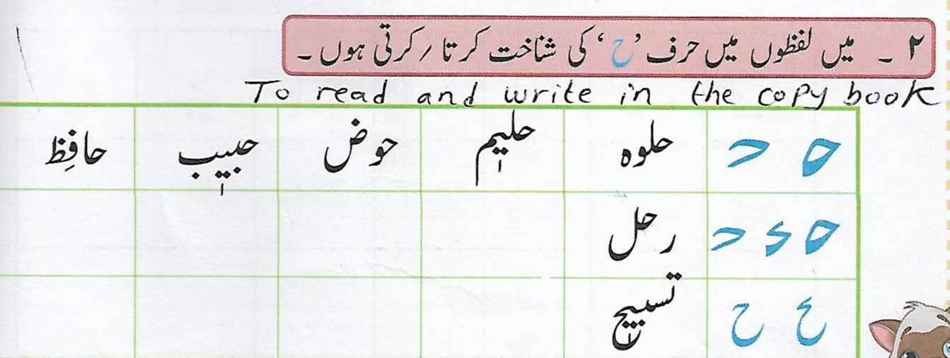

Slide 3
