Slide 1
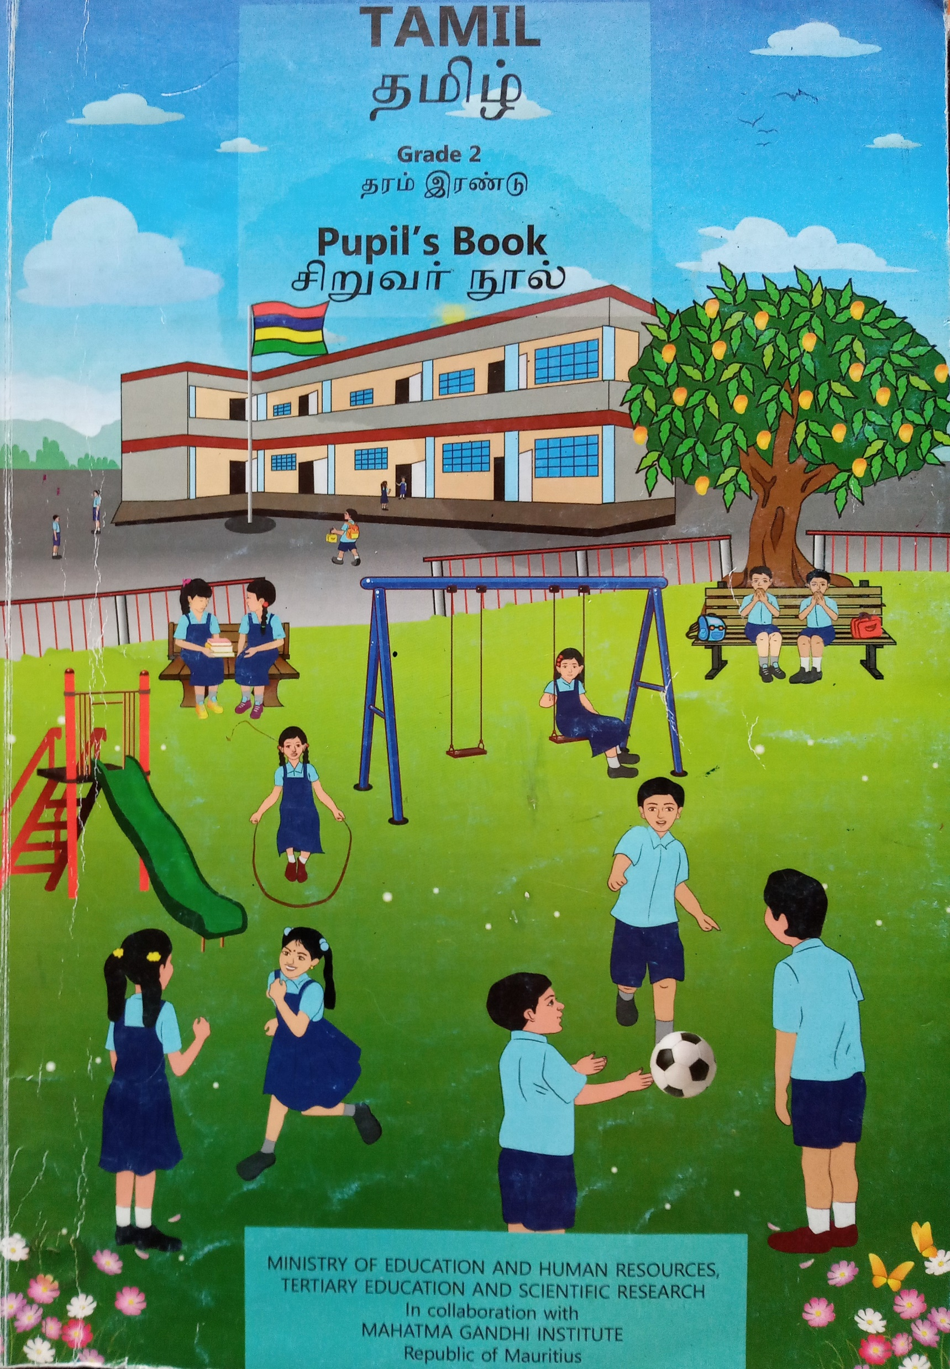

Northland and sunfield city primary school
Teacher Name: kalaivanee.M
Grade: 2
Subject: Tamil
Week: 12

Slide 2
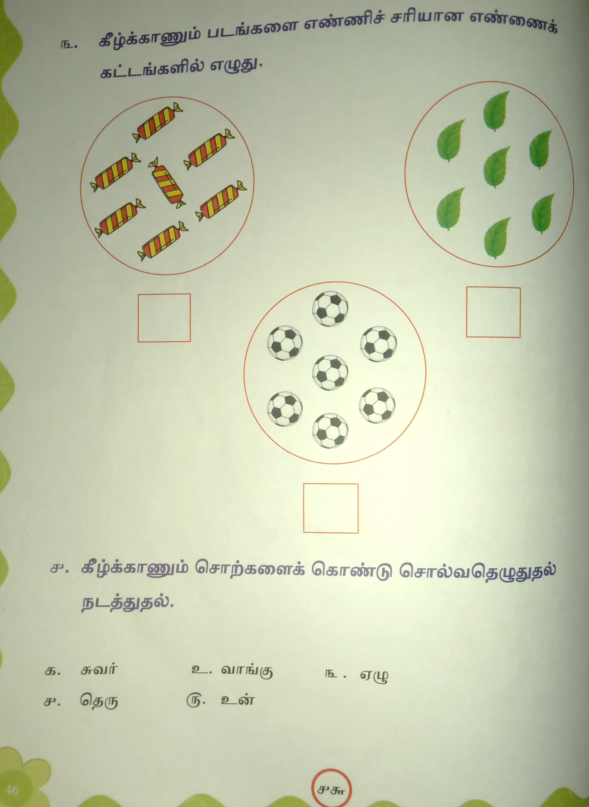

Slide 3
