Slide 1

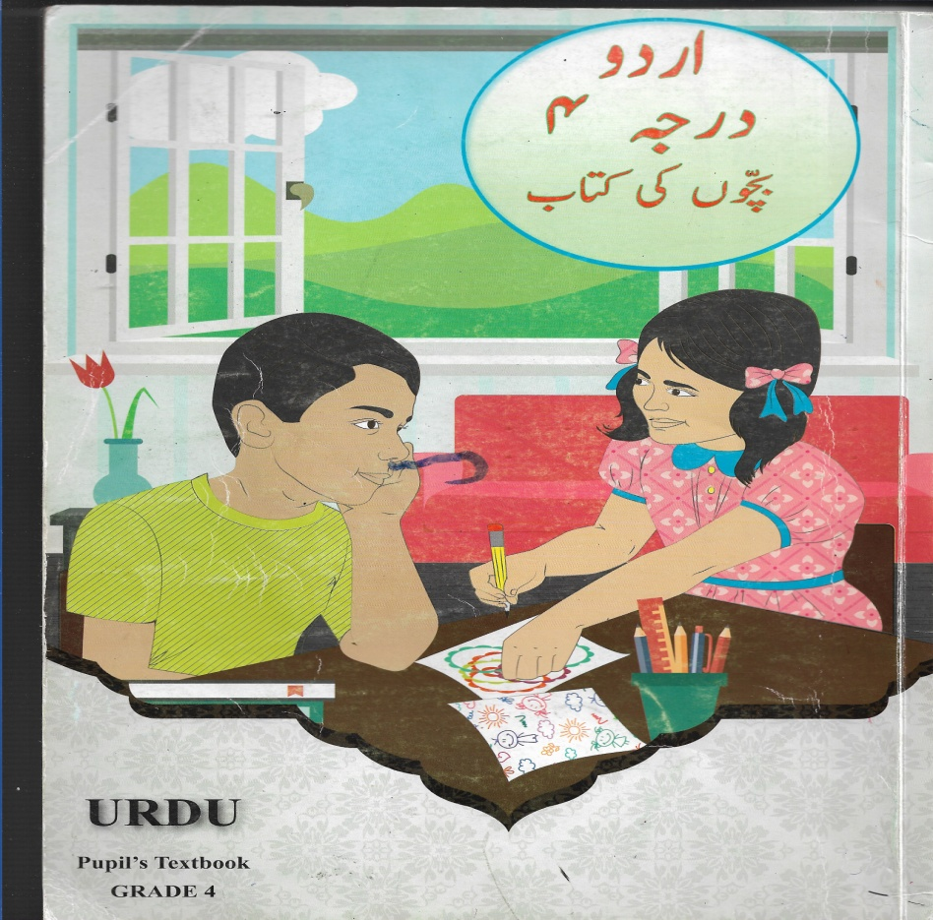
NORTHLANDS AND SUNFIELD CITY PRIMARY SCHOOL
GRADE FOUR
URDU WEEK 14
PAGE 71
REVISION WORK

Slide 2
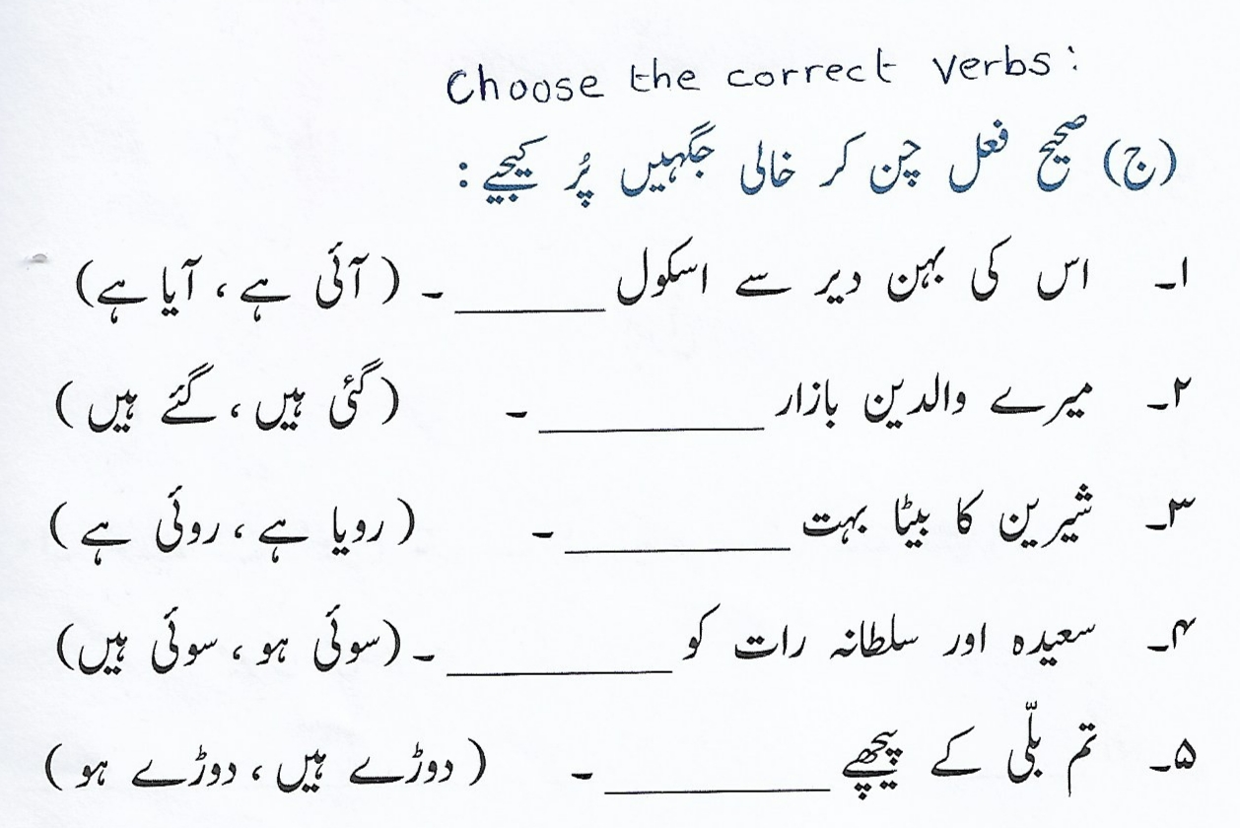

Slide 3
