Slide 1


NORTHLANDS AND SUNFIELD CITY PRIMARY SCHOOL
URDU GRADE TWO
WEEK 14
PAGE 47 LESSON 13

Slide 2
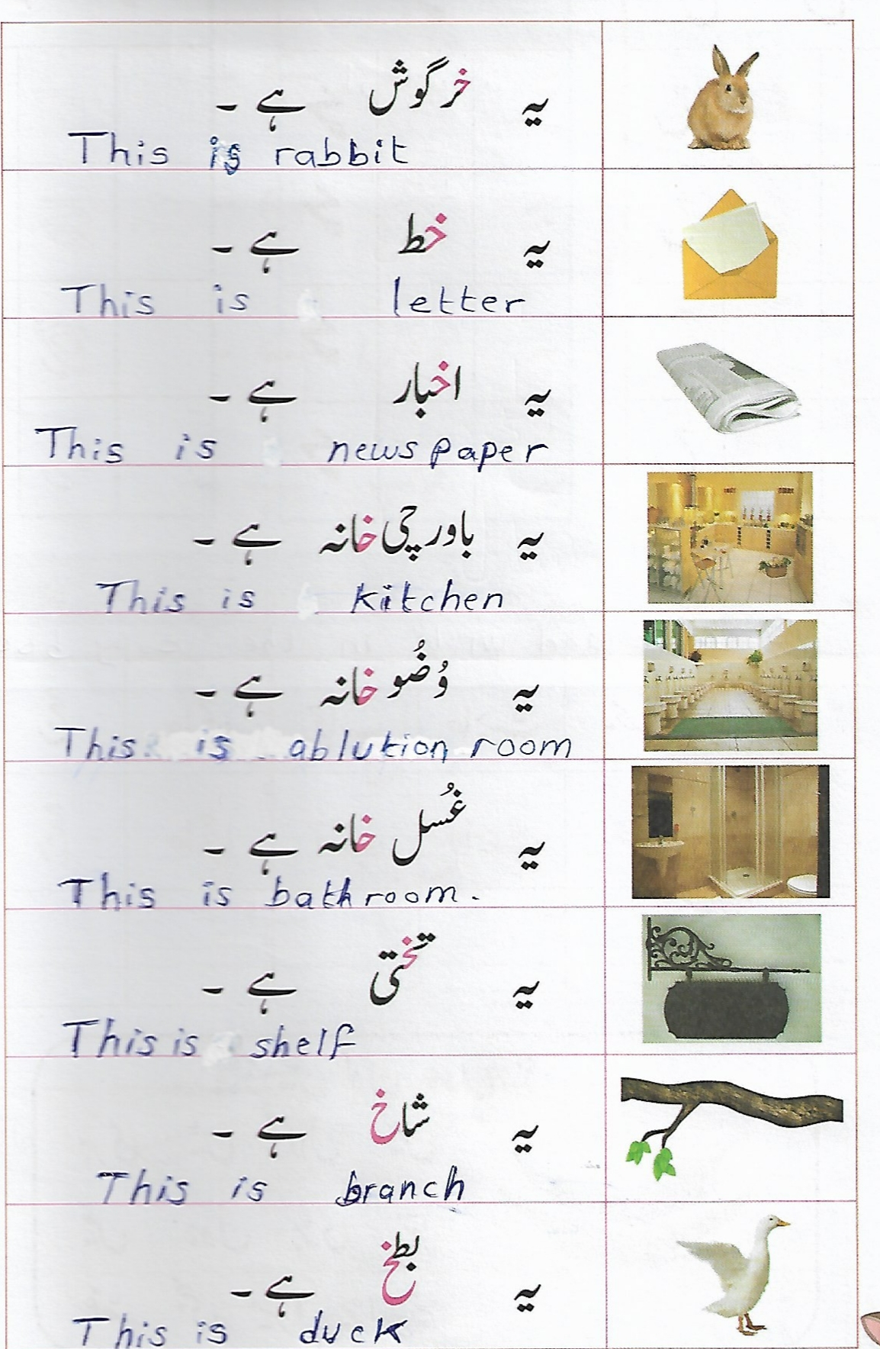

Slide 3
