Slide 1

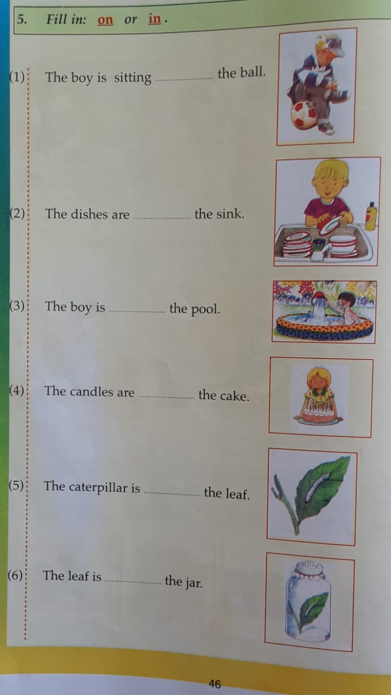
NORTHLANDS & SUNFIELD CITY SCHOOL
WEEK 13 ENGLISH Part 2
Grade 2 Prepared by Ms Pareshma

Slide 2
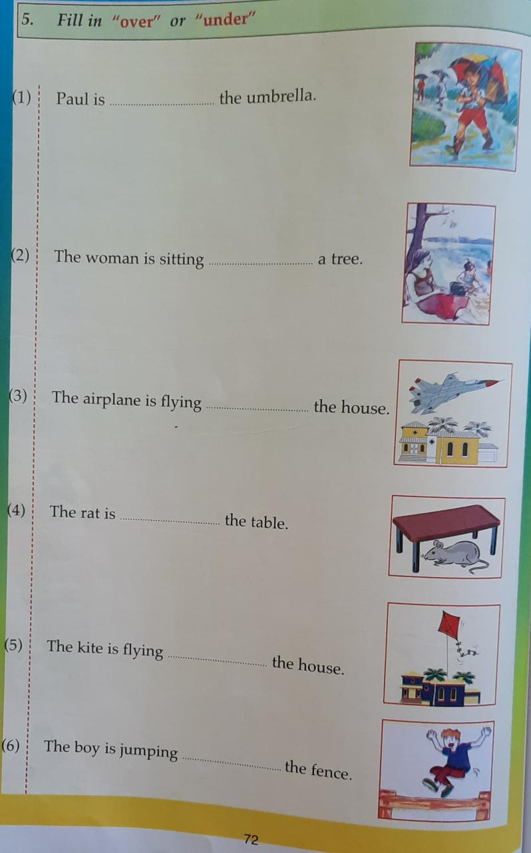

Slide 3
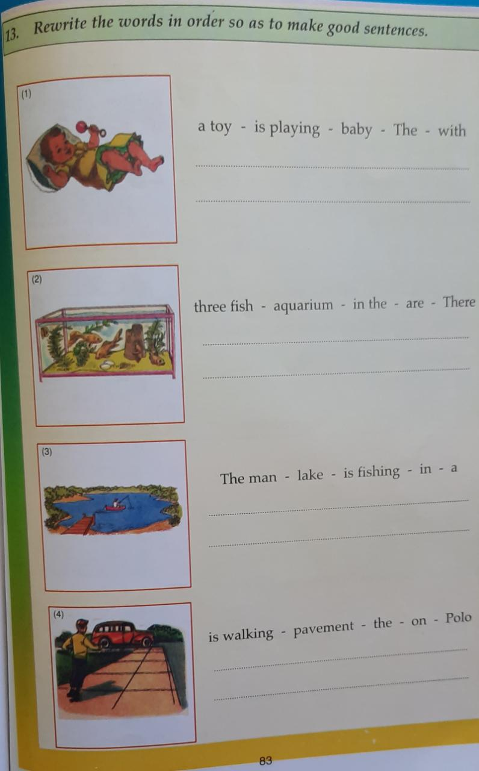
Source: Paving the way to success English Grade 2 – D. V. Chetty

