Slide 1
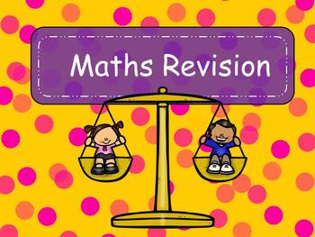
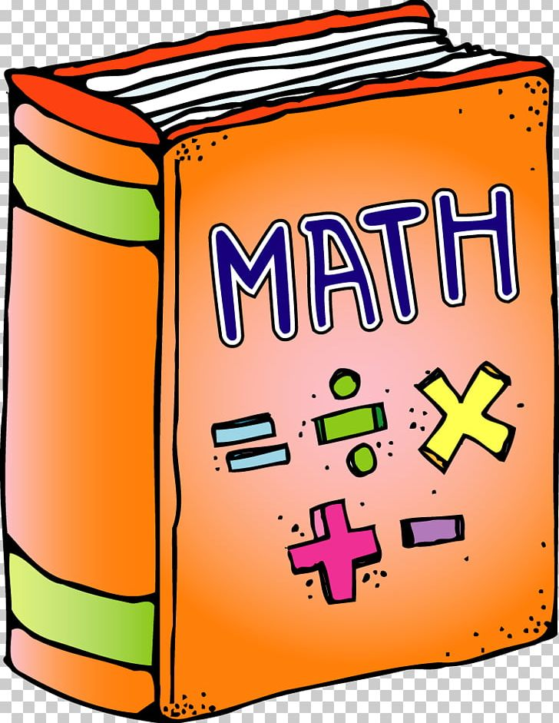
NORTHLANDS & SUNFIELD CITY SCHOOL
Mathematics Grade 2
Revision Exercises Week 12
Prepared by Miss Mehreen

Slide 2
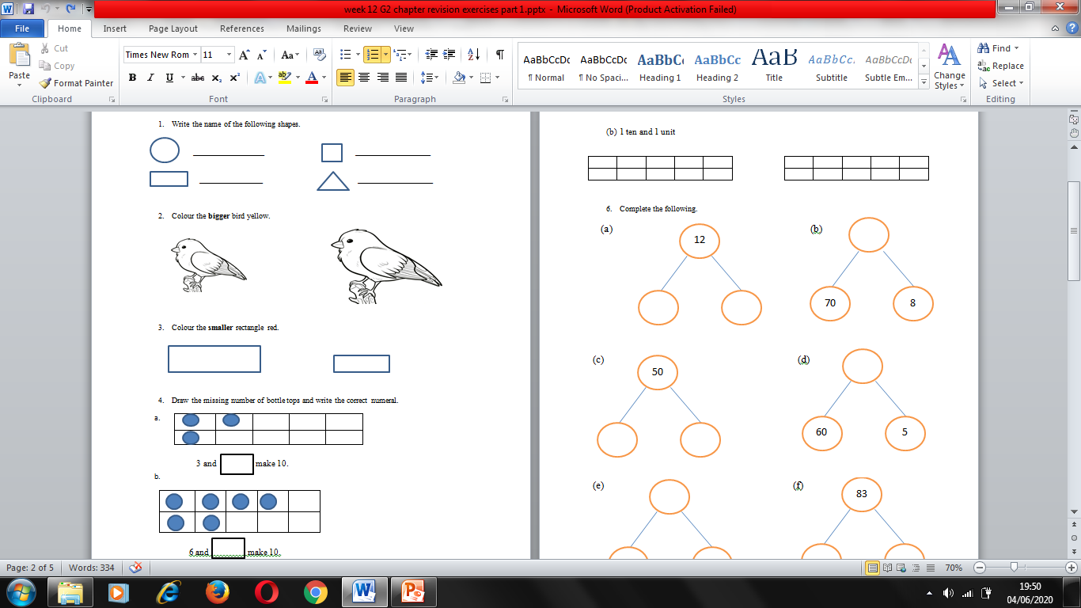
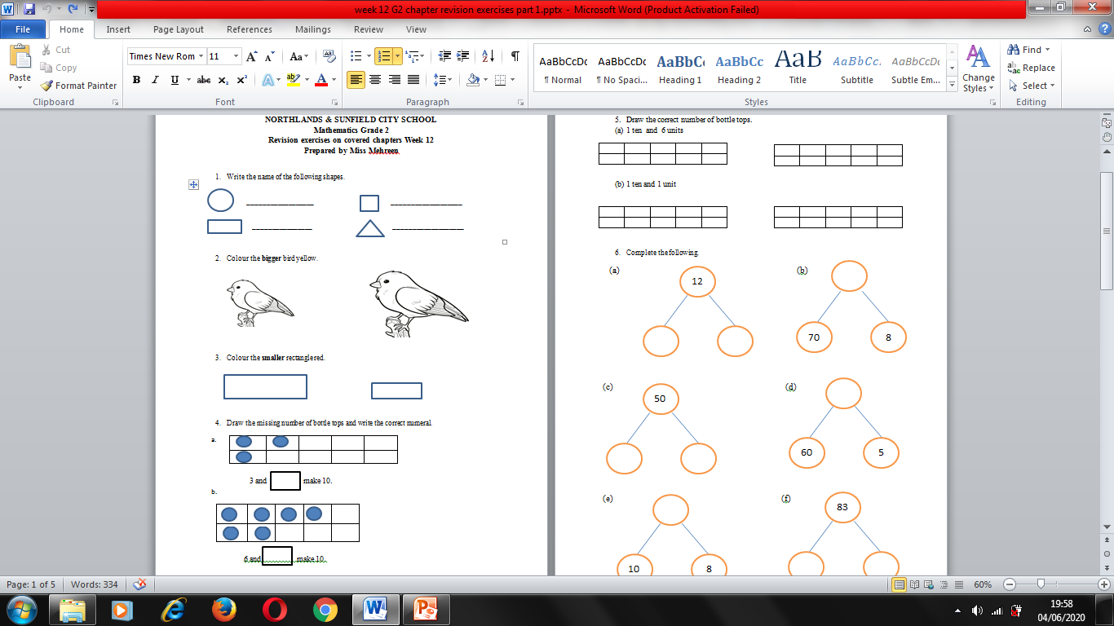

Slide 3
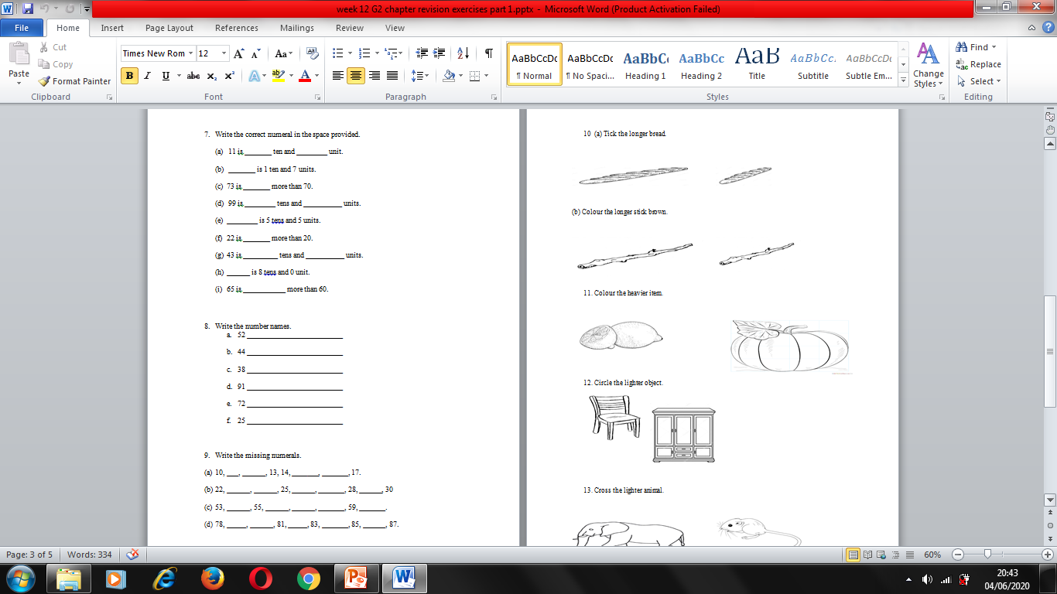
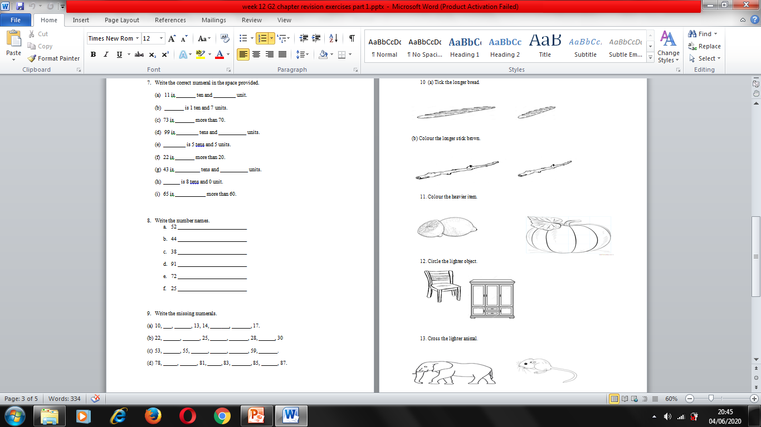

Slide 4
https://www.youtube.com/watch?v=krthACA6Xj8

