Slide 1
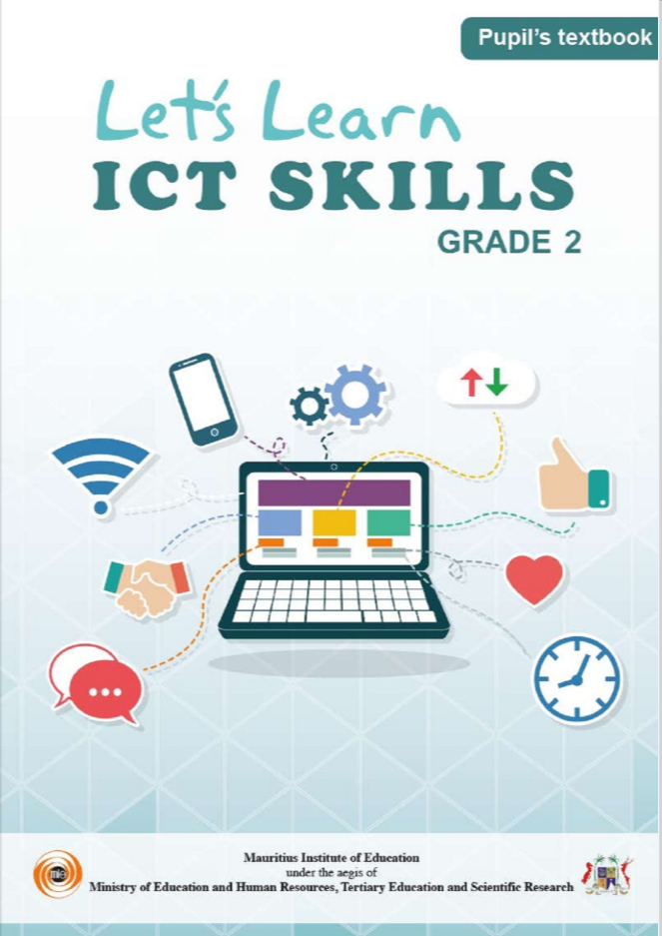

NORTHLANDS SCHOOL AND SUNFIELD CITY SCHOOL
Week 12
Part 1
Revision work
Presented by: Miss Neema ICT teacher
Refer to: http://portal.mie.ac.mu/curriculum.html

Slide 2
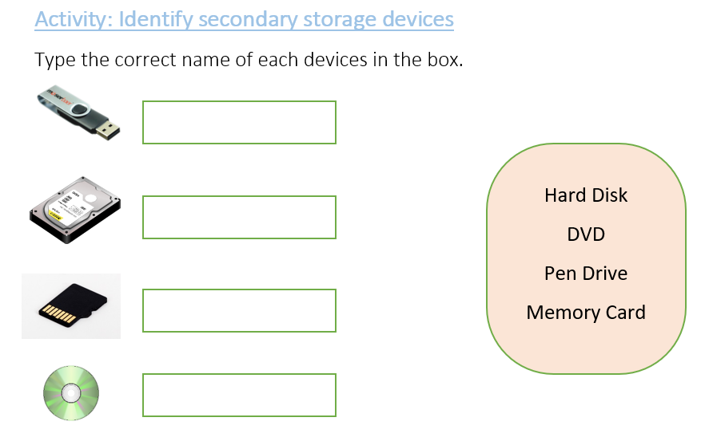


Example

Slide 3
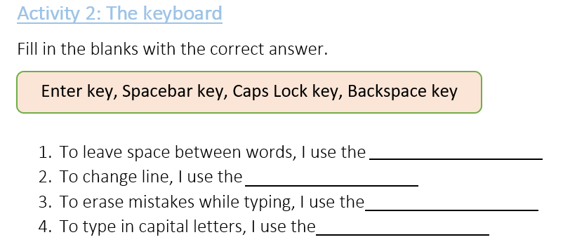
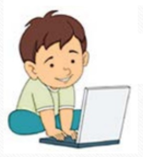
I open the file
WEEK 12 G2 ICT
Part 2
To do Activity 1 & 2
Example

