Slide 1

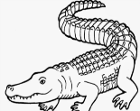

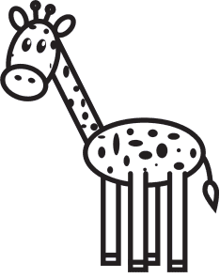

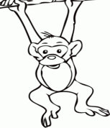
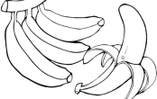


NORTHLANDS & SUNFIELD CITY SCHOOL
ENGLISH Grade 2 WEEK 11 HOMEWORK
Prepared by Ms Pareshma
I write the correct words.
A …………………………….. eats f___ s ___ .
b) A …………………………….. eats l__a__es.
c) A …………………………….. eats ba__ __n__s.
d) A …………………………….. eats g__ __s__.
2. I choose the right answer from the brackets.
I am sharing __________ juice with Mary. (our, my)
The children ______ ____________ a film. (are watching , is watching)
Sarah has three _____________. (pencils, pencil)
You ____________ eating. (is , are)
Sila has many ___________. (coins, coin)

Slide 2
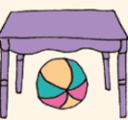
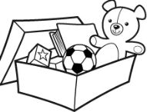


3. Look at the pictures and choose the correct preposition.
a) The ball is ___________ the table.
b) The toys are ___________ the box.
c) The apple is __________ the books.
d) The plane is _________ the house.
in on over under
4. Choose and write the opposites of the words in brackets.
( old tall sad slow far)
The tree is ______________ . (short)
The man and the woman are _______________ . (young)
My school is _______________ from my house. (near)
She cannot go to the shopping mall. She is __________ . (happy)
The tortoise is too _____________ . (fast)

Slide 3
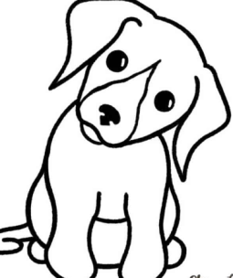
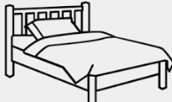


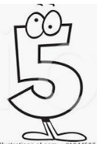

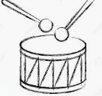
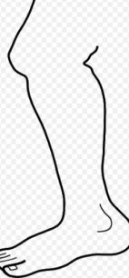
5. I write the correct letter.
a) | b)
c) | d)
e) | f)
g) | h)
.... o g
b …… d
…. e n
…. i r d
…. i v e
l e a …..
... r u m
l ……. g
A song for you.
https://www.youtube.com/watch?v=QvsQ9hYKq7c

