Slide 1


NORTHLANDS SCHOOL AND SUNFIELD CITY SCHOOL
WEEK 11
PART 1
Revision – typing practice
Presented by: Miss Neema ICT teacher
Refer to: http://portal.mie.ac.mu/curriculum.html

Slide 2
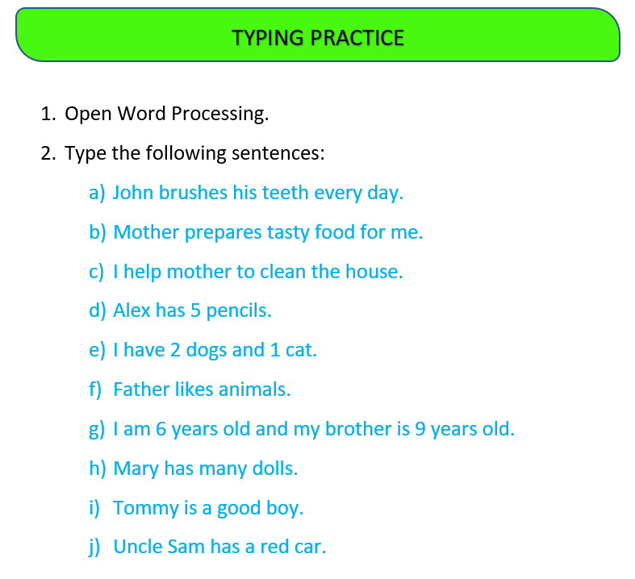

Slide 3


