Slide 1


NORTHLANDS AND SUNFIELD CITY PRIMARY SCHOOL
GRADE 4
WEEK 13
LESSON 4:PAGE 49 EXERCISE 9,10 AND 11

Slide 2
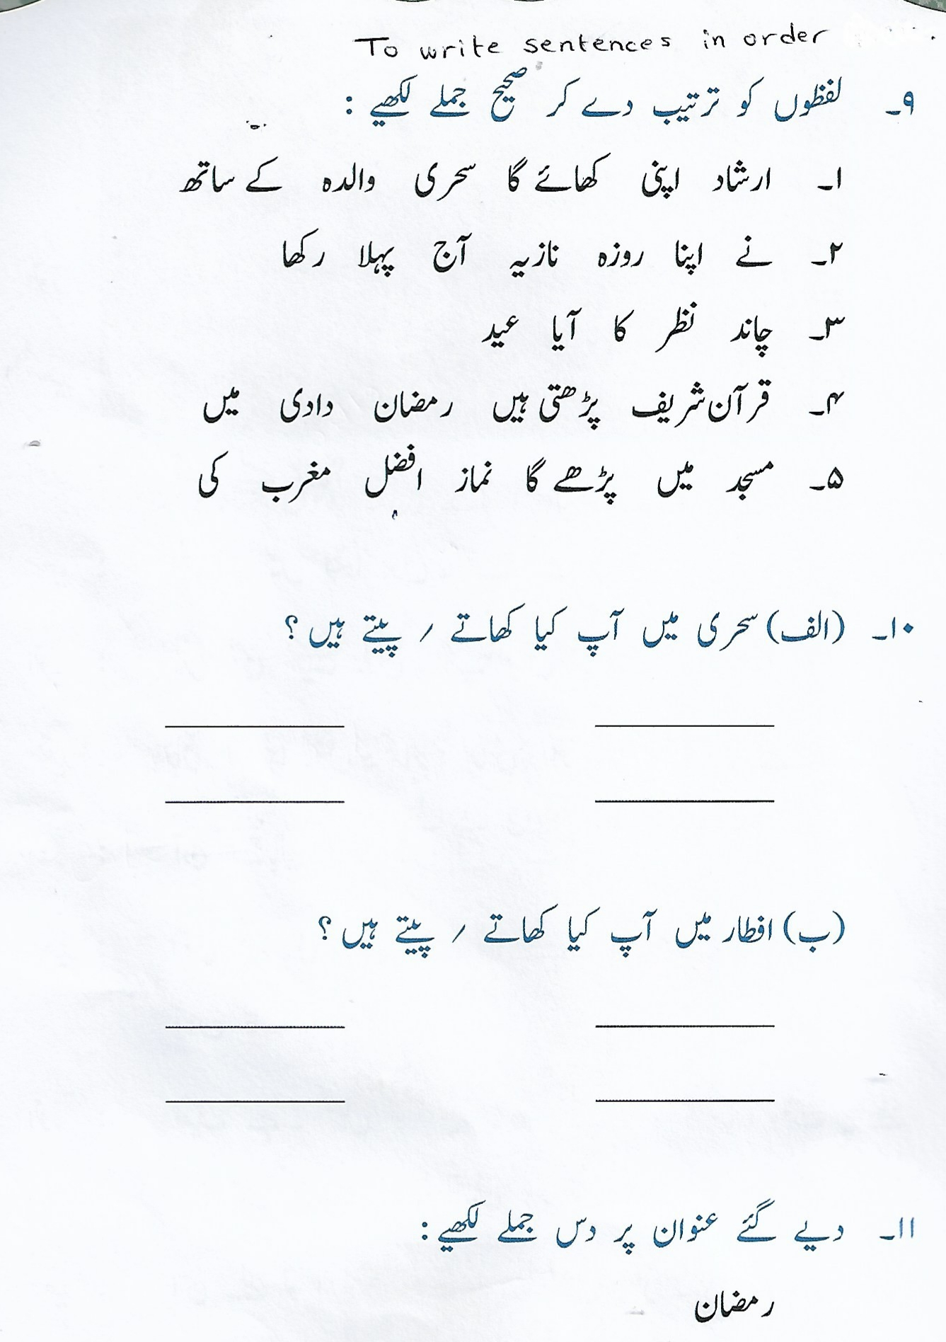
PAGE 49 EXERCISE 9,10 AND 11

Slide 3
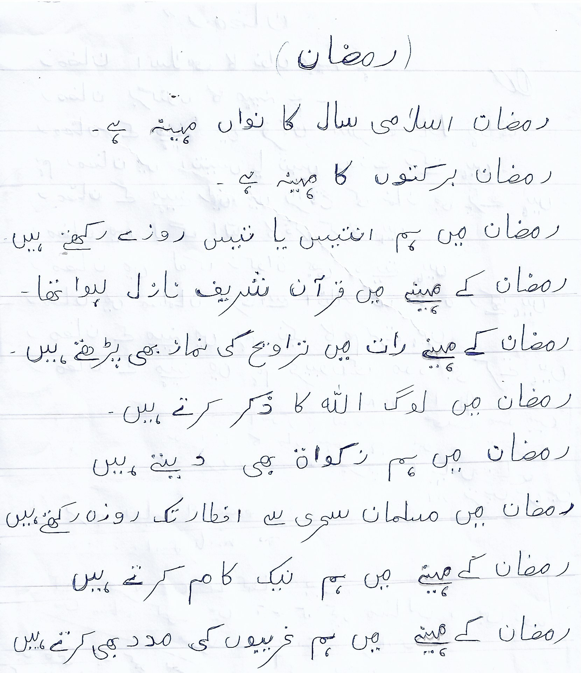
TO READ AND WRITE IN THE COPYBOOK

