Slide 1
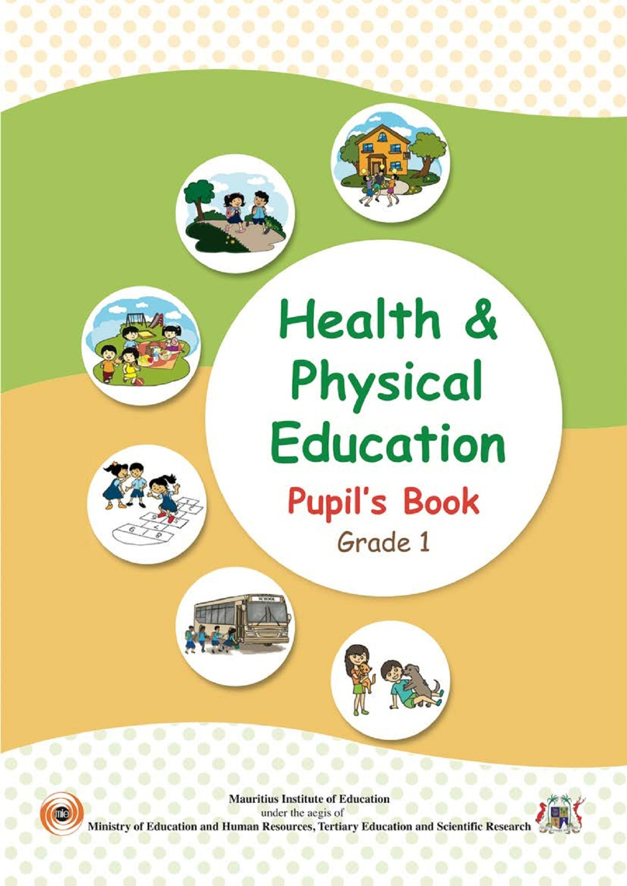
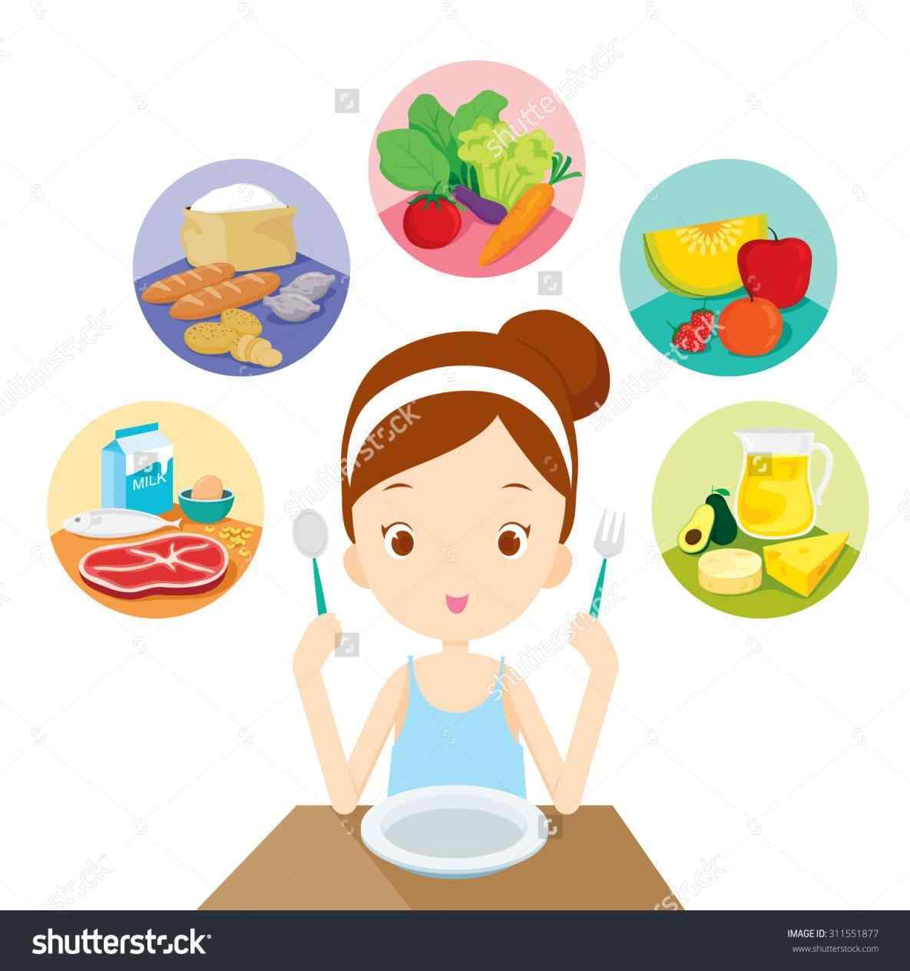

Northlands and Sunfield City School
Grade 1– Health Education
Unit 3 – Food
Lesson 4 - Eat clean and safe food
Week 9 prepared by Miss Amrine and Miss Nametah
All topics being covered on the online lessons will be covered again at school when the child resumes normal classes. Pupils must label their weekly lessons clearly on their books/ copybooks or printed lessons for future reference.

Slide 2
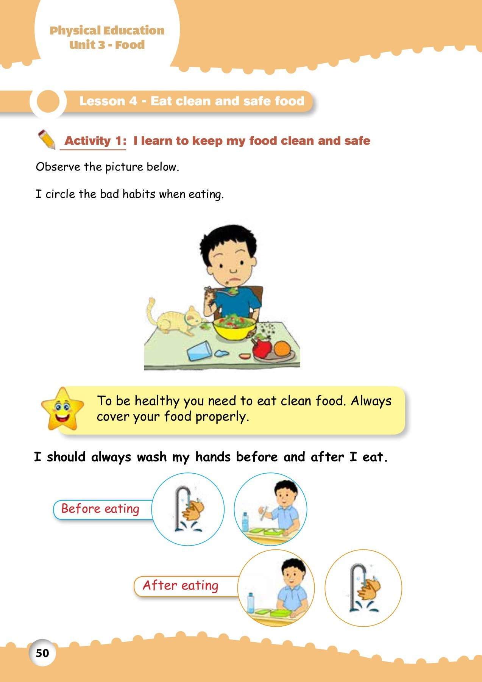
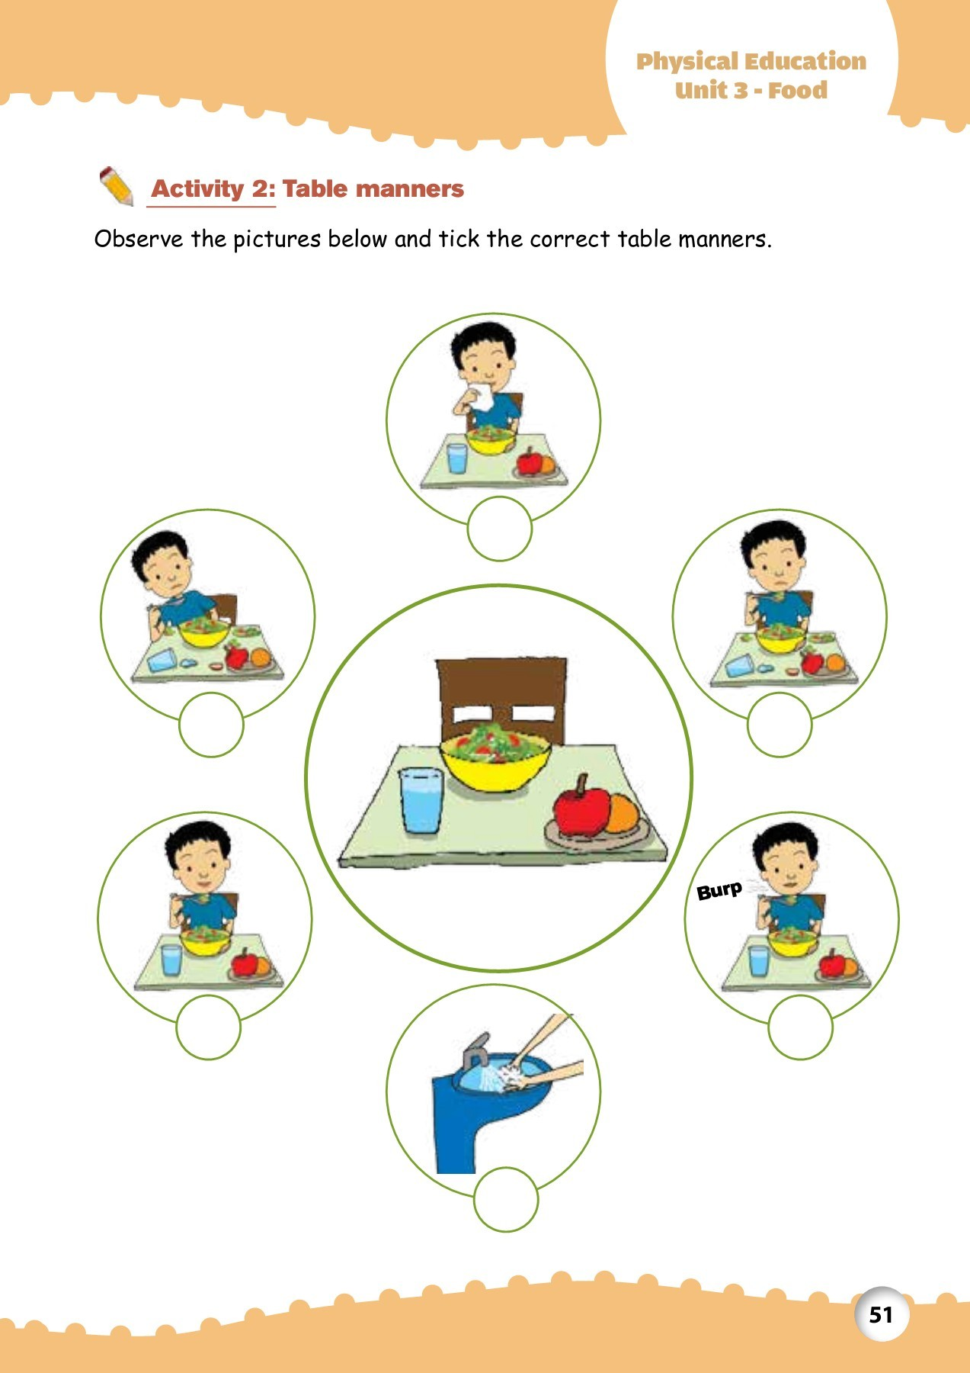
I learn to how keep my food clean and safe
I learn table manners

Slide 3

