Slide 1

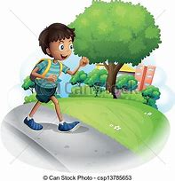

Northlands and Sunfield City School
Grade 3– Health Education
Unit 3 – Walking along the road and
Steps in crossing the road
Week 8 prepared by Miss Amrine
All topics being covered on the online lessons will be covered again at school when the child resumes normal classes. Pupils must label their weekly lessons clearly on their books/ copybooks or printed lessons for future reference.

Slide 2
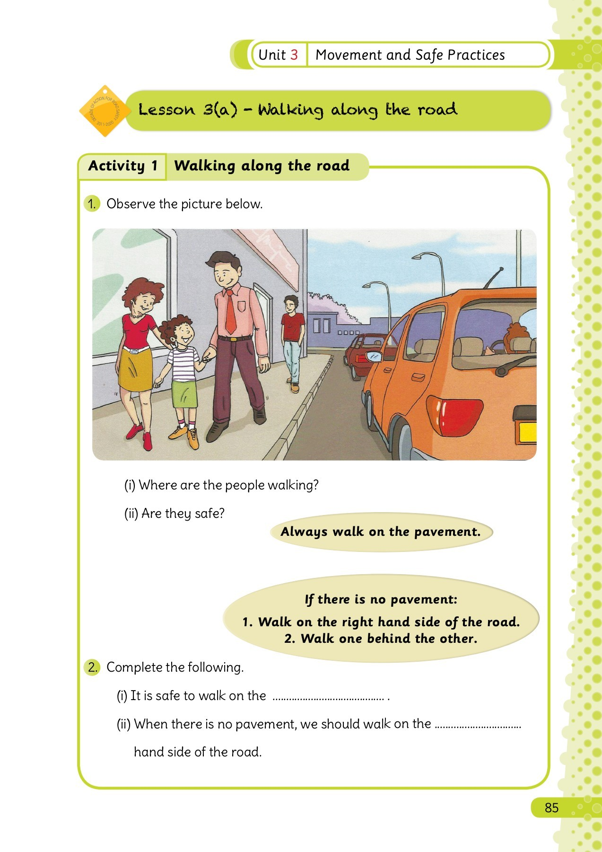
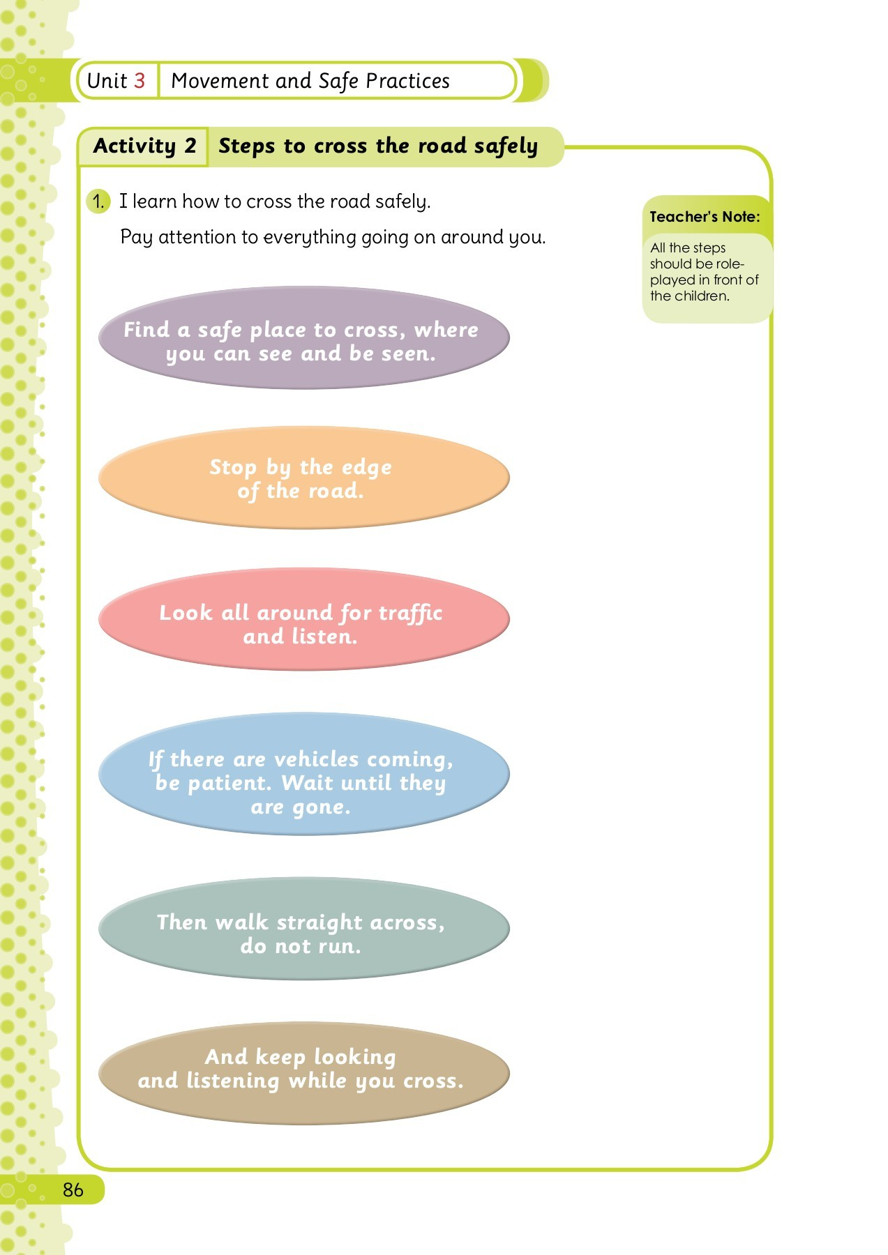
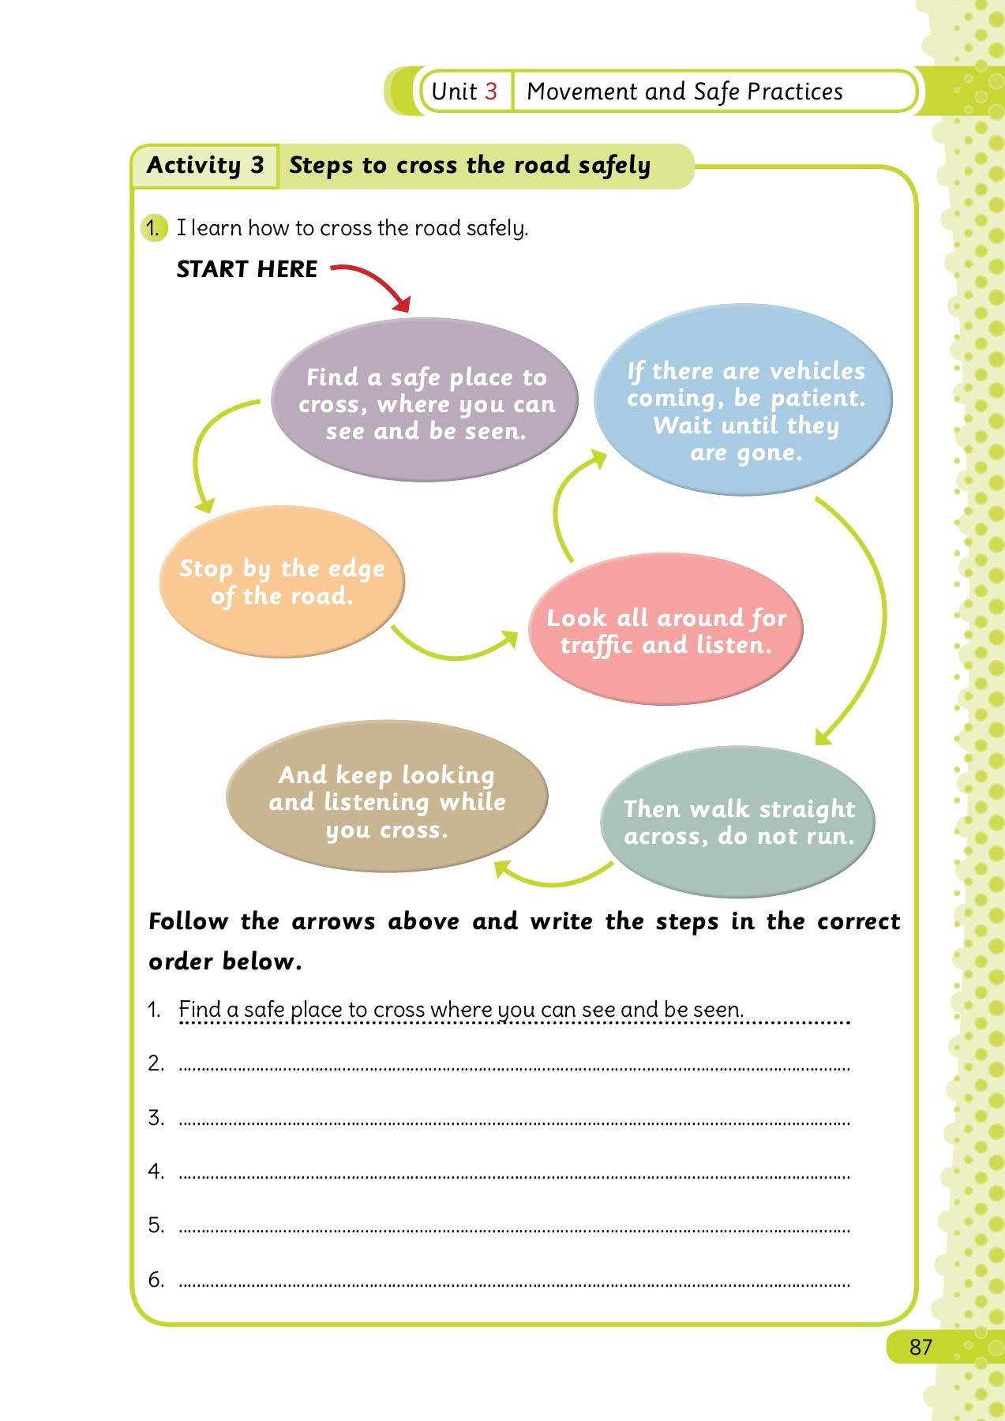
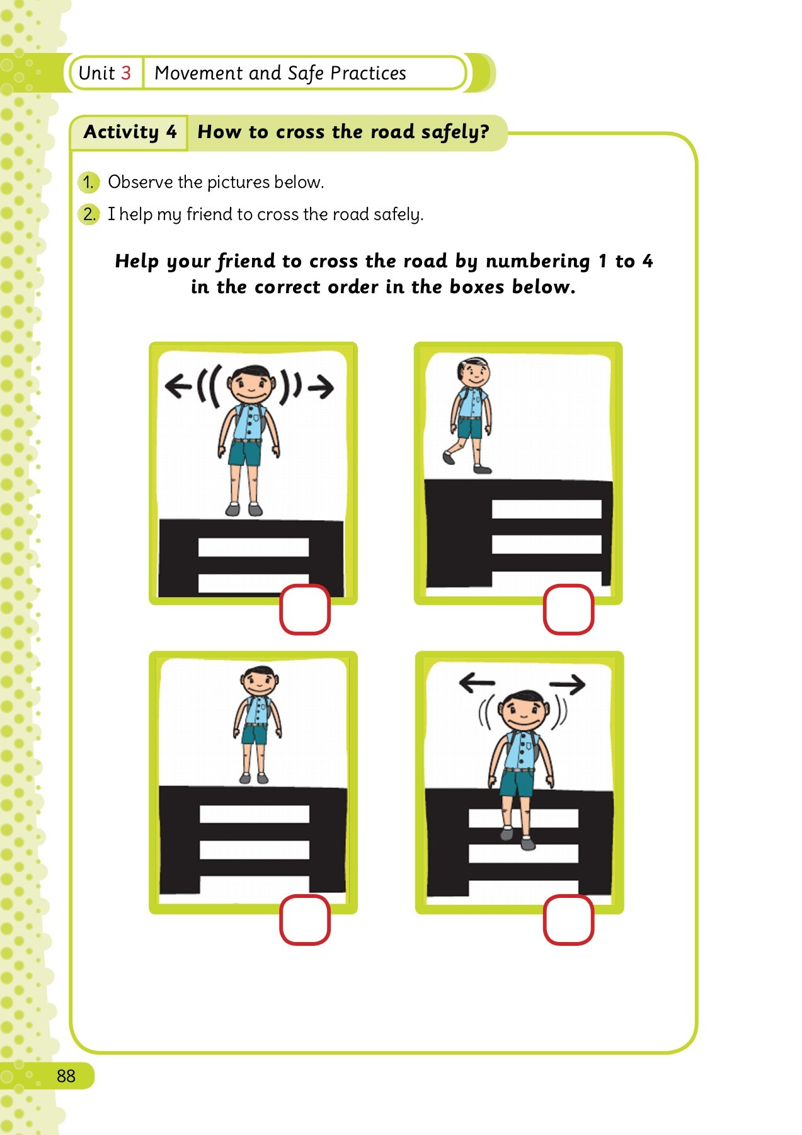
Walking along the road

Slide 3

