Slide 1


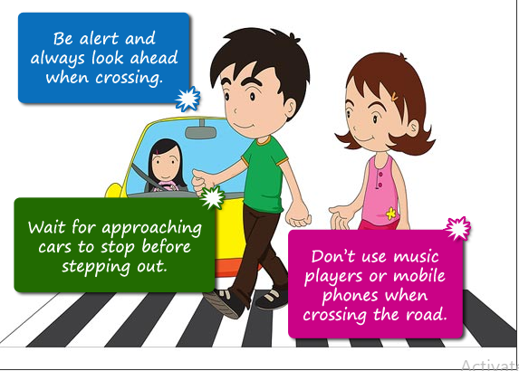
Northlands and Sunfield City School
Grade 3– Health Education
Unit 3 – Crossing the road
Week 7 prepared by Miss Amrine

Slide 2





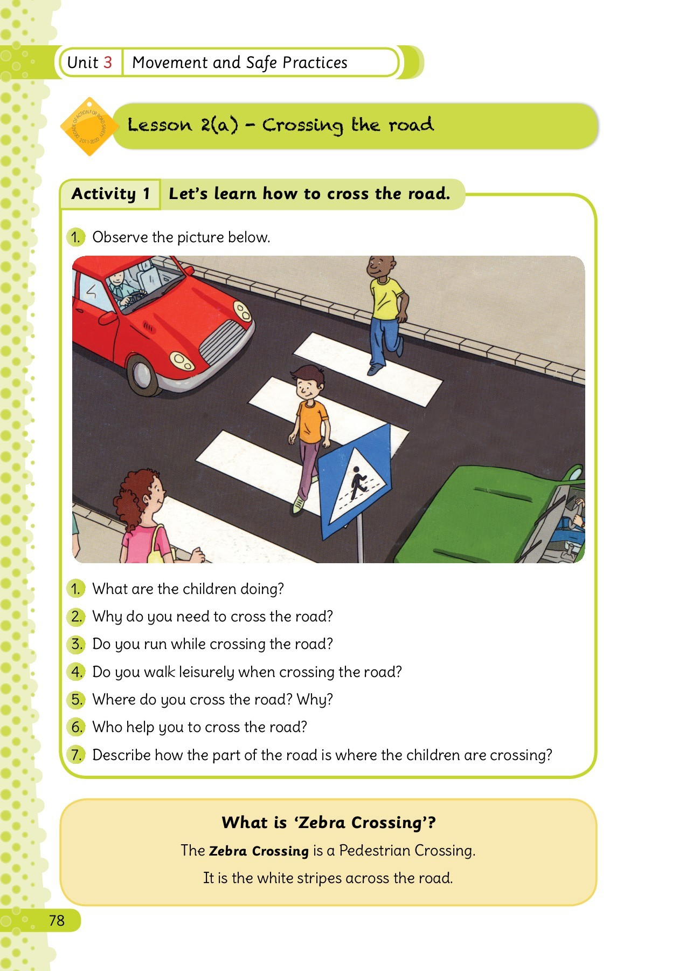
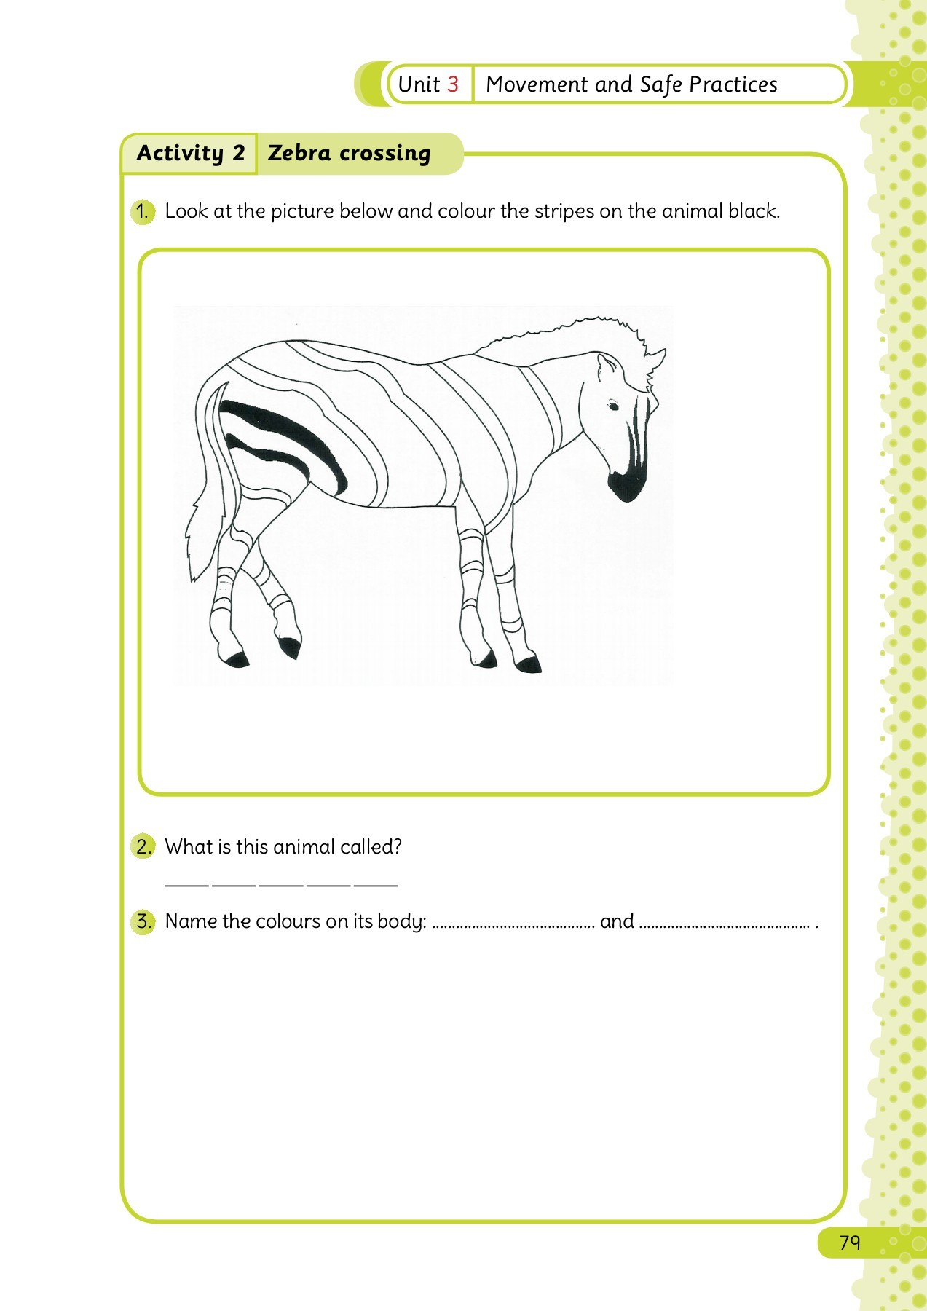
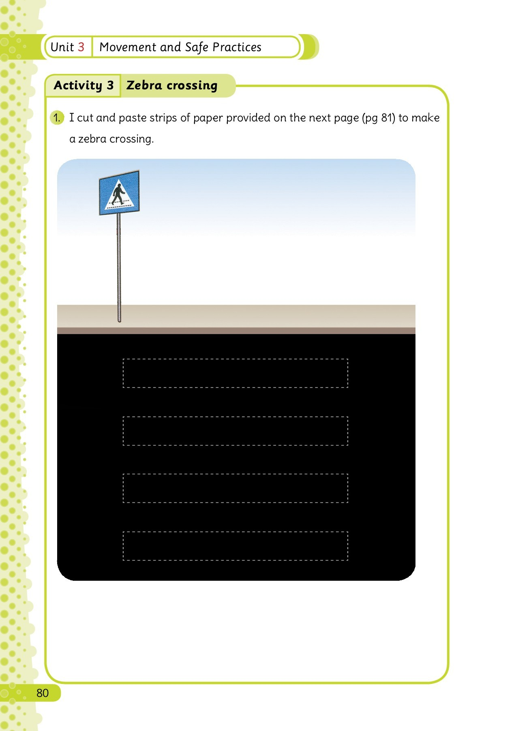
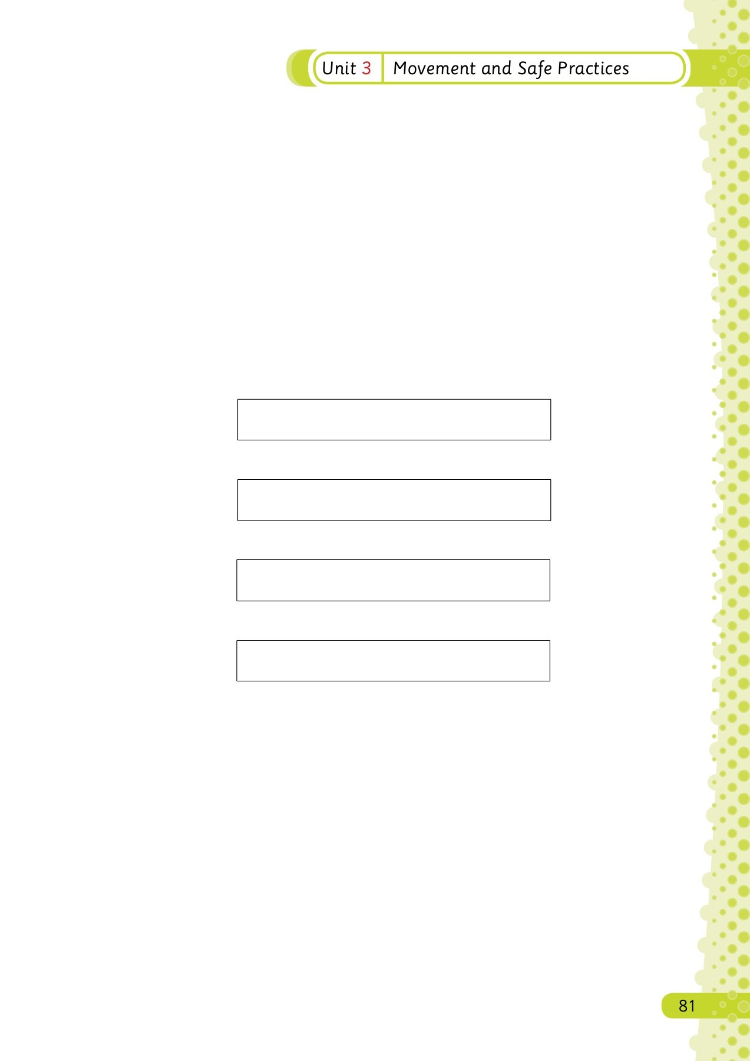
Crossing the road

Slide 3

