Slide 1
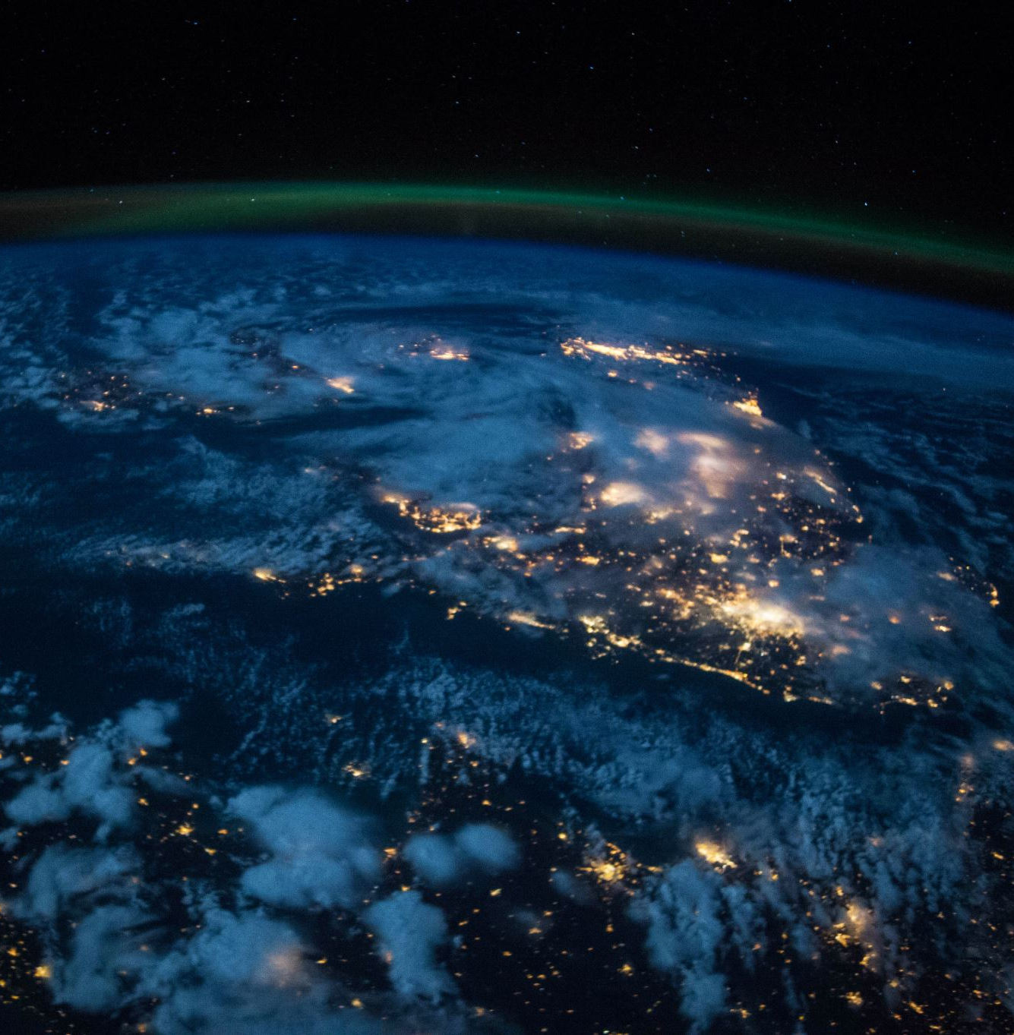
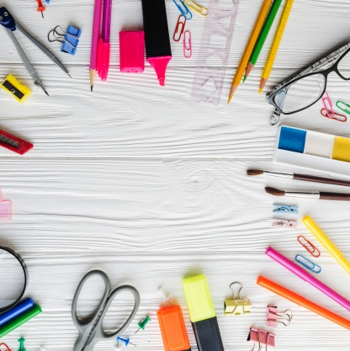
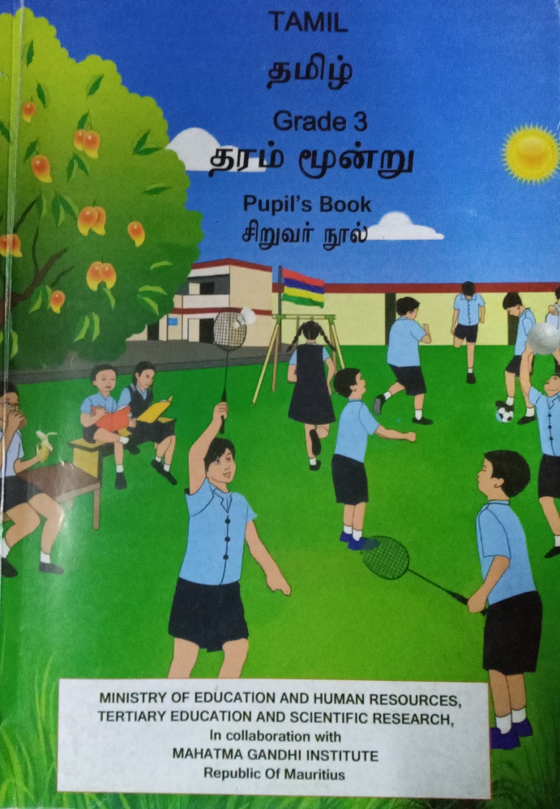
Northland and sunfield city primary school.
Subject: Tamil
Teacher name: Kalaivanee.M
Grade:3
Week (9)

Slide 2
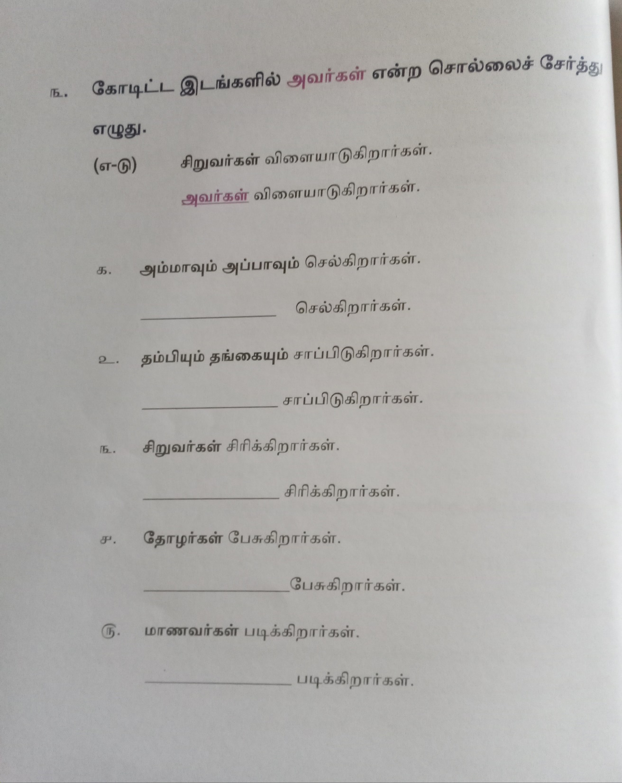

The students need to add the word அவர்கள் in the given space. This work need to be done in Tamil copybook.

Slide 3
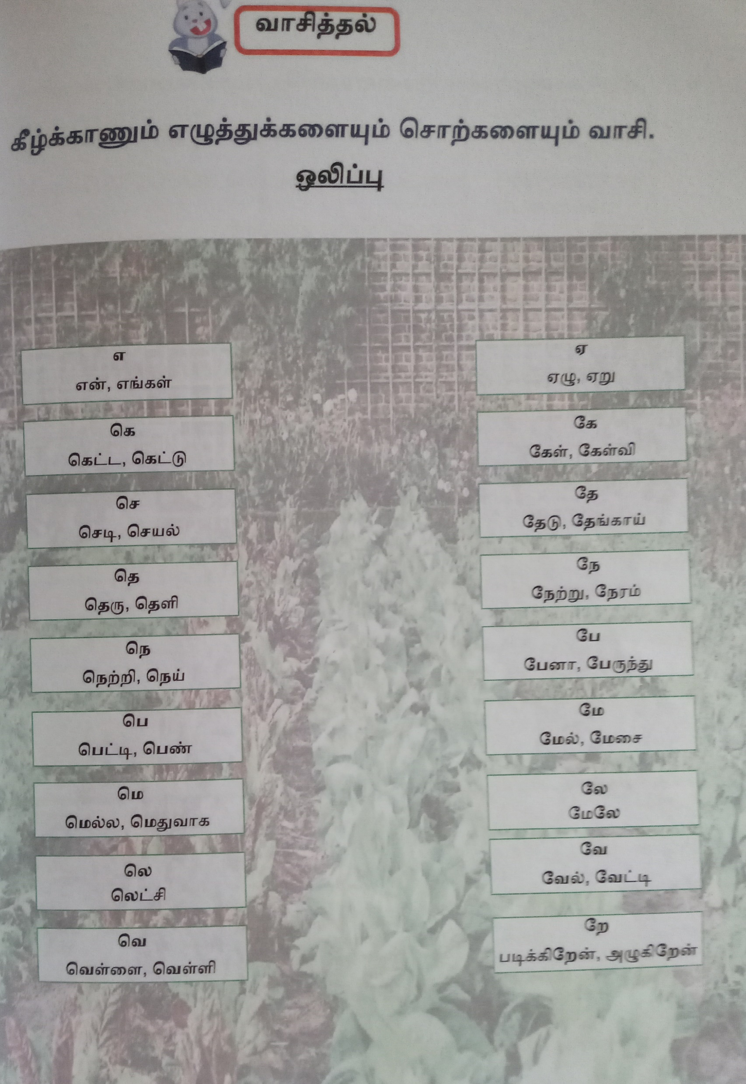
The students need to read and copy the words 3 times in their Tamil copy book.

Slide 4
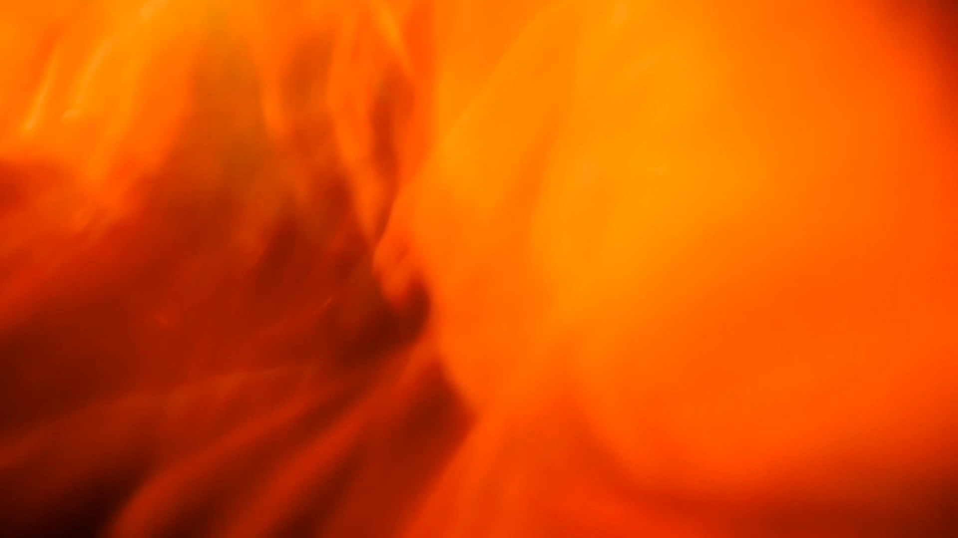
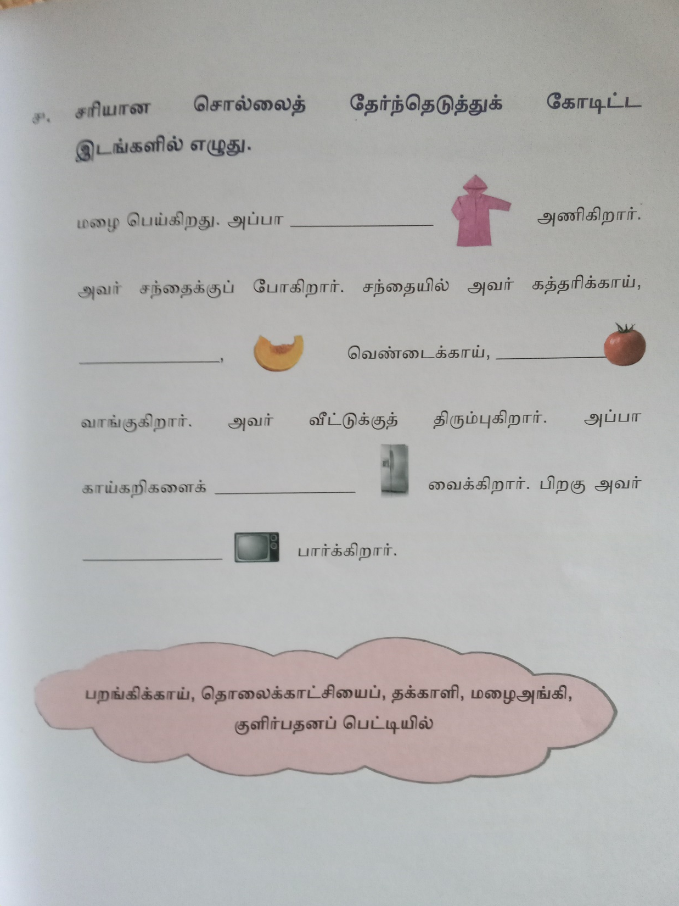
Fill in the blanks with the correct answers. This work need to be done in Tamil copy book with the help of parents.

