Slide 1


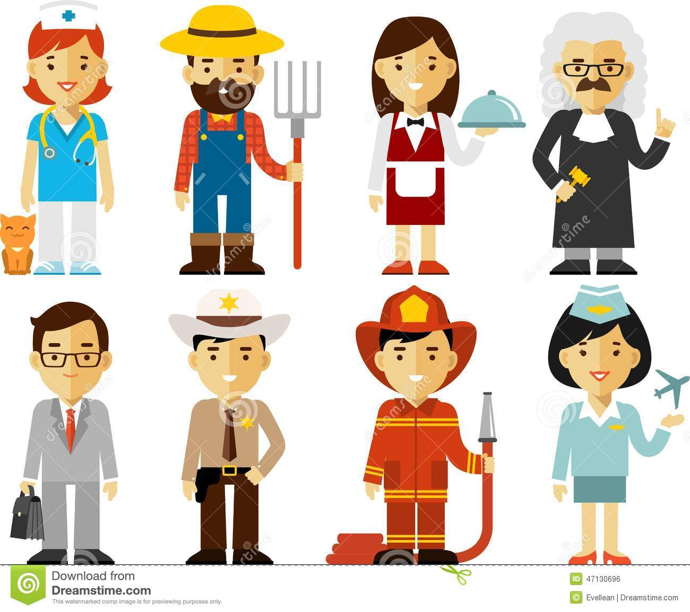
Northlands &Sunfiled City School
“All topics being covered on the online lessons will be covered again at school when the child resumes normal classes.”
Week 9 lower pps my family part 1
Theme: My Family
Different types of occupations
Presented by Mrs. Savrina Khadun

Slide 2
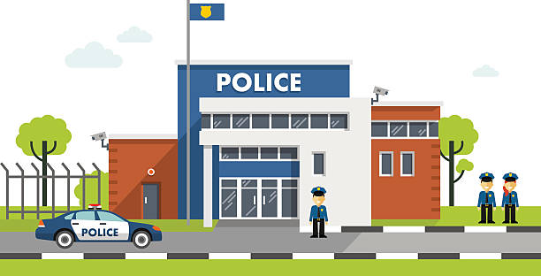
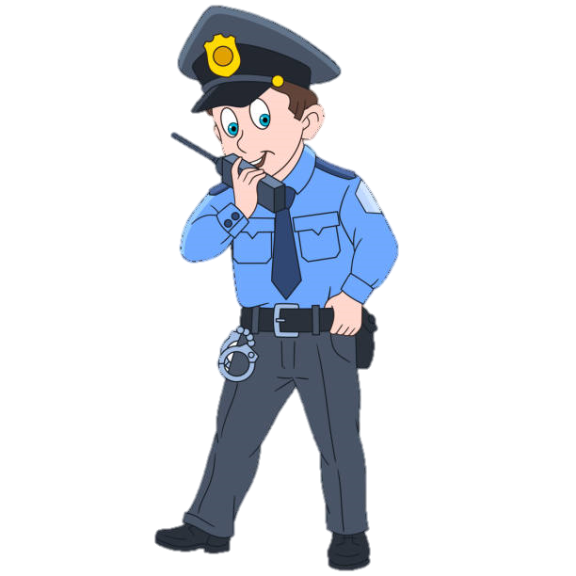
He is a police officer .

Slide 3
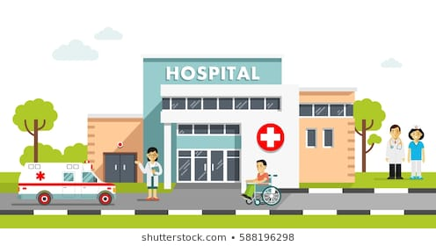
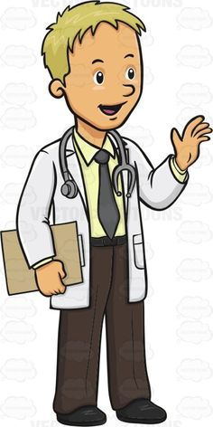
He is a doctor.

Slide 4

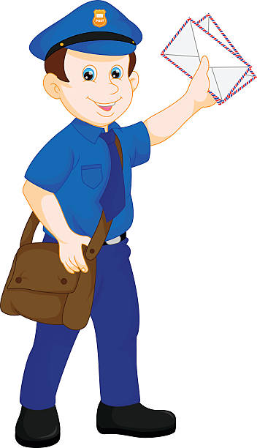
He is a postman.

Slide 5
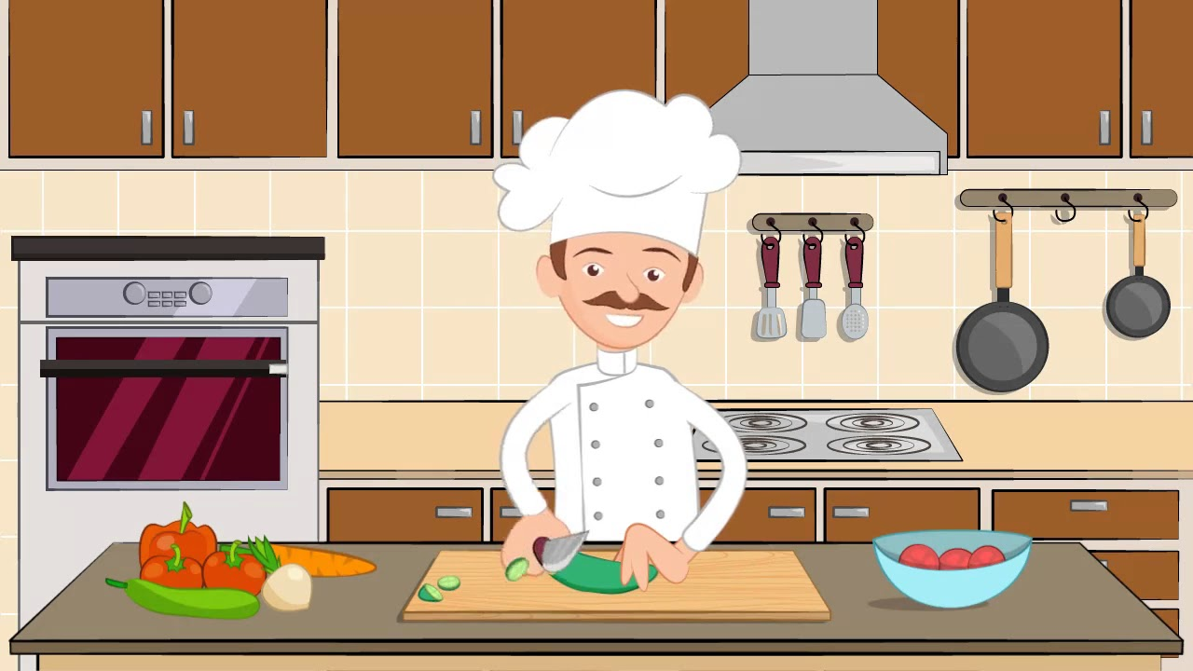
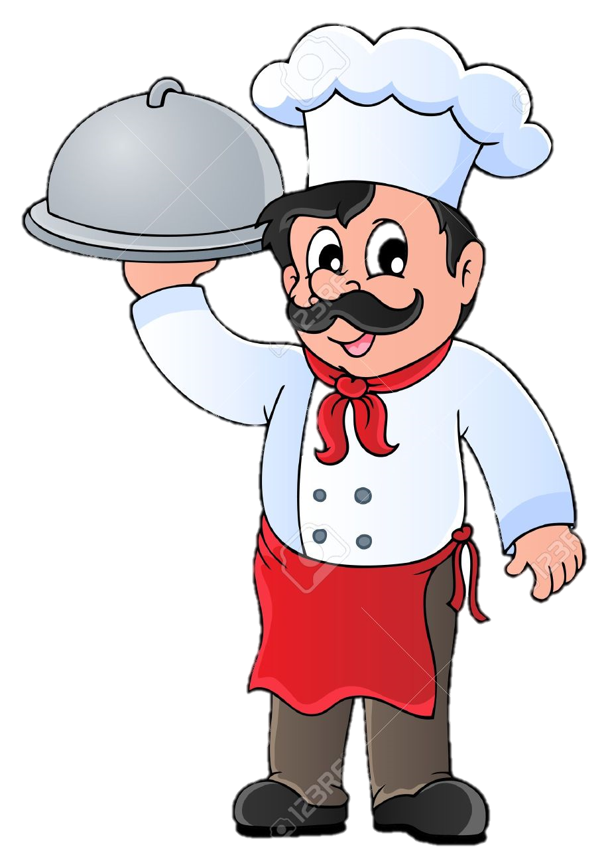
He is a cook.

Slide 6
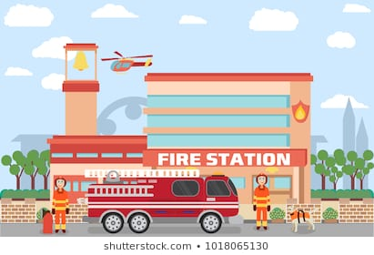
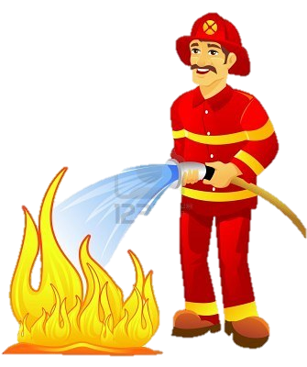
He is a firefighter.

Slide 7
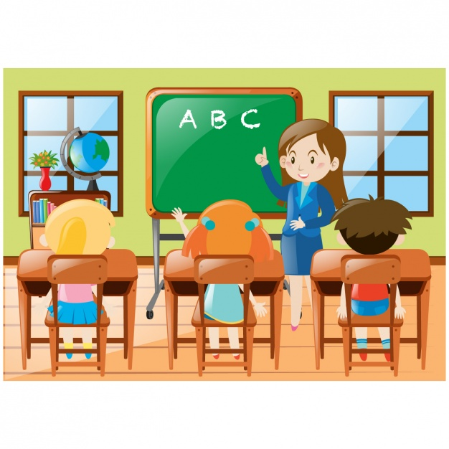

She is a teacher.

Slide 8
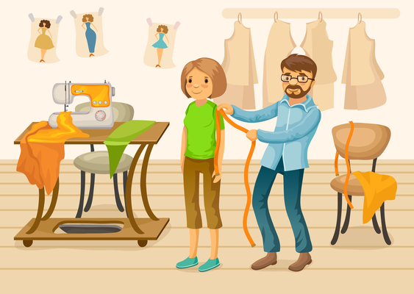
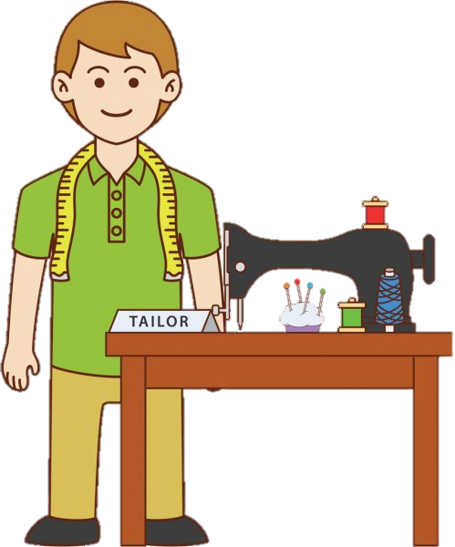
He is a tailor.

Slide 9


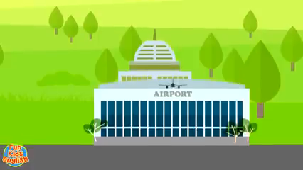
Occupation songs

Slide 10




