Slide 1

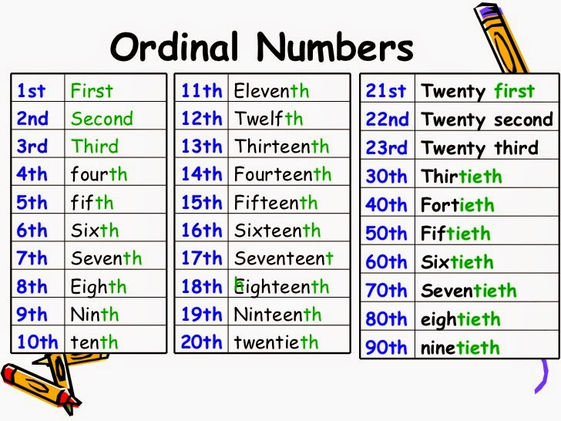
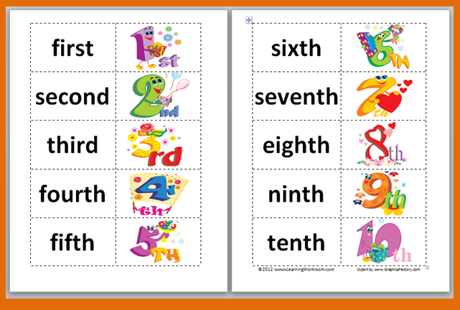
NORTHLANDS & SUNFIELD CITY SCHOOL
Mathematics Grade 2
Homework Week 9
Prepared by Miss Mehreen

Slide 2
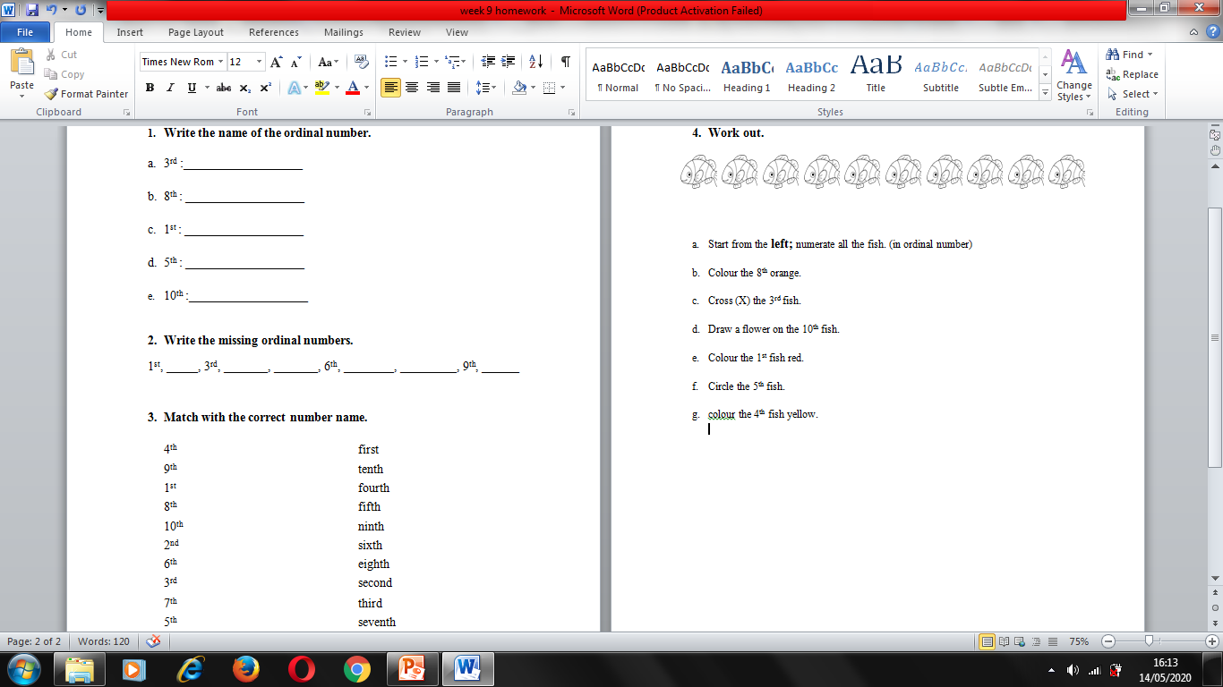

Slide 3
