Slide 1

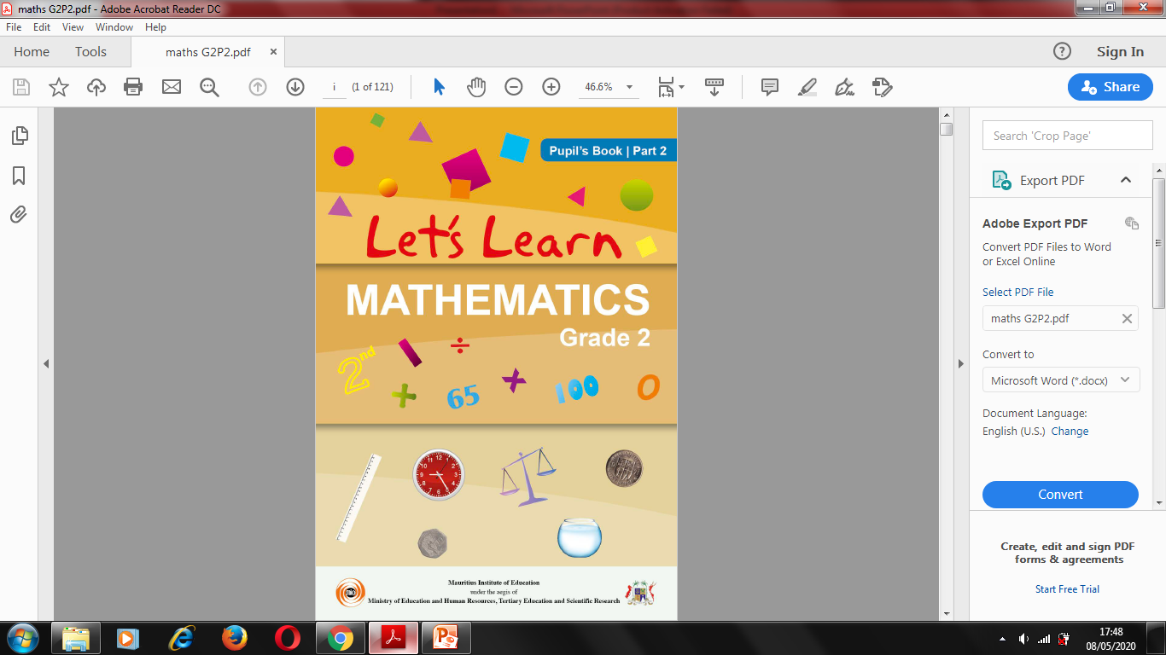
NORTHLANDS & SUNFIELD CITY SCHOOL
GRADE 2- MATHEMATICS
ORDINAL NUMBERS
WEEK 9 (Prepared by Miss Mehreen)

Slide 2
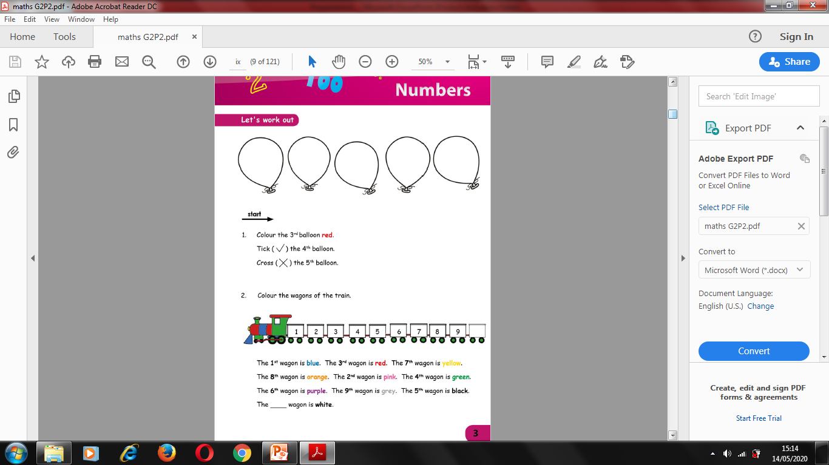

Slide 3
