Slide 1

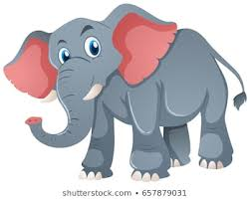
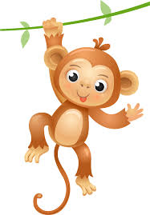
Northlands and Sunfield City School
Grade 1-Mathematics homework
Prepared by Miss Keshini
Tick (√ ) the big animal

Slide 2

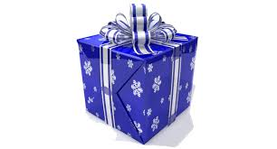
2. Cross (x) the small gift

Slide 3
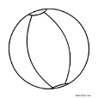

Draw a big ball
4. Draw a small pencil

