Slide 1


NORTHLANDS AND SUNFIELD CITY SCHOOL
Grade 1– Français
Topic: Le temps et le son [d]
Week 9
Prepared by Miss Shrutee
French MIE text book part 1
Pg. 61-63

Slide 2
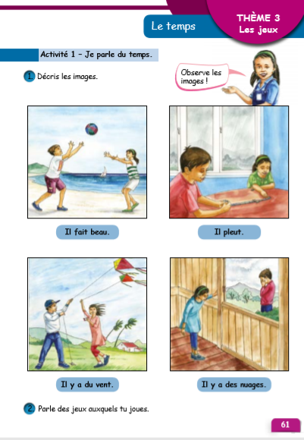
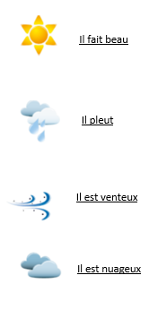
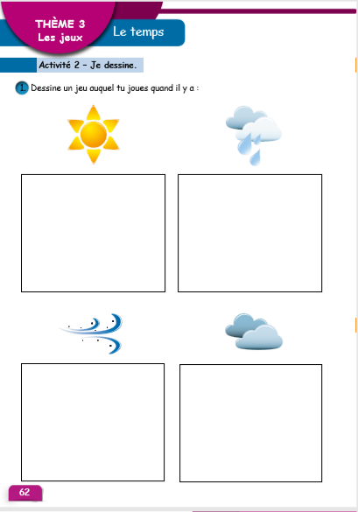

Slide 3
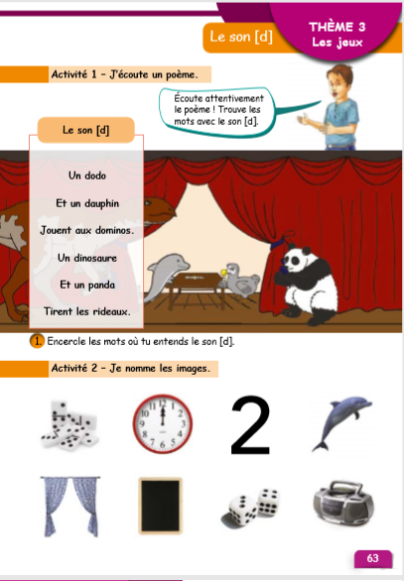
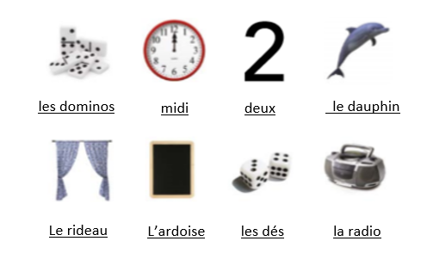
Le son [d]

