Slide 1


Northlands and Sunfield City School
Grade 1– English Week 9
Unit 3 - The pronouns
(Who, I, and You)
Prepared by Miss Dikshita

Slide 2
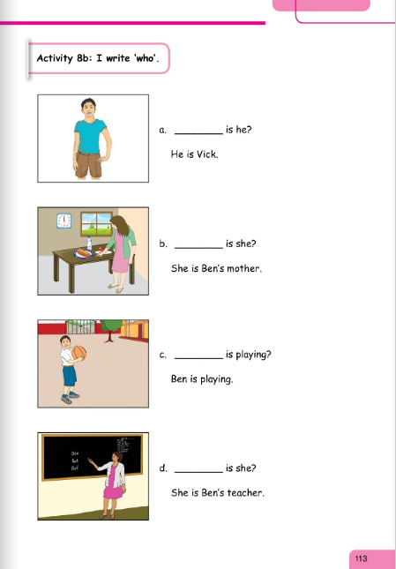
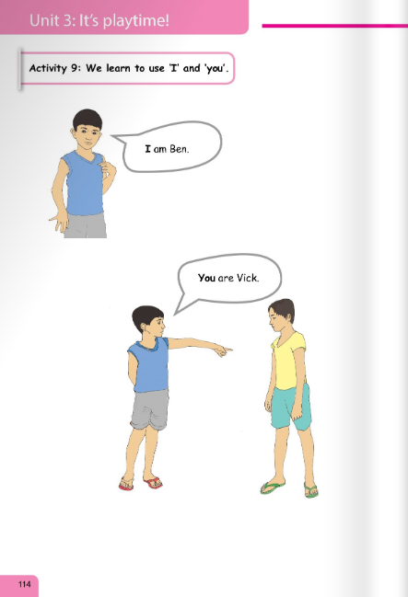
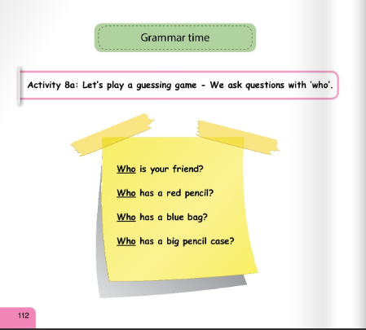

Slide 3
