Slide 1
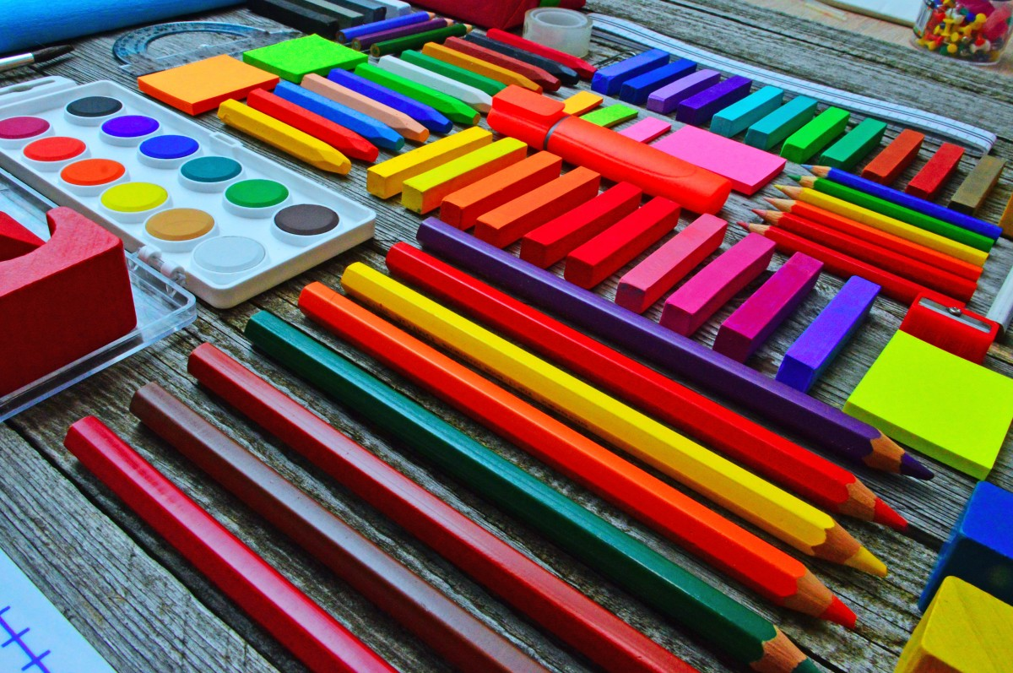
Northlands and Sunfield City Primary School
Grade 2
Miss Pooja
Week 9 Part 1

Slide 2

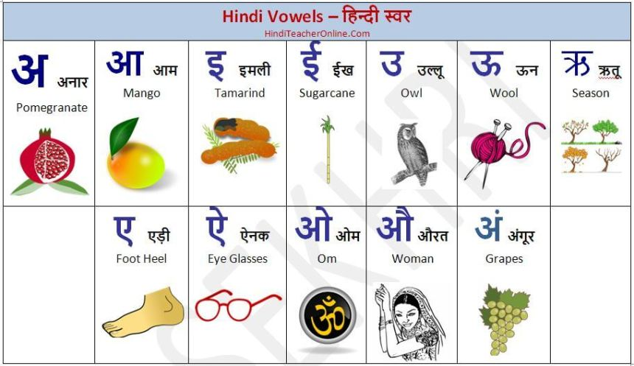
Vowels in Hindi

Slide 3
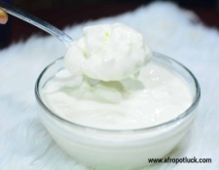
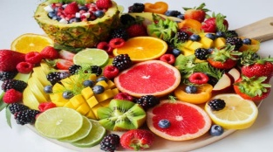
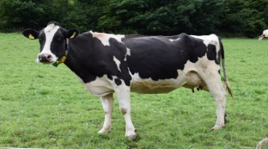


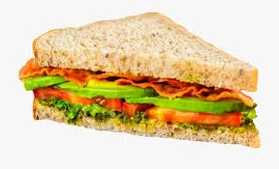
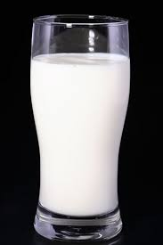
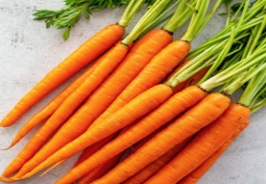

Letters, syllables, words and pictures with English words.
1. द द + ही = दही (yogurt)
2. ग गा + य = गाय (cow)
3. ल लड़ + का = लड़का (boy)
4. द दू + ध = दूध (milk)
5. ट टोक + री = टोकरी (basket)
6. फ फ + ल = फल (fruit)
7. द दी + दी = दीदी (sister)
8. र रो + टी = रोटी (bread)
9. ग गा + जर = गाजर (carrot)
https://youtu.be/i_9Hbp-S5Vk
https://youtu.be/HUoj5s5AnZg
Notes:
Pupils are asked to note down the letters, syllables and words in their hindi copybook.
With the help of parents the pupils should try to draw the pictures next to each words.

