Slide 1

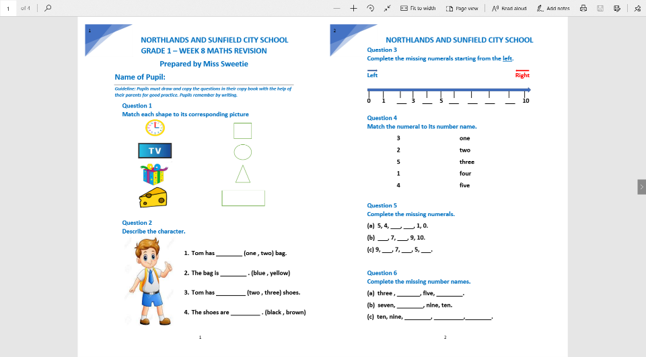
NORTHLANDS AND SUNFIELD CITY SCHOOL
GRADE 1– MATHEMATICS REVISION – WEEK 8
"All topics being covered on the online lessons will be covered again at school when the child resumes normal classes. Pupils must label their weekly lessons clearly on their books/copy books or printed lessons for future reference."
Pg 1 Q 1 & 2
Pg 2 Q 3 , 4 , 5 & 6

Slide 2
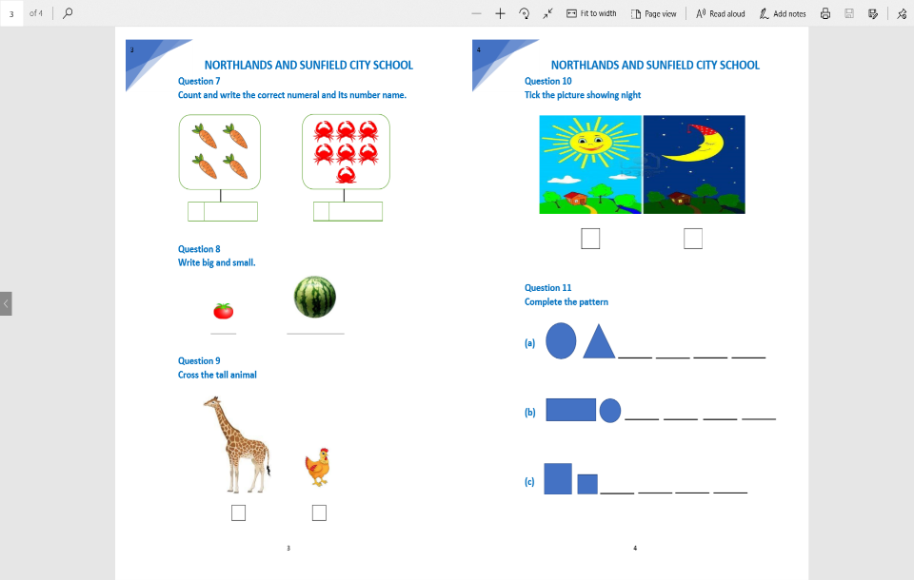
REVISION Questions to be attempted
Pg 3 Q 7 , 8 & 9
Pg 4 Q 10 & 11

