Slide 1

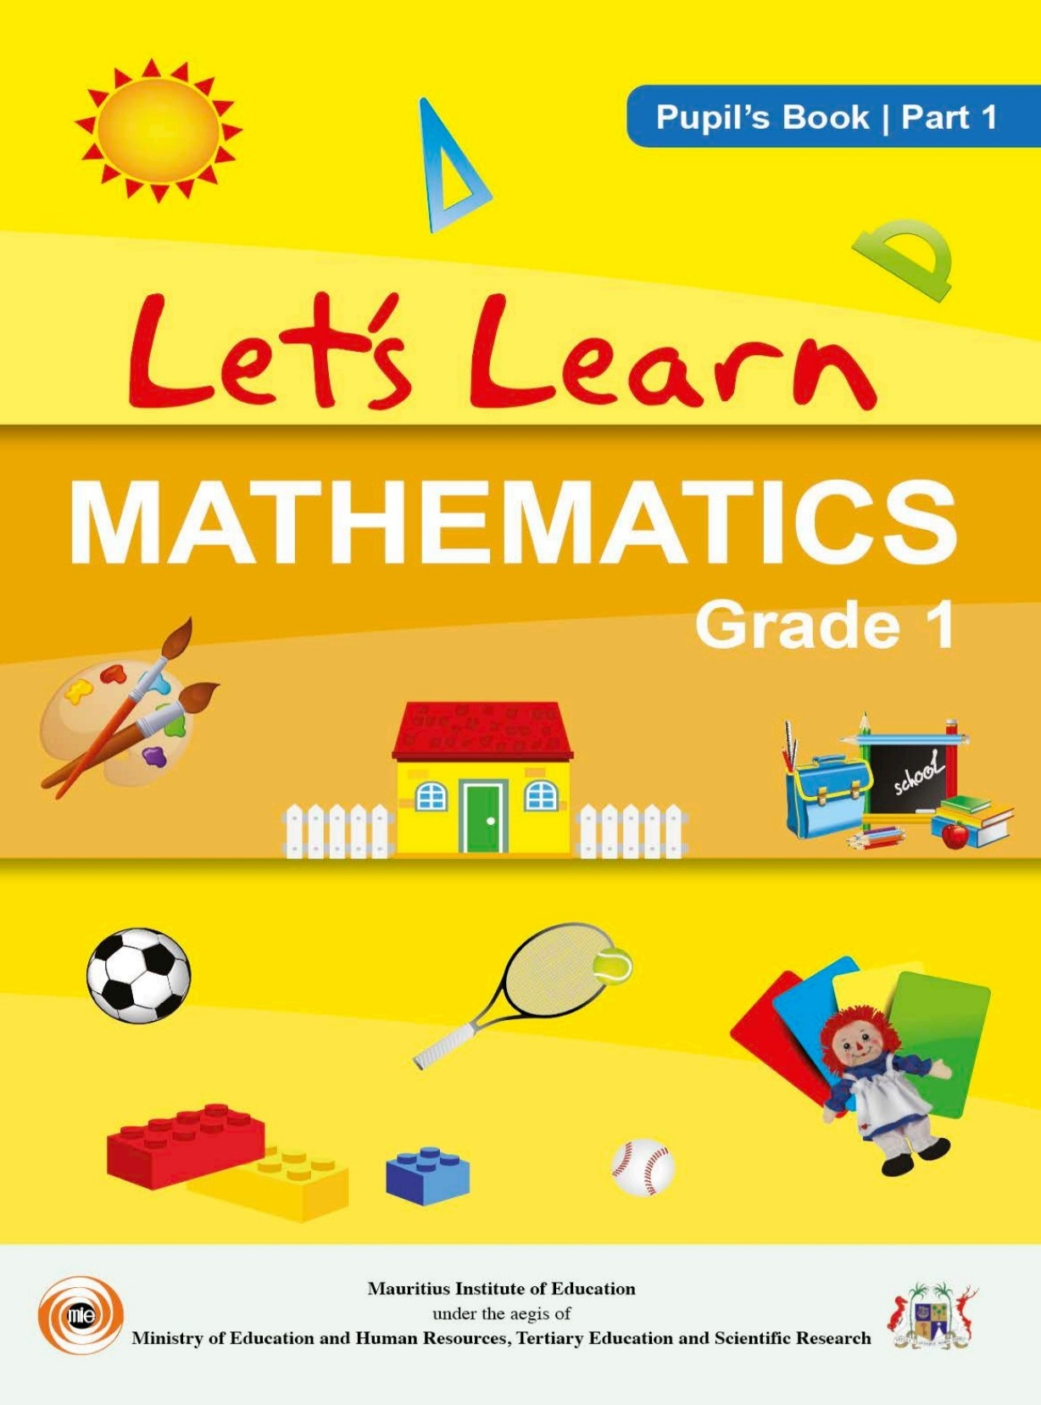
Northlands and Sunfield City School
Grade 1– Mathematics – PATTERN pg 57 - 67
Week 7 prepared by Miss Sweetie
( END OF MATHEMATICS GRADE 1 PART 1 )
OBJECTIVE:
Identify the ‘’rule’’ of a set of shapes, colours, numbers and objects to be able to complete a pattern.
PATTERN are created when shapes, colours, numbers and other objects are arranged in a particular order and repeated over and over again.
PATTERN are things that follows a ‘’rule’’.
Create sample cards from the book on pg 65 & 67 to make a Memory Game.

Slide 2
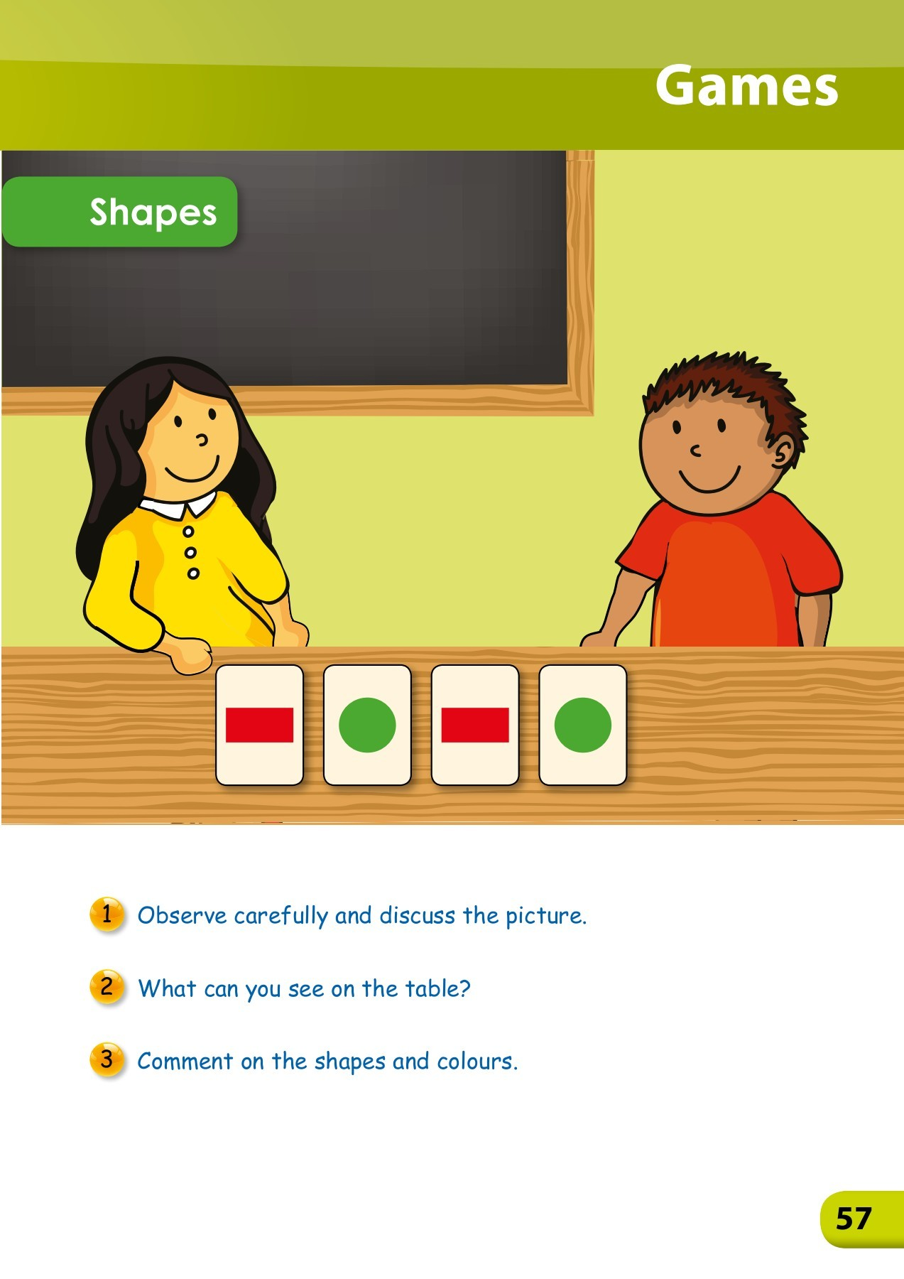
‘PATTERN’ picture discussion on page 57
The little girl Anna and the little boy Tom are in front of the classroom.
They are happy playing together.
I can see shape-cards on the table. They are playing a memory game.
The 1st shape is a red rectangle, the 2nd shape is a green circle, the 3rd shape is a red rectangle and the 4th shape is a green circle.
The rule of the pattern is:- a red rectangle follows a green circle and a green circle follows a red rectangle.
This is repeated over and over again.
This is called PATTERN – PATTERN are things that are arranged following a rule.
You can create your own memory game and play. For example you can cut and stick the pictures on pg 65 and 67. Stick them on cardboards to play with friends.

Slide 3
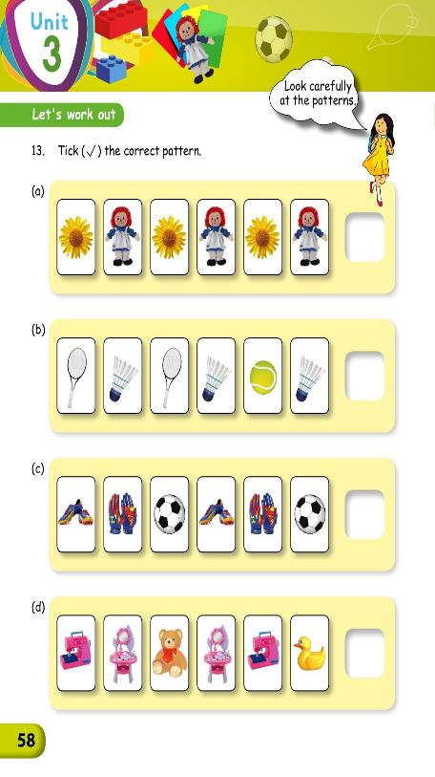
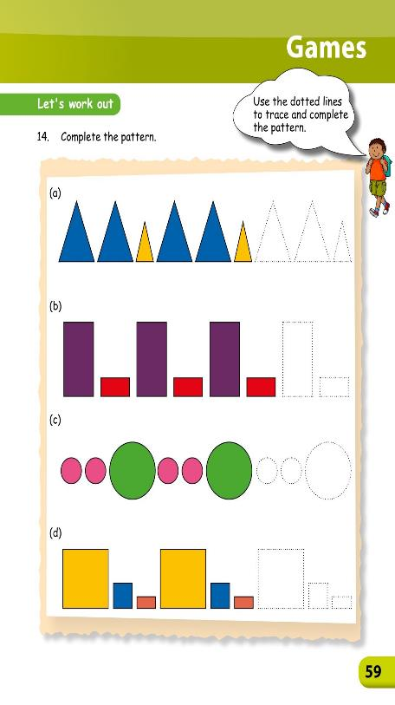
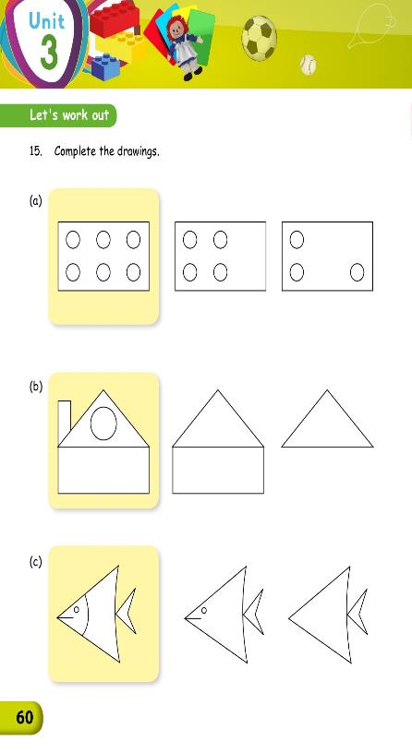
HOMEWORK Questions to be attempted
Pg 58
Q 13 ( a , b , c & d )
Pg 59
Q 14 ( a , b , c & d )
Pg 60
Q 15 ( a , b & c )

Slide 4
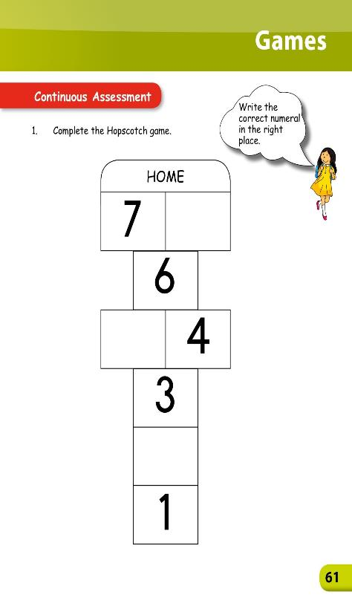
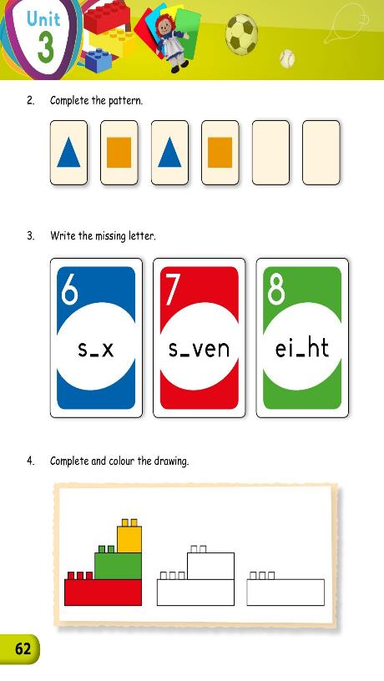
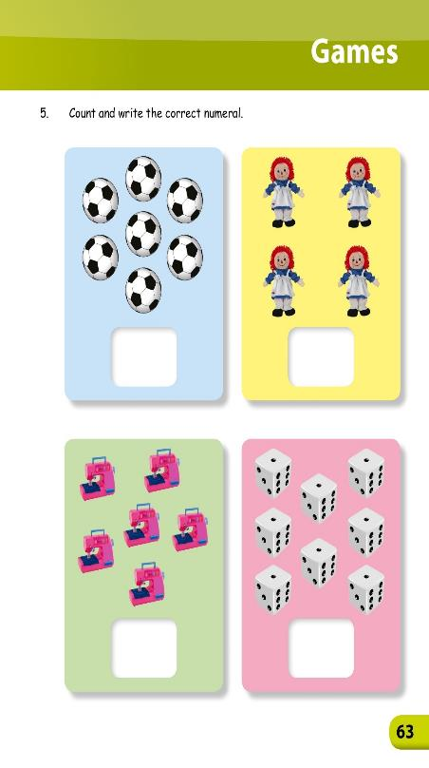
HOMEWORK Questions to be attempted
Pg 61
Q 1
Pg 62
Q 2 , 3 & 4
Pg 63
Q 5

