Slide 1


Northlands and Sunfield City School
Grade 1– English Week 10
Unit 3 - Sound /h/, Sound /e/ and Sound /p/
Prepared by Miss Dikshita
Sources:
https://portal.mie.ac.mu/curriculum.html

Slide 2
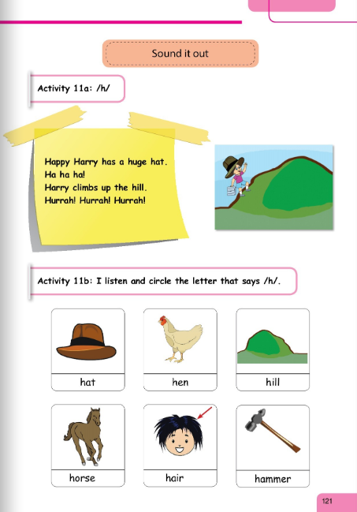
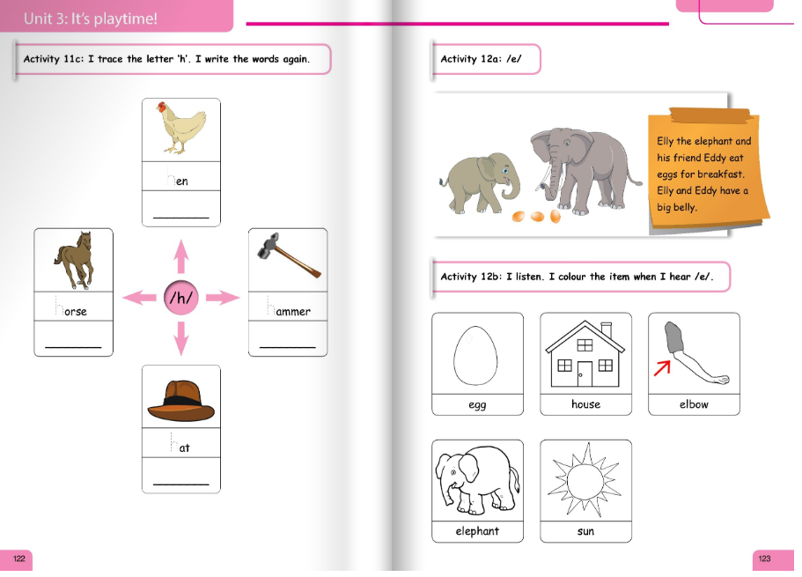

Slide 3
