Slide 1


Northlands & Sunfield City School
Grade 2 – English
Week 9
Prepared by Miss Yajna

Slide 2
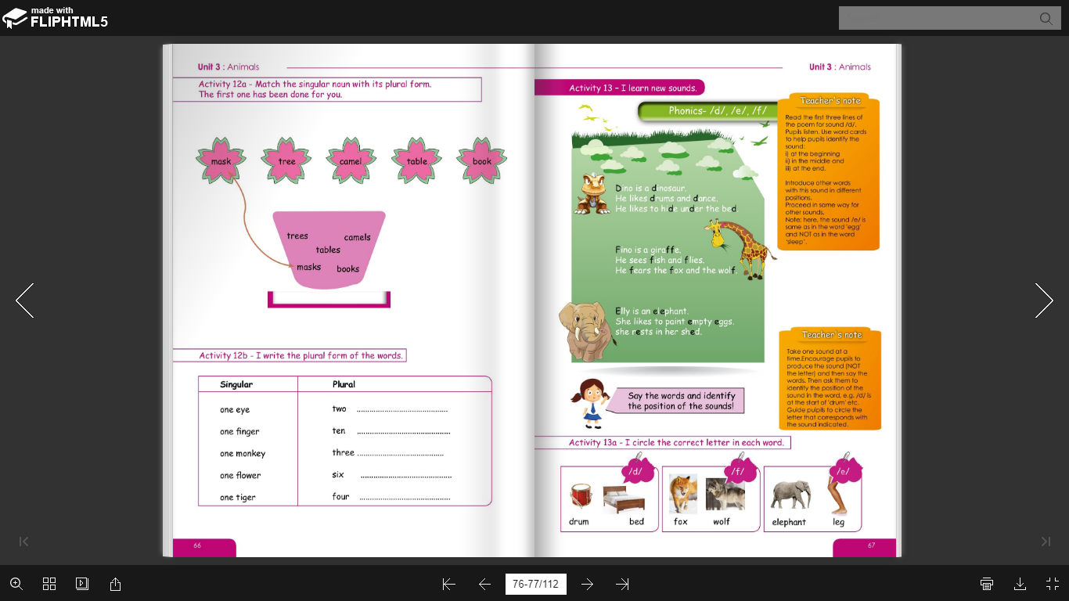
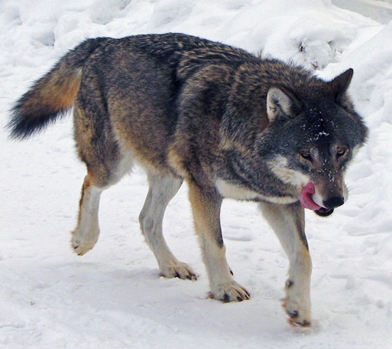
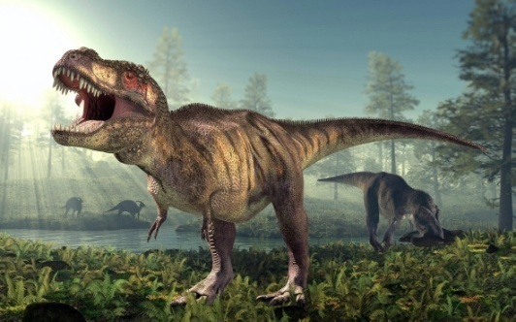
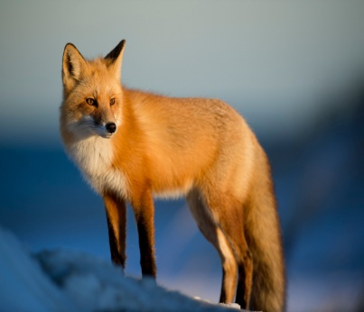
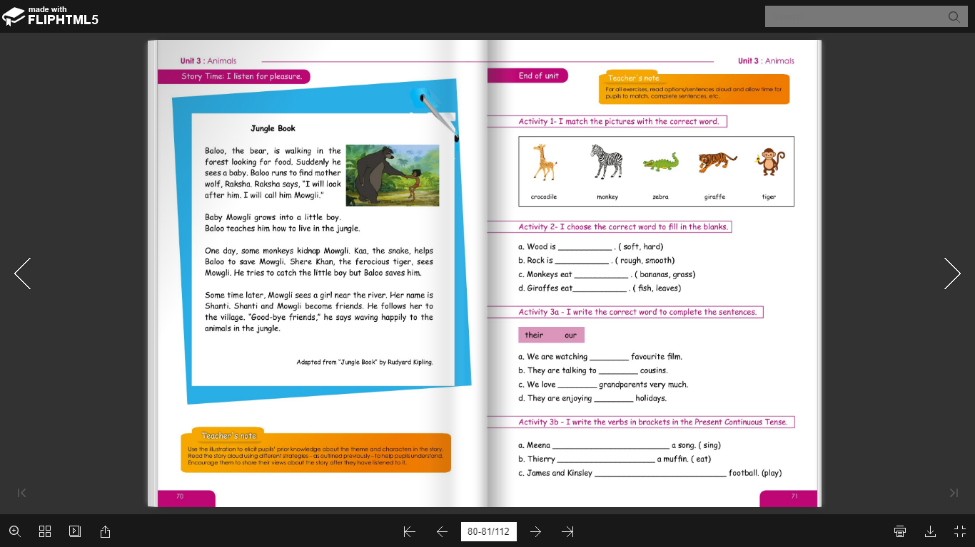
Sound /d/, /e/, /f/- page 67

Slide 3
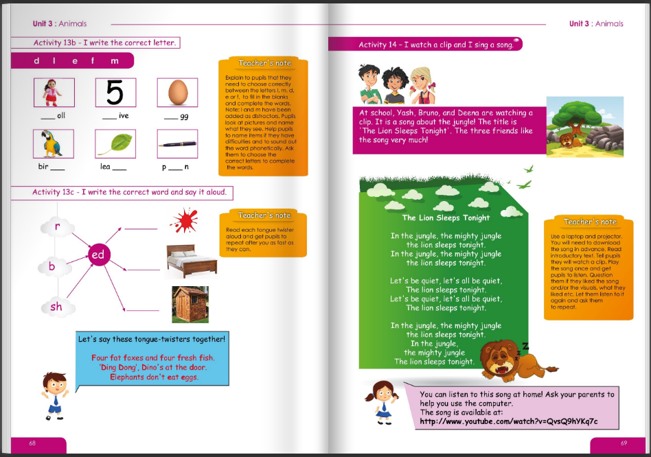

Slide 4

Story: Jungle Book – page 70
Jungle- is a forest with thick trees, plants and animals.
Kidnap- take someone away illegally by force.
Ferocious- cruel or violent.
Waving- move one’s hand to and fro in greeting or as a signal.

