Slide 1

GRADE 3
HINDI
MISS DEEPIKA
NORTHLANDS PRIMARY
AND
SUNFIELD CITY SCHOOL
WEEK 9 PART 1

Slide 2
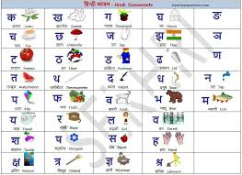
हिंदी व्यंजन – HINDI CONSONANTS

Slide 3
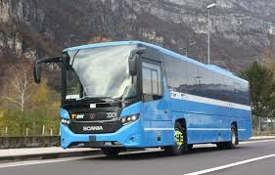

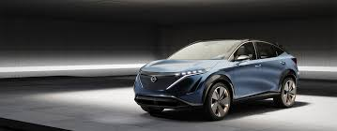

SOME DIFFICULT WORDS
बस – Bus
सड़क – Road
३. कार – Car
४. तरफ़ - Direction

Slide 4




५. सवारी – Vehicle
अनेक – Several
७. सीधी - Straight
८. दाईं - Right

