Slide 1


NORTHLANDS AND SUNFIELD PRIMARY SCHOOL
GRADE THREE
PART TWO
WEEK NINE
MISS NAZIMA

Slide 2
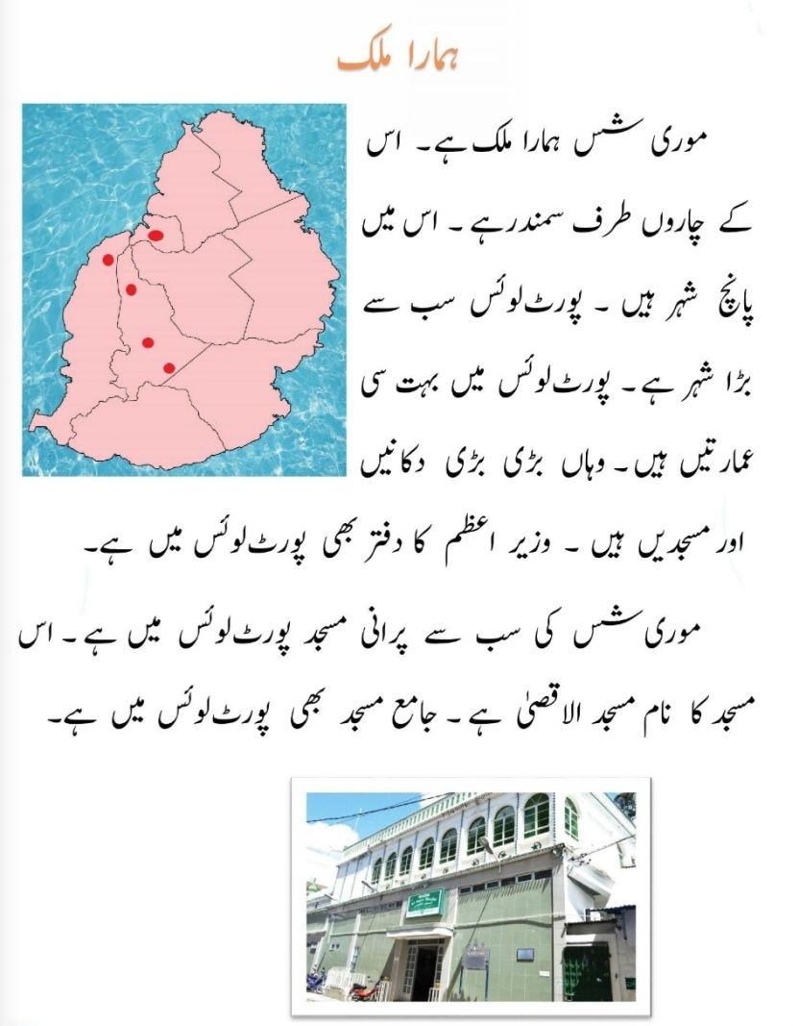
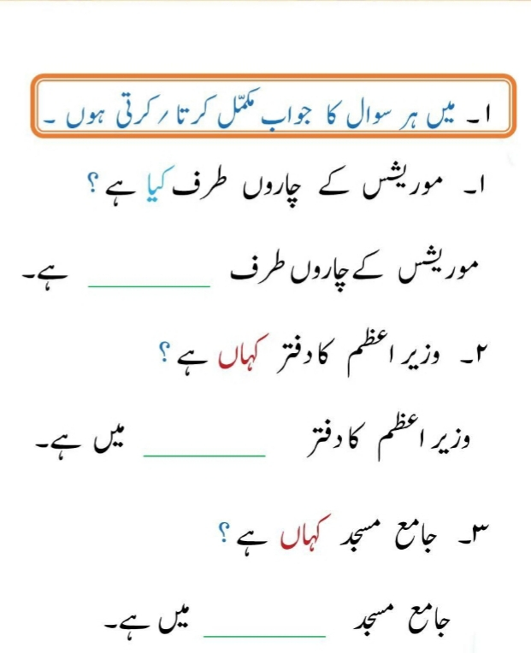
PAGE 39: LESSON 4

Slide 3
