Slide 1


NORTHLANDS AND SUNFIELD CITY PRIMARY SCHOOL
GRADE TWO
PART ONE
WEEK NINE
MISS NAZIMA

Slide 2
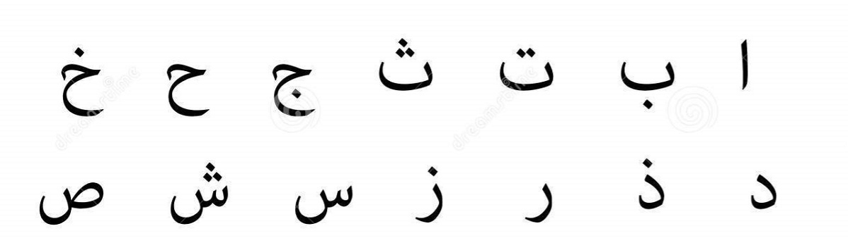
URDU HUROOF-E-TAHAJI
URDU ALPHABETS

Slide 3
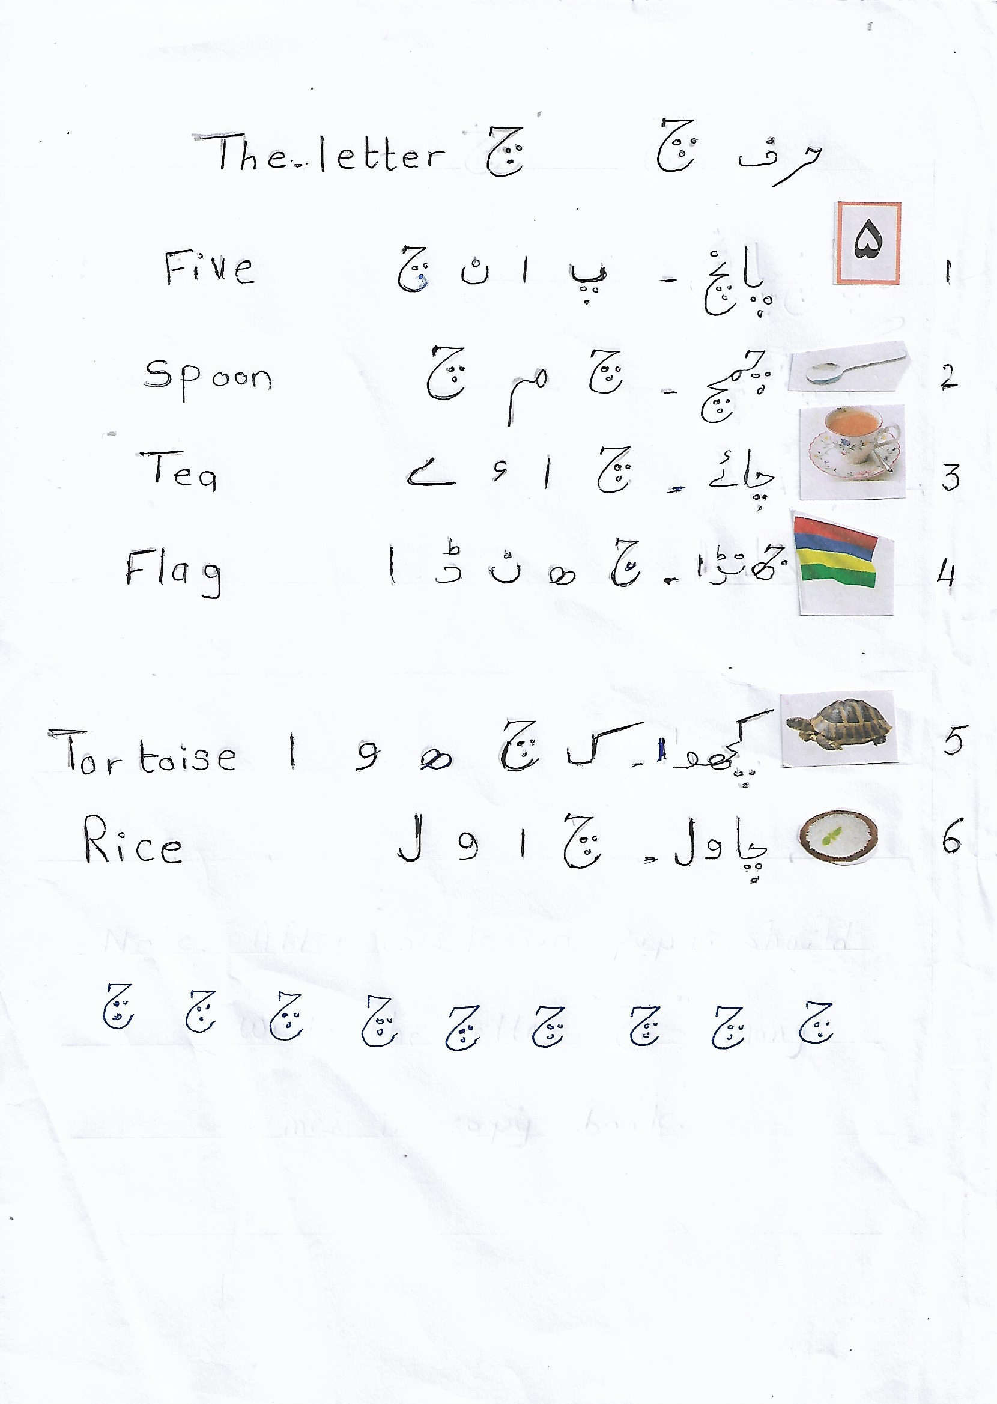
https://www.youtube.com/watch?v=X_DcqzicDMU

