Slide 1
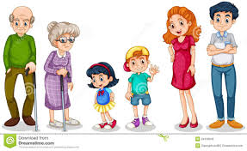
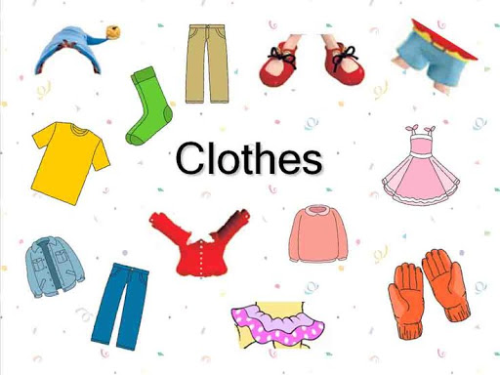

Northlands & Sunfield City
Primary and Pre-Primary School
“All topics being covered on the online lessons will be covered again at school when the child resumes normal classes”.
My Family
Different types of clothes
Presented by Miss Sujata

Slide 2
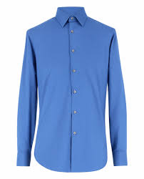
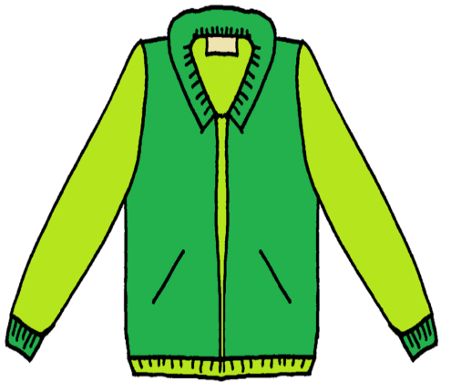
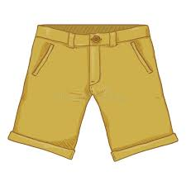
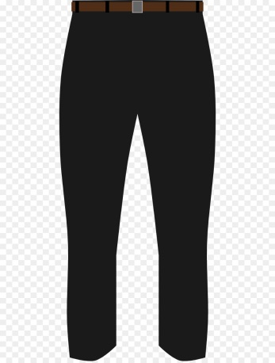
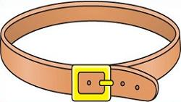

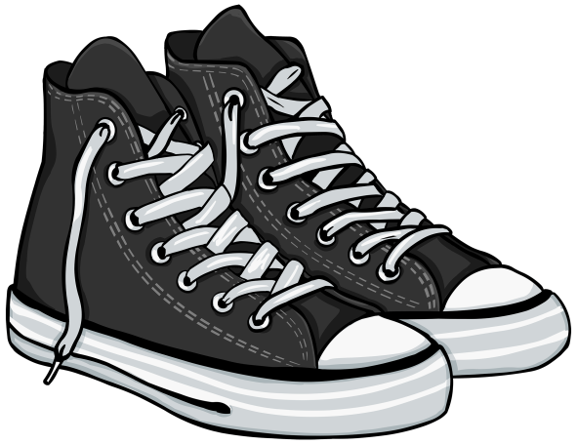
The clothes and belongings of a man
a short
the trousers
a shirt
a jacket
a belt
a tie
the shoes

Slide 3
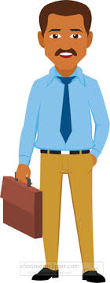
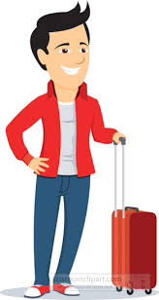
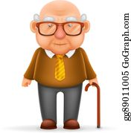
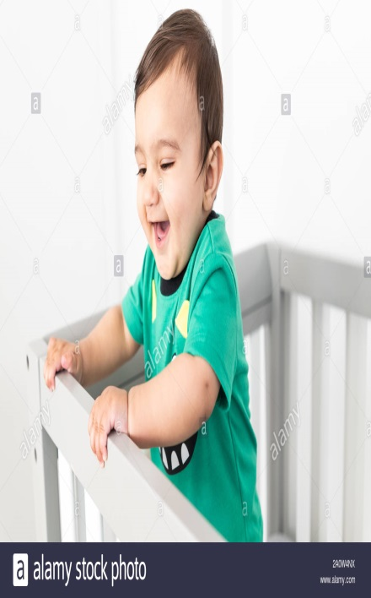
Father is wearing a blue shirt .
His belt is black.
Brother is wearing a red jacket and blue jeans.
Grandfather is wearing a yellow tie.
His shoes are brown.
The baby is wearing a green t-shirt.

Slide 4
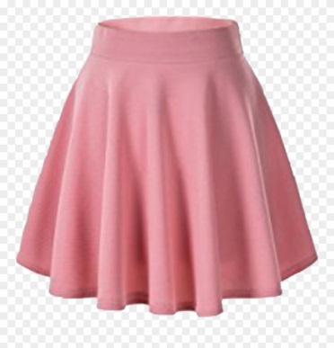
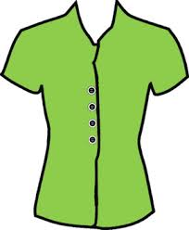
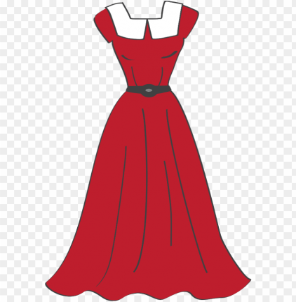
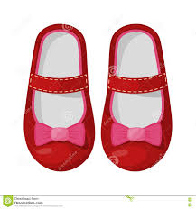

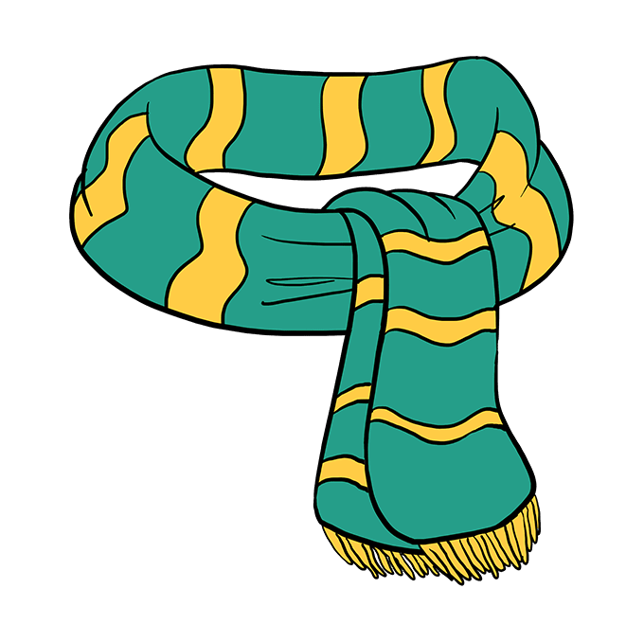
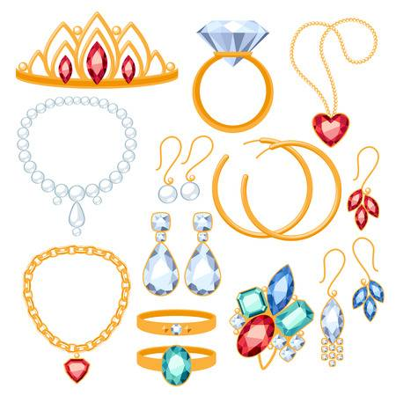
The clothes and belongings of a woman
a skirt
a blouse
a dress
the shoes
a hat
a scarf
the jewelleries

Slide 5
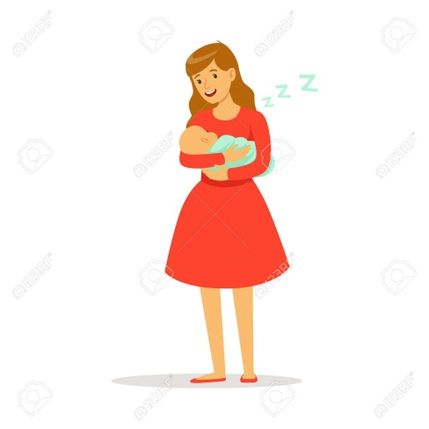
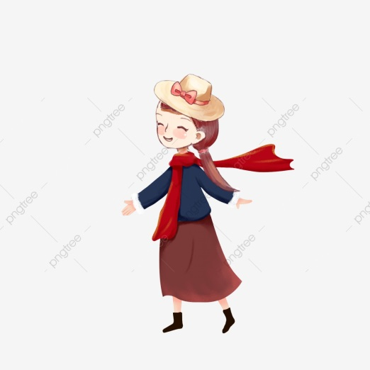
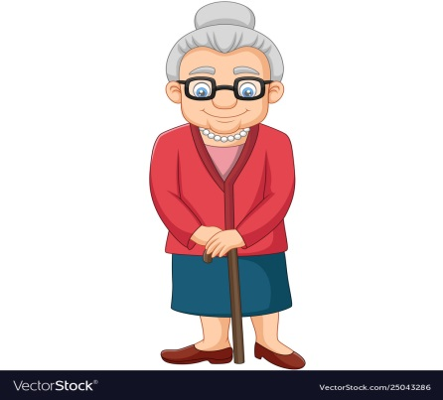
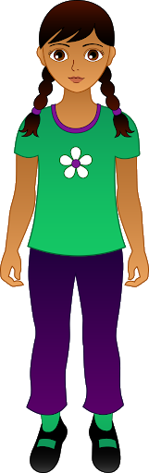
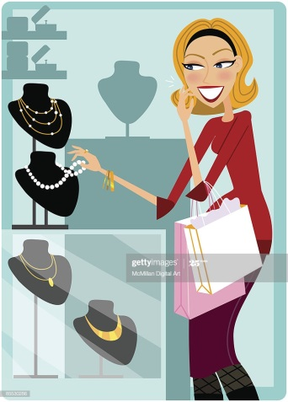
Mother is wearing a beautiful dress.
Her dress is short.
My little sister has a hat and a scarf.
My blouse and pants are clean.
Grandmother likes to wear long skirt.
My elder sister is buying some jewelleries.

Slide 6
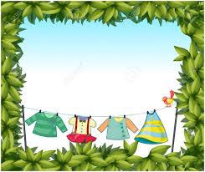
Goodbye

