Slide 1





NORTHLANDS & SUNFIELD CITY
PRIMARY & PRE-PRIMARY SCHOOL
MOTHER’S DAY
WEEK10 UPPERPPS
REFERENCE: www.youtube.com
Link: https://www.youtube.com/watch?v=cClPo7aogrw
Presented by Miss Sujata

Slide 2






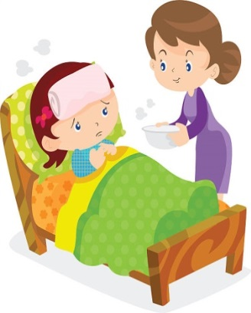

Qualities of a mother

Slide 3


