Slide 1

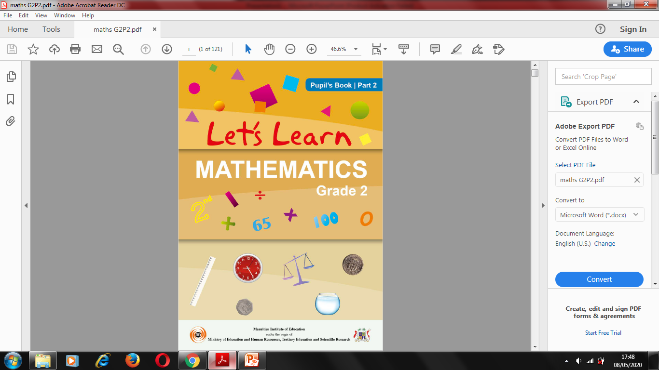
NORTHLANDS & SUNFIELD CITY SCHOOL
GRADE 2- MATHEMATICS
ORDINAL NUMBERS
WEEK 8 (Prepared by Miss Mehreen & edited by Ms. Umika Ramoo)
NOTE: "All topics being covered on the online lessons will be covered again at school when the child resumes normal classes. Pupils must label their weekly lessons clearly on their books/copy books or printed lessons for future reference."

Slide 2
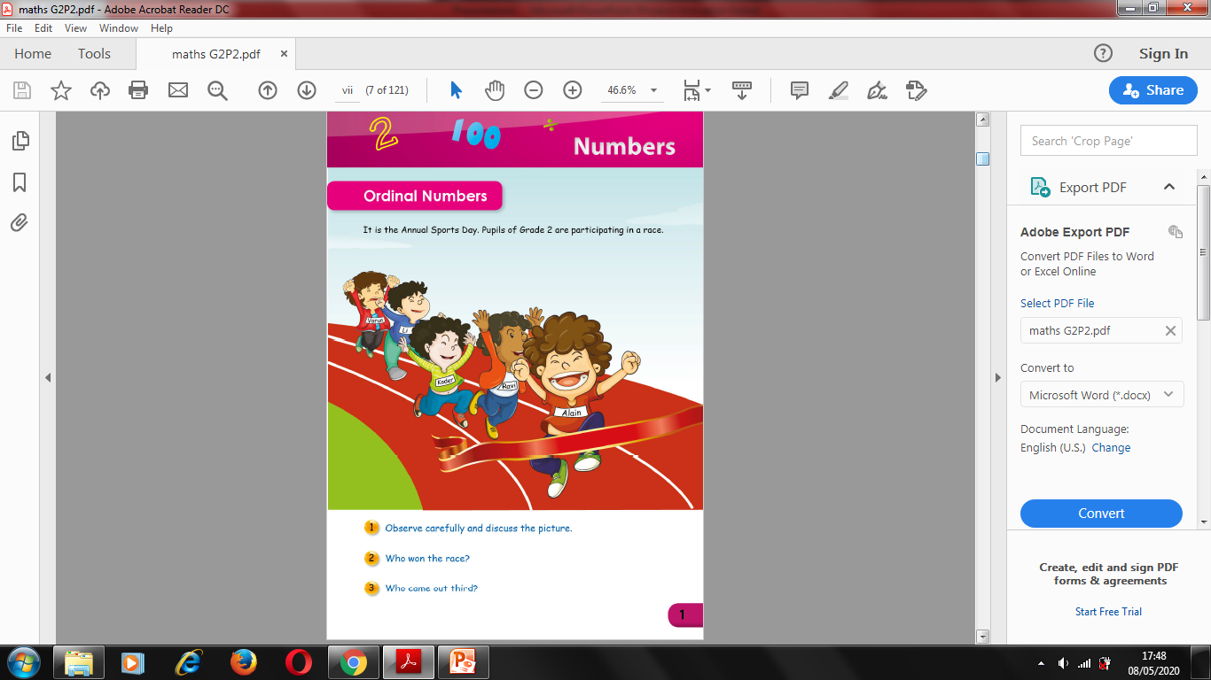

Slide 3
