Slide 1


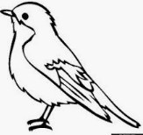

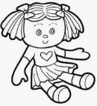
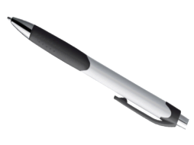
NORTHLANDS & SUNFIELD CITY SCHOOL
Week 8- English (Evaluation of unit 3 Animals)
Grade 2 Prepared by Ms Pareshma
NOTE: "All topics being covered on the online lessons will be covered again at school when the child resumes normal classes. Pupils must label their weekly lessons clearly on their books/copy books or printed lessons for future reference."
I choose the correct answers from the list given below.
fish cat grass cabbage giraffe carrots monkey
A crocodile eats ……………………………….. .
A …………………………. eats leaves.
A ………………………… eats bananas.
A zebra eats …………………. .
A ……………… drinks milk.
A hare eats …………………… .
A goat eats …………………… .
2. I say the word and I write the missing letters.
B
e
…
…
.
B
i r
…
…
..
P
…
…
n
…
…
…
o l
l

Slide 2
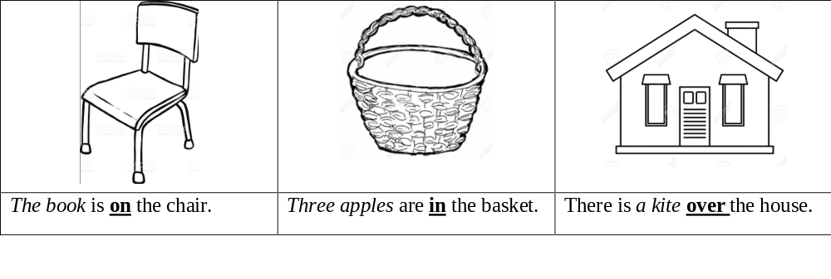
NORTHLANDS & SUNFIELD CITY SCHOOL
3. I read and I draw.
4. I choose the answer in the brackets.
A glass is ………………… but a rock is ……………………….. . (rough , smooth)
Cotton wool is ……………………. but wood is ……………….. . (soft , hard)
We are playing with …………….. toys. (their , our)
The children are going to ……………….. grandmother’s place. (my, their)
The teachers talk to ……………….. pupils.(our , their)
The boy ………………………….. to the shop. (is going , are going)
I …………………………. in the book. ( are writing , am writing)
The man ……………………… the door. (are opening , is opening)

Slide 3
NORTHLANDS & SUNFIELD CITY SCHOOL
5. I write the correct form- singular or plural.
Mary has one …………………. (brother) and two ……………… . (sister)
I have many …………………… . (book)
Sam is reading a …………………. . (novel)
The child is picking a ……………… . (flower)
The ………………… are in their classroom. (pupil)
There are three ………… on the roof. (cat)
6. Write the verbs in the Present Progressive Tense.
I ………………………………….. to the market. (to go)
Rita ………………………….. at the dog. (to look)
The girls ………………………… with their dolls. (to play)
Mother …………………………….. food. (to cook)
Father ……………………………… a letter. (to write)

