Slide 1


NORTHLANDS SCHOOL AND SUNFIELD CITY SCHOOL
PART 5
Word Processing – The Keyboard
Week 8
Presented by: Miss Neema ICT teacher

Slide 2
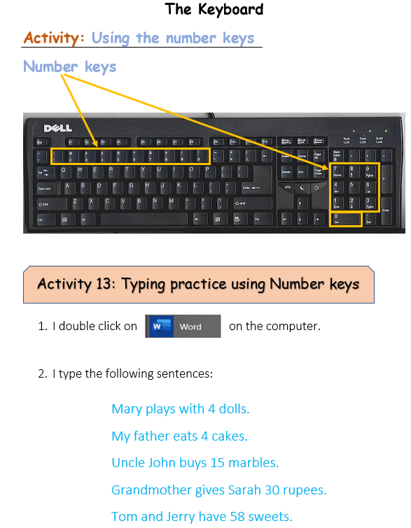
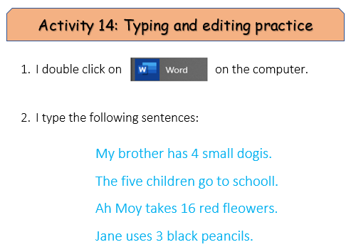

Slide 3
