Slide 1


NORTHLANDS SCHOOL AND SUNFIELD CITY SCHOOL
PART 3 - Week 7
Spreadsheet
Page 49 - 53
Presented by: Miss Neema ICT teacher

Slide 2
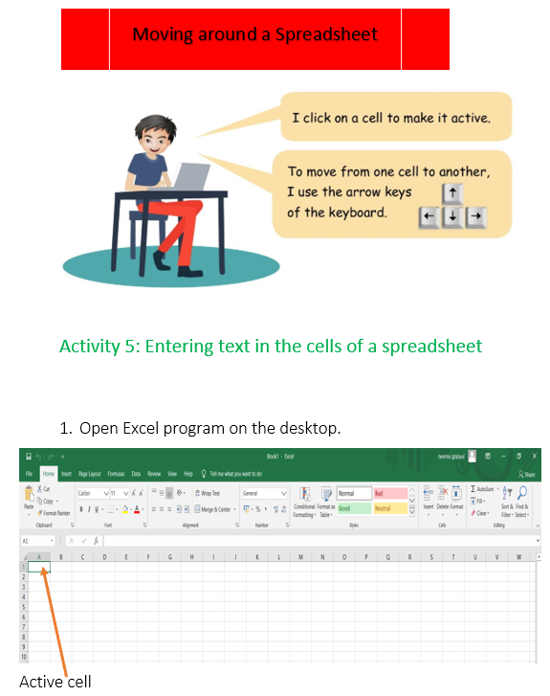
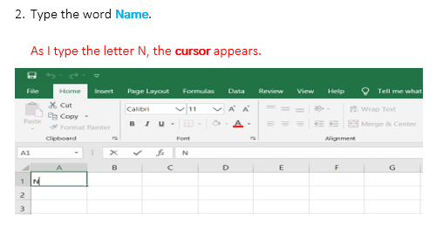

Slide 3
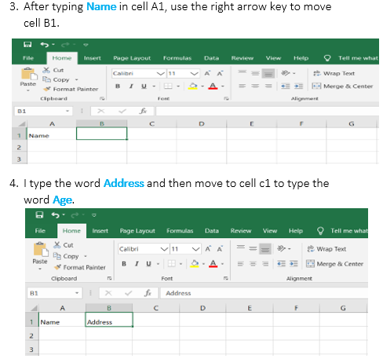
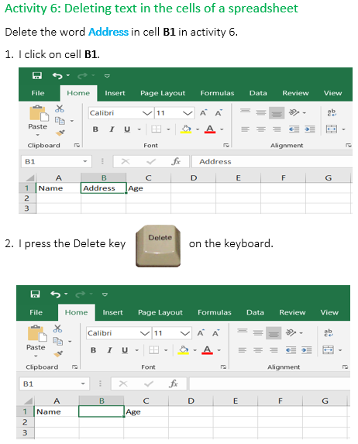

Slide 4
