Slide 1


NORTHLANDS AND SUNFIELD CITY SCHOOL
French
Week 7 Grade 2
Part 1
Prepared by Miss Jennita
Le son R & Revision
Exercises

Slide 2
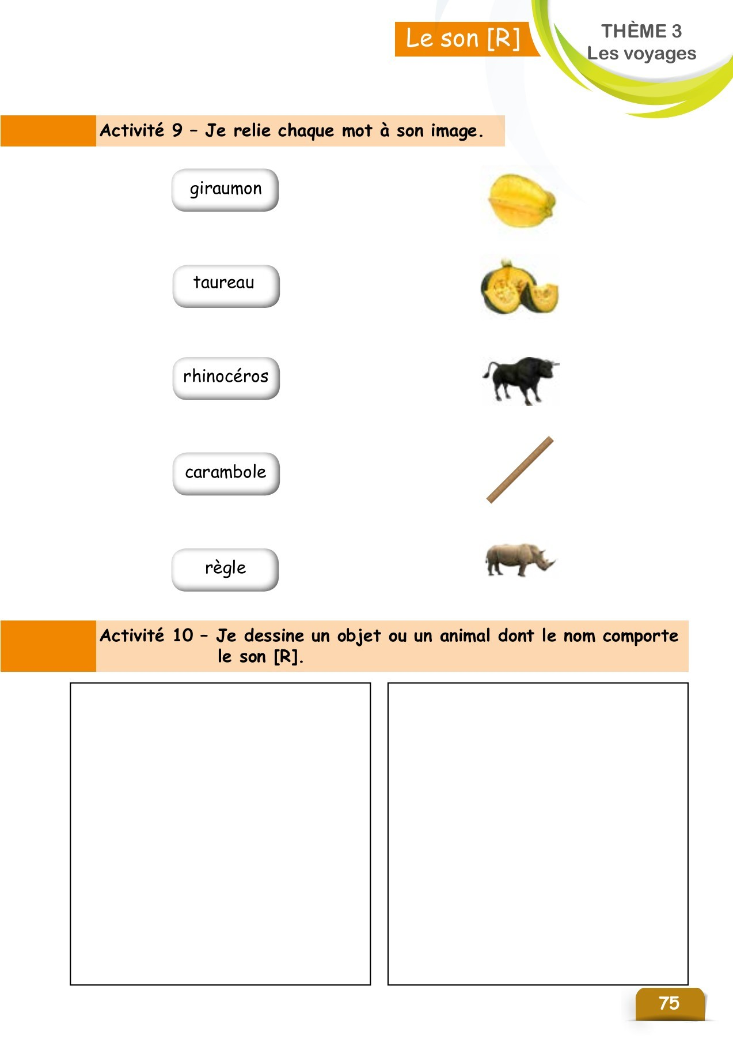

Slide 3
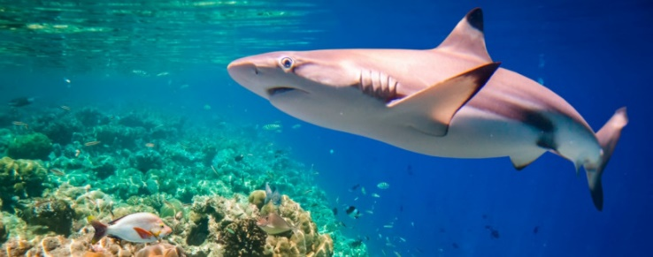
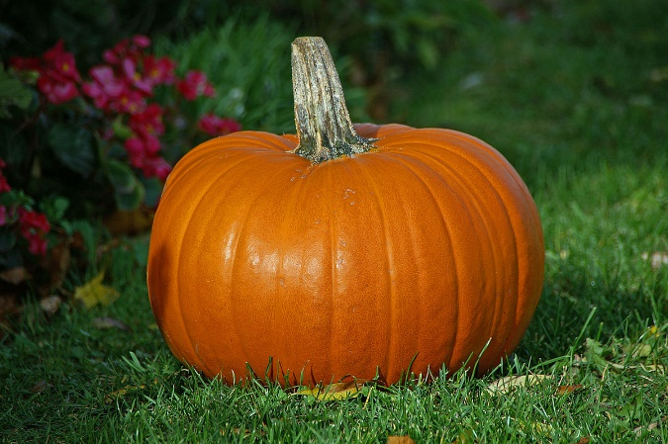
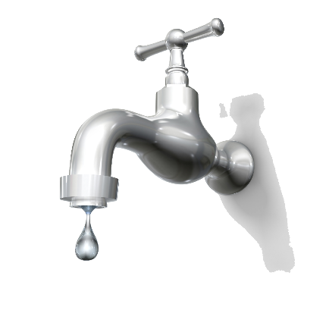
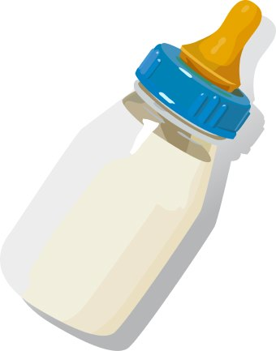
Le son r (R)
requin
giraumon
robinet
biberon

