Slide 1


NORTHLANDS SCHOOL AND SUNFIELD CITY SCHOOL
Week 10
Presentation - Part 1
Page 62 – 67 – Activity 1 – 3(a)
Presented by: Miss Neema ICT teacher
Refer to: http://portal.mie.ac.mu/curriculum.html

Slide 2
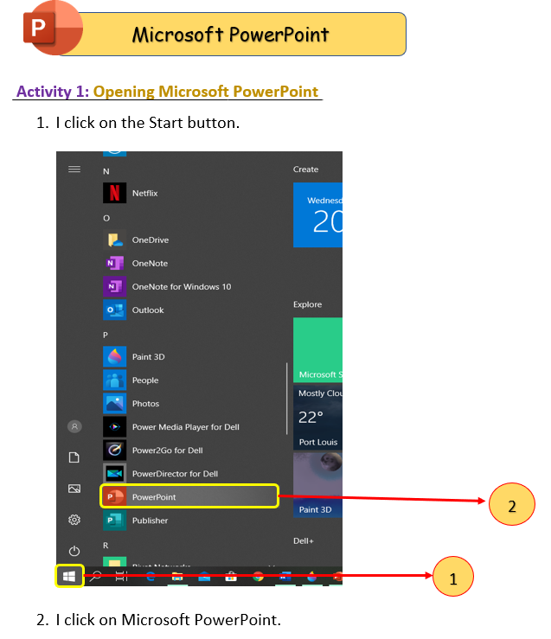
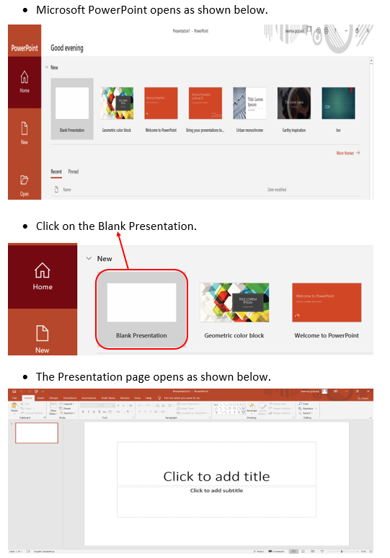

Slide 3
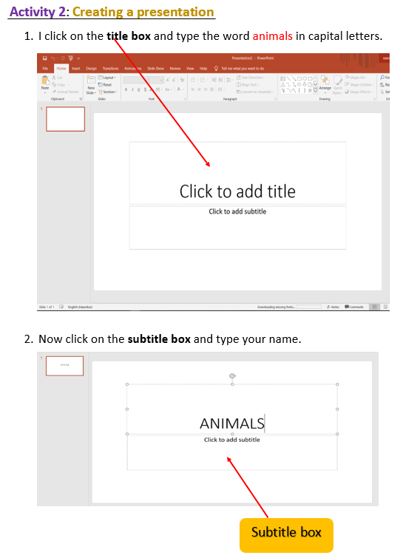
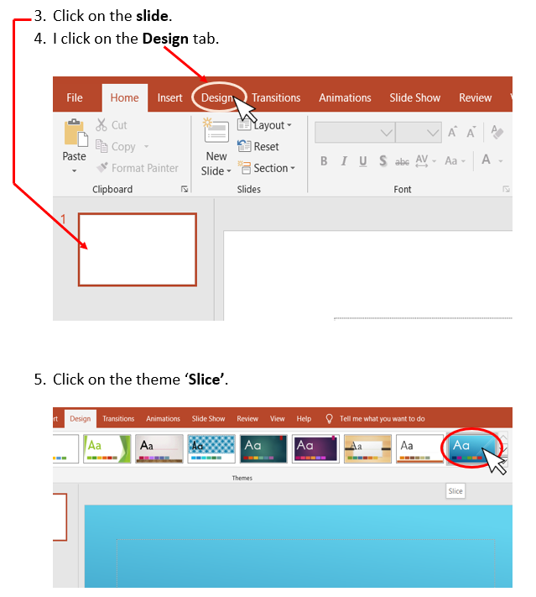

Slide 4
