Slide 1

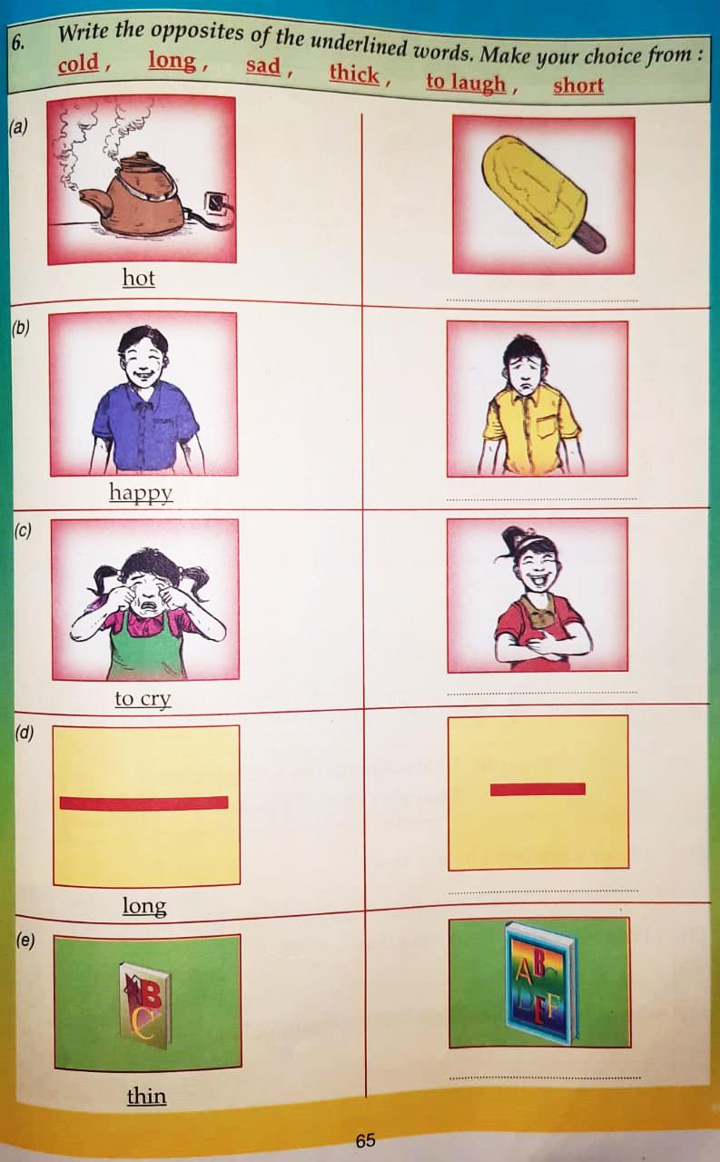
NORTHLANDS & SUNFIELD CITY SCHOOL
WEEK 10 ENGLISH PART 3
Grade 2
Prepared by Ms Pareshma

Slide 2
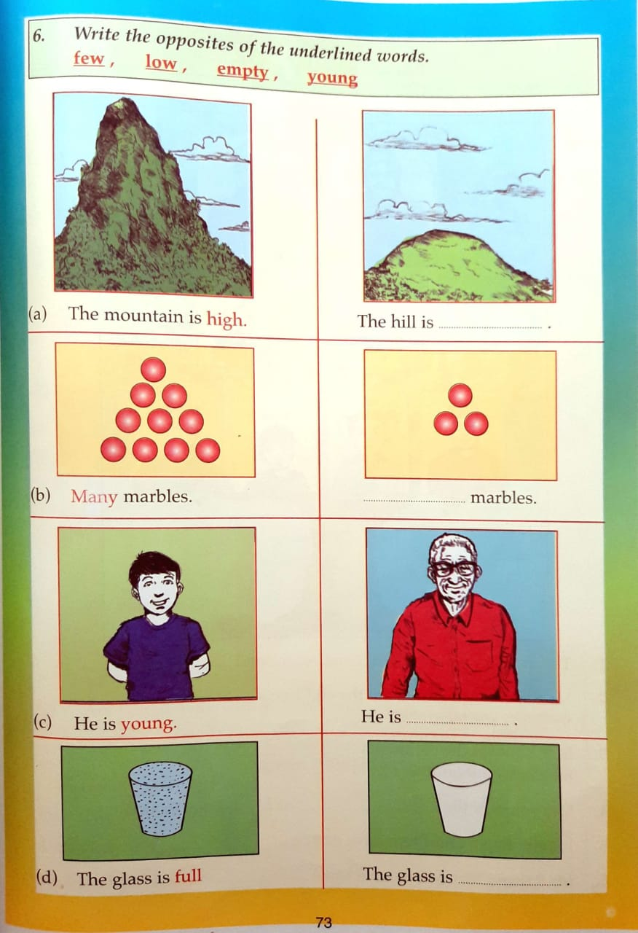

Slide 3
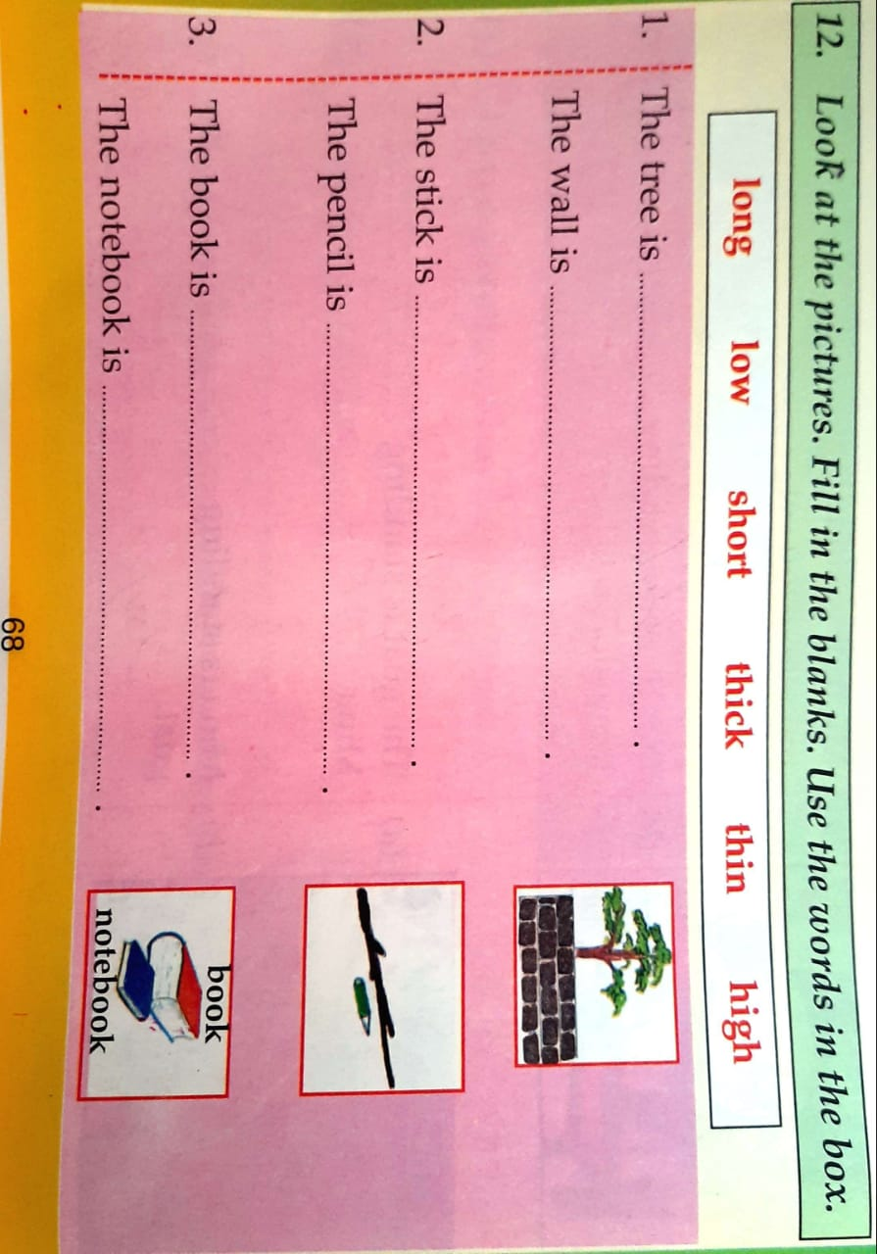
Source: Paving the way to success English Grade 2 – D. V. Chetty

