Slide 1


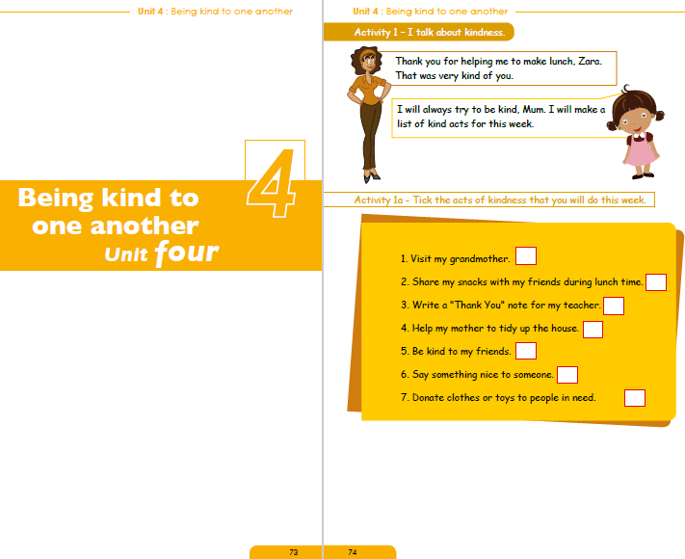
NORTHLANDS & SUNFIELD CITY SCHOOL
WEEK 10 ENGLISH Part 1
Grade 2 Prepared by Ms Pareshma
Source: http://portal.mie.ac.mu/curriculum.html

Slide 2
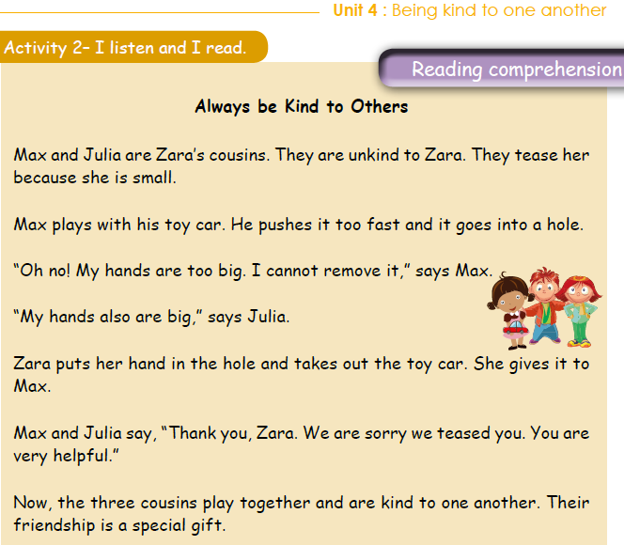
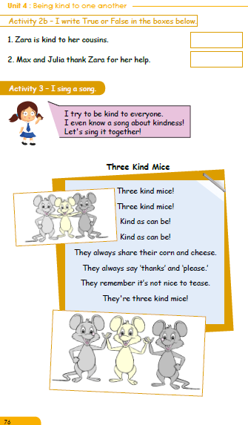
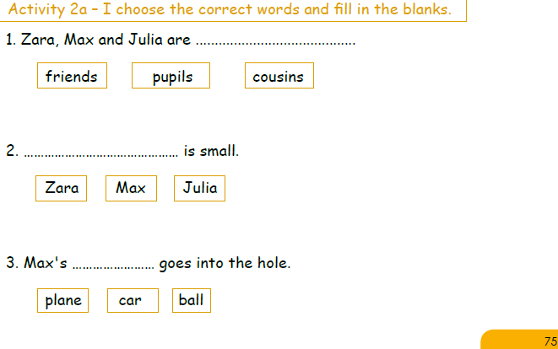

Slide 3
