Slide 1


NORTHLANDS SCHOOL AND SUNFIELD CITY SCHOOL
PART 1
Revision – using the Mouse & Keyboard
Week 10
Presented by: Miss Neema ICT teacher
Refer to: http://portal.mie.ac.mu/curriculum.html

Slide 2
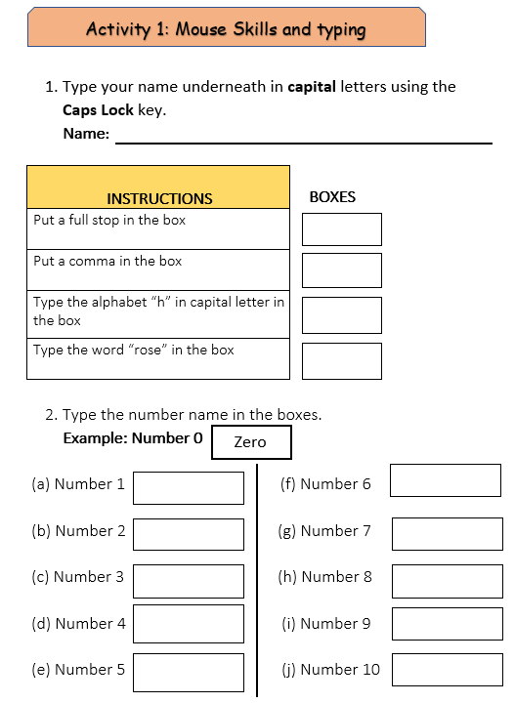
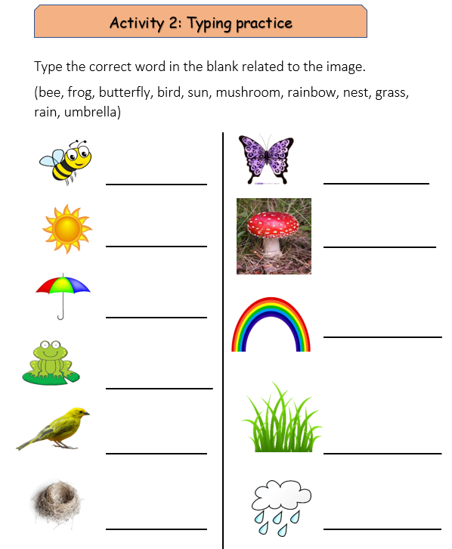

I open file
WEEK 10 G1 ICT Part 2 to do Activity 1 and Activity 2

