Slide 1

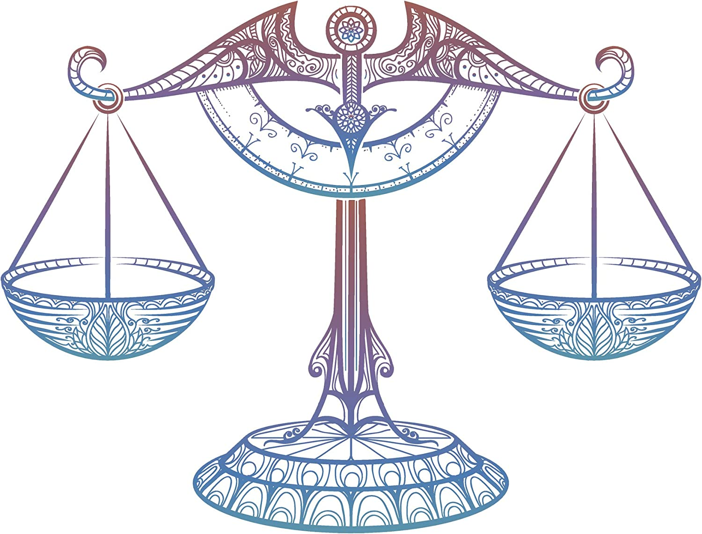
NORTHLANDS & SUNFIELD CITY SCHOOL
Grade 2 – 2nd term 2020
Mathematics
Chapter: Mass
Prepared by Miss Mehreen

Slide 2
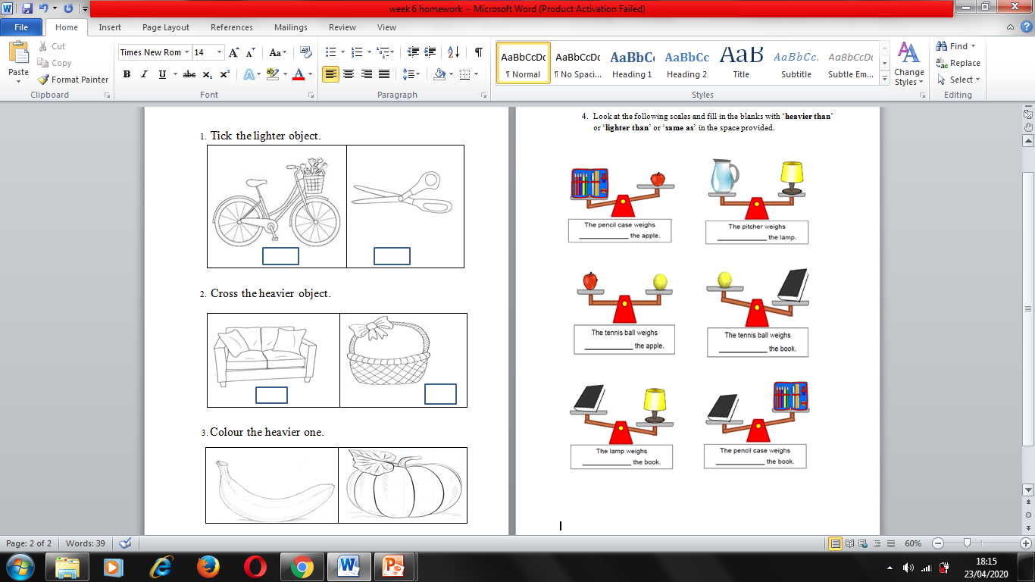

Slide 3
